Slide 1
Year 2
Parent Meeting
2026

Slide 2


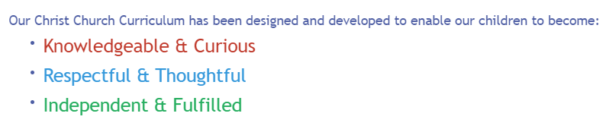
Our curriculum

Slide 3
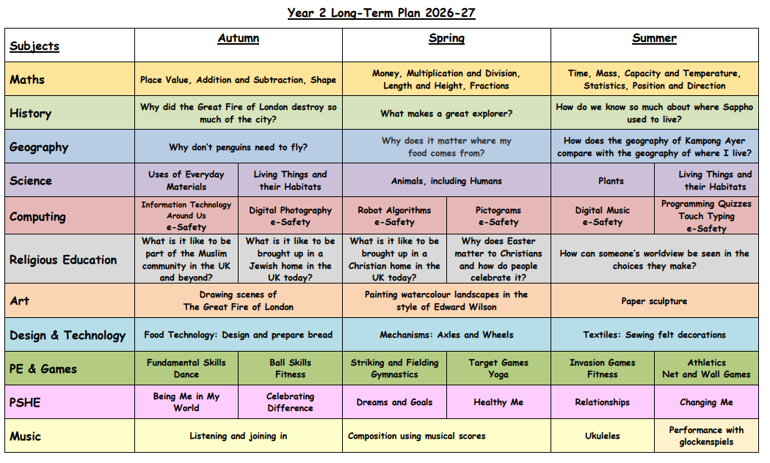

Slide 4
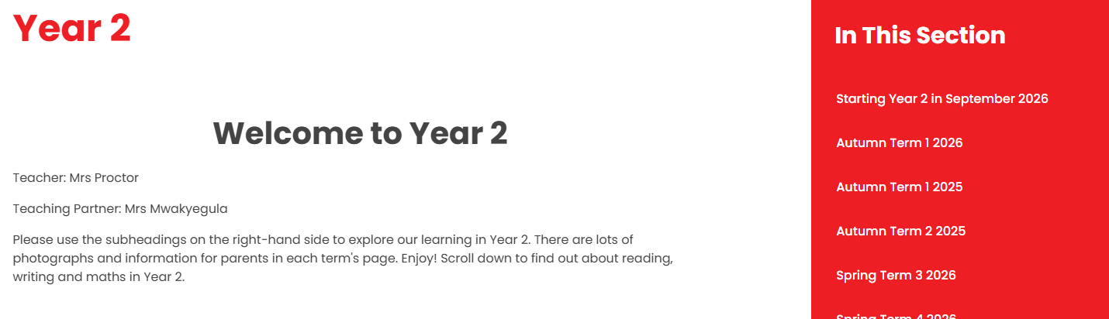
Year 2 Webpage
https://christchurchschoolchelt.web05.juniperwebsites.co.uk/year-2

Slide 5

Maths in Year 2
Place Value / Addition and Subtraction / Multiplication and Division / Geometry / Money / Measure / Position and Direction /Fractions / Statistics/ Time
I have videos on our website which might help explain how we teach different aspects of Maths.
Support your child by using NumBots for little and often practise of addition and subtraction.
We will move onto Times Tables Rock Stars after our lessons on multiplication and division.
By the end of Year 2, pupils need to know 2, 5, 10 x tables and begin 3 x tables.

Slide 6
NumBots
Their log in is in their reading diaries.
COUNTING TO CALCULATING
NumBots equips each pupil with the set of core maths skills they require by building their knowledge from the ground up - starting at the very beginning with subitising.
Once pupils can recognise small quantities of objects (“counting-without-counting”), they are asked to subitise two groups, presented together. The deliberate use of previous arrangements helps introduce the idea of numbers being partitioned, laying the foundation for number bonds.
Familiar pictorial representations (including bar models and cherries) raise the difficulty of questions without affecting pupils’ confidence. Pupils begin to explore abstract number problems within 10, and practice automating their responses to “one/two more/less than...” questions.
This natural mathematical progression from one concept to the next ensures pupils are fully prepared to move on, from adding and subtracting within 10, to bridging 10, to finally answering questions involving two-digit numbers. Number lines and hundred squares are then used to explain more sophisticated addition and subtraction strategies, such as partitioning and compensation.
AUTOMATICY & UNDERSTANDING
Instant recall of key number facts must be built on a secure and genuine mathematical understanding in order for pupils to move forward and solve increasingly complex problems.
NumBots Story Mode is designed to develop pupils’ understanding of the relationship between different numbers and concepts, such as partitioning and the part-whole model. NumBots’ deliberate teaching-for-mastery approach has led to carefully sequenced and varied levels that ensure pupils fully grasp each essential new skill. As a result of methodically layering up the complexity, pupils maintain maths confidence and are primed to learn the next concept.
As well as cementing their understanding, pupils’ recall is also significantly boosted. While Story Mode is underpinned by best practice in memory formation - i.e. short, spaced practice sessions on interleaved material - the quick-fire questions and low-stakes quizzing in Challenge Mode enhances pupils’ retrieval of number bonds and addition and subtraction facts and improves the efficiency of their mental strategies.

Slide 7
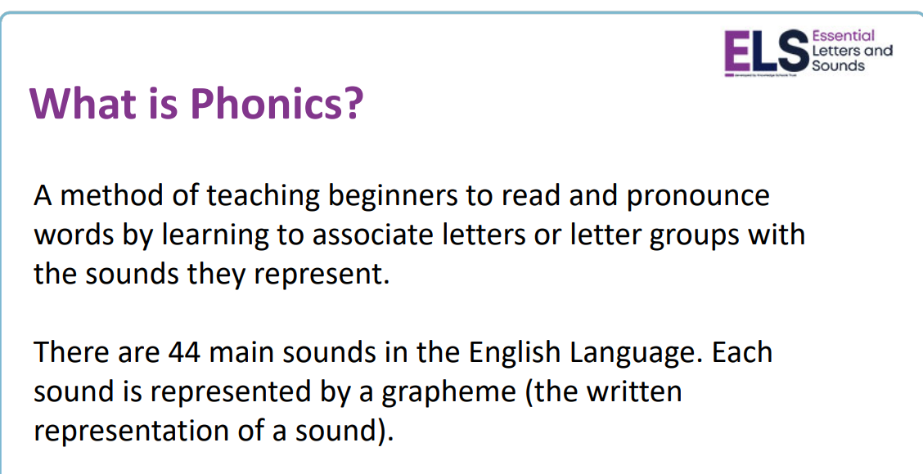

Slide 8
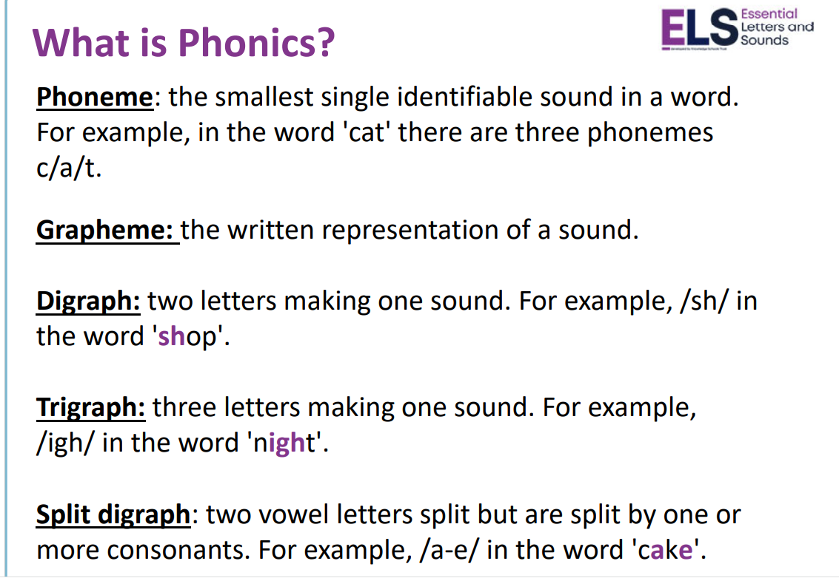

Slide 9
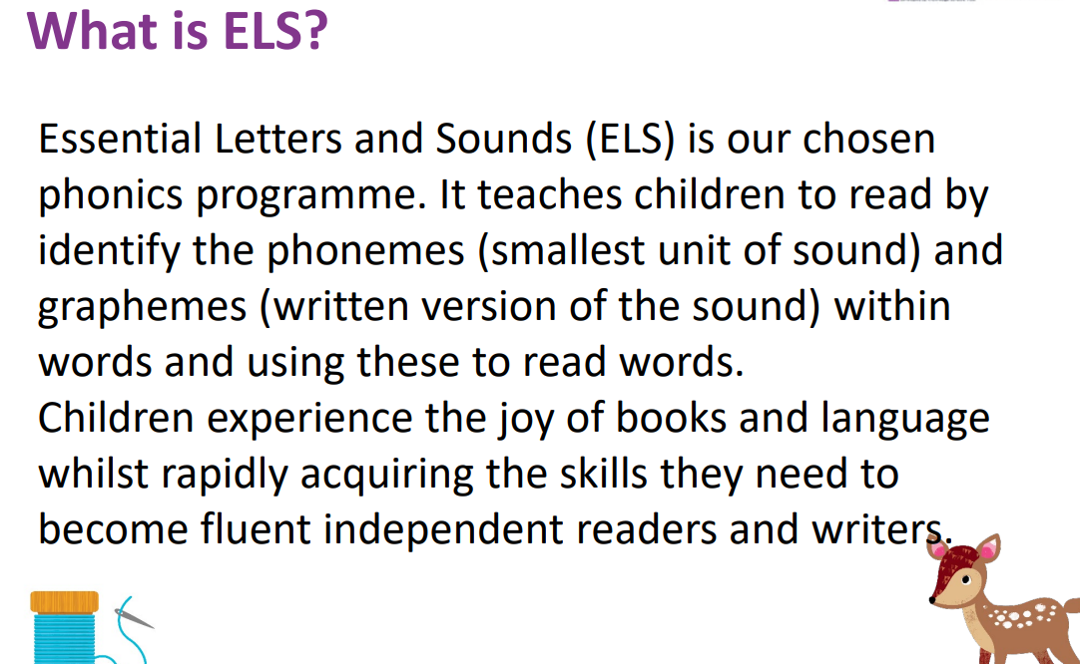

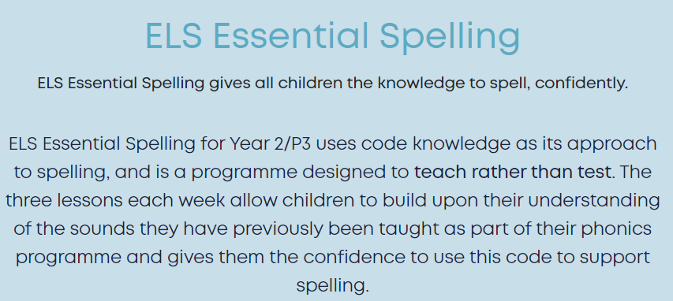


Slide 10
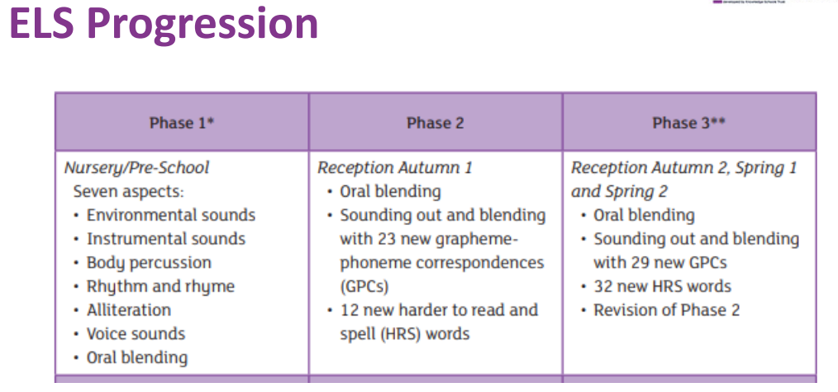

Slide 11
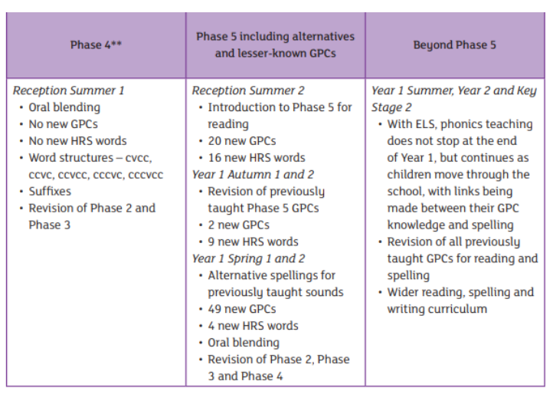

Slide 12
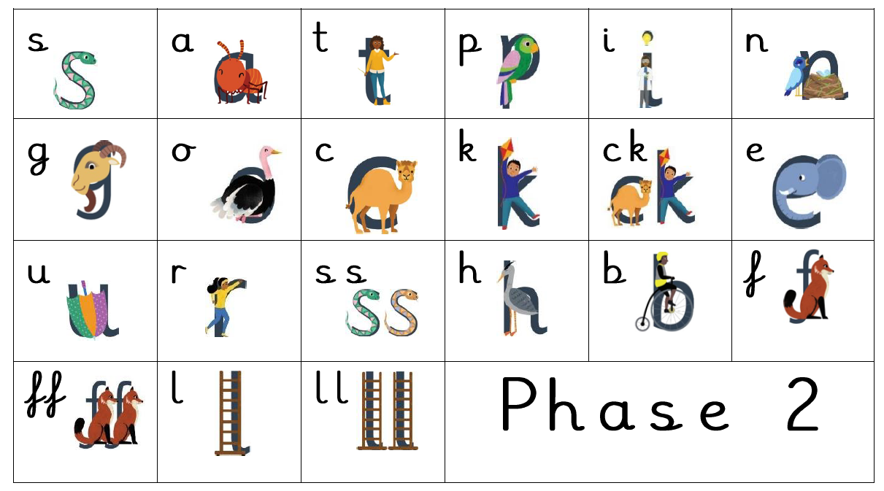

Slide 13
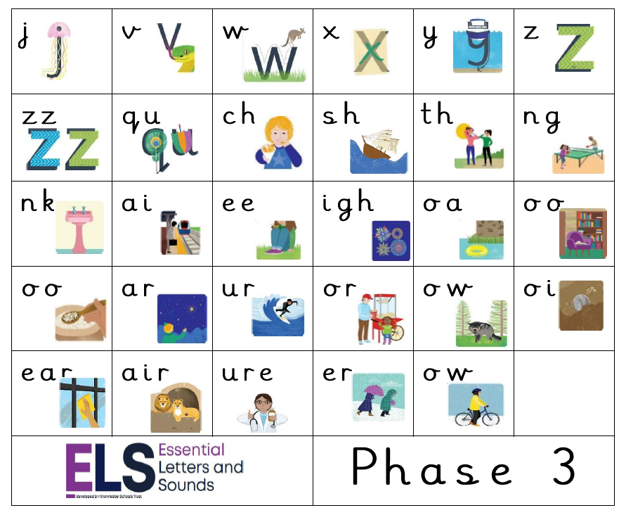

Slide 14
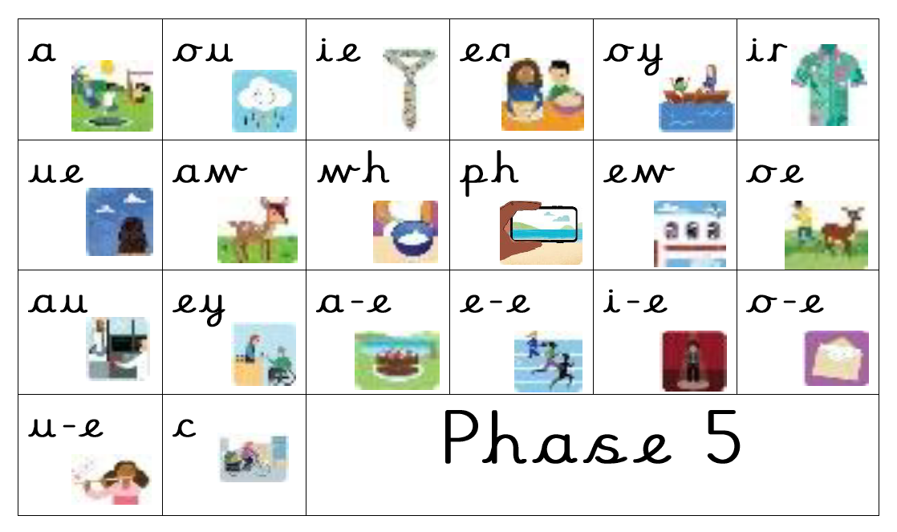

Slide 15
How do we teach phonics at Christ Church?
In Year 2, the majority of children normally progress on to the spelling patterns in the Year 2 Spelling Appendix using “Essential Spelling.”
Pupils who have not secured their knowledge of phonics have short interventions to plug their gaps. We regularly assess their sound recognition and send home lists for you to practice at home too.
The children also learn “harder to read and spell words.”

Slide 16
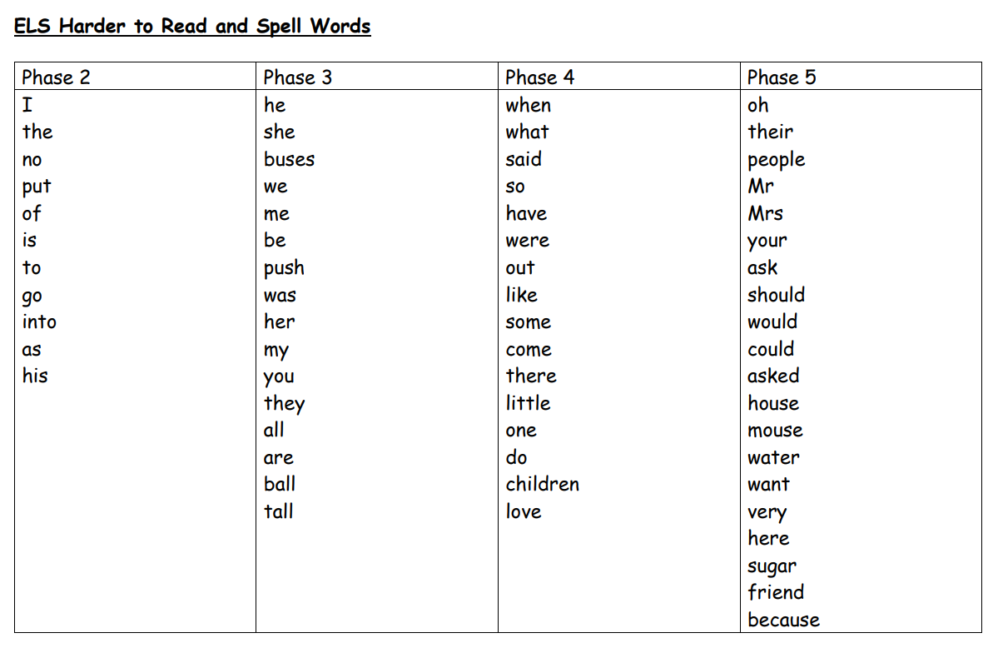

Slide 17
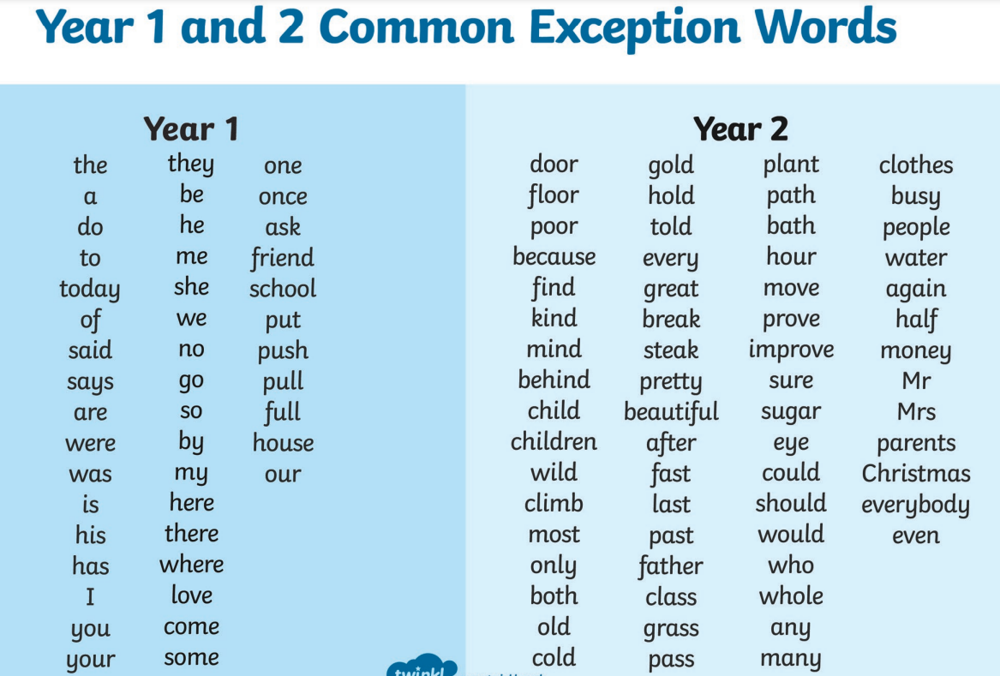

Slide 18
Correct Pronunciations
Please visit the Year 2 Webpage to see videos of the correct pronunciations for the pure sounds.

Slide 19
What is the Phonics Screening Check?
The Phonics Screening Check is a statutory check of your child’s phonics knowledge. It helps the DfE to confirm whether children have made the expected progress.
The phonics screening check takes place in June, in the Summer Term of Year 1.
Pupils who did not pass this in Year 1, will re-sit it in June 2026. These results are then submitted to the Local Authority.

Slide 20

What does the check look like?
There are 20 real words and 20 pseudo words. Children are told if the words are real or “alien” words.
They get more difficult as the test continues. They complete the check with their class teacher.

Slide 21
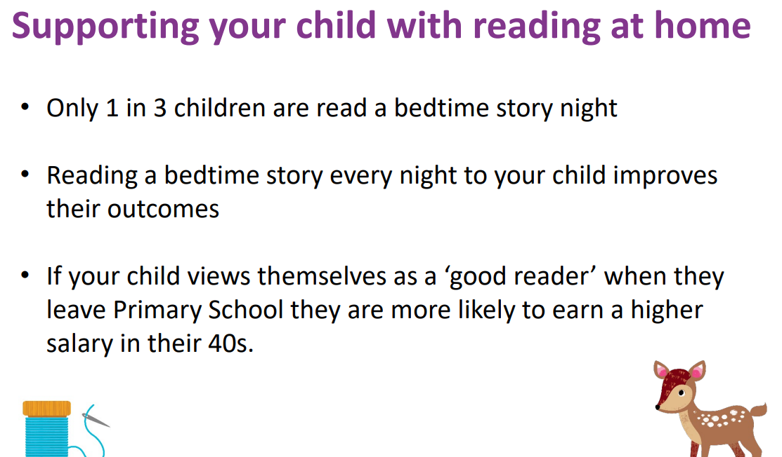

Slide 22
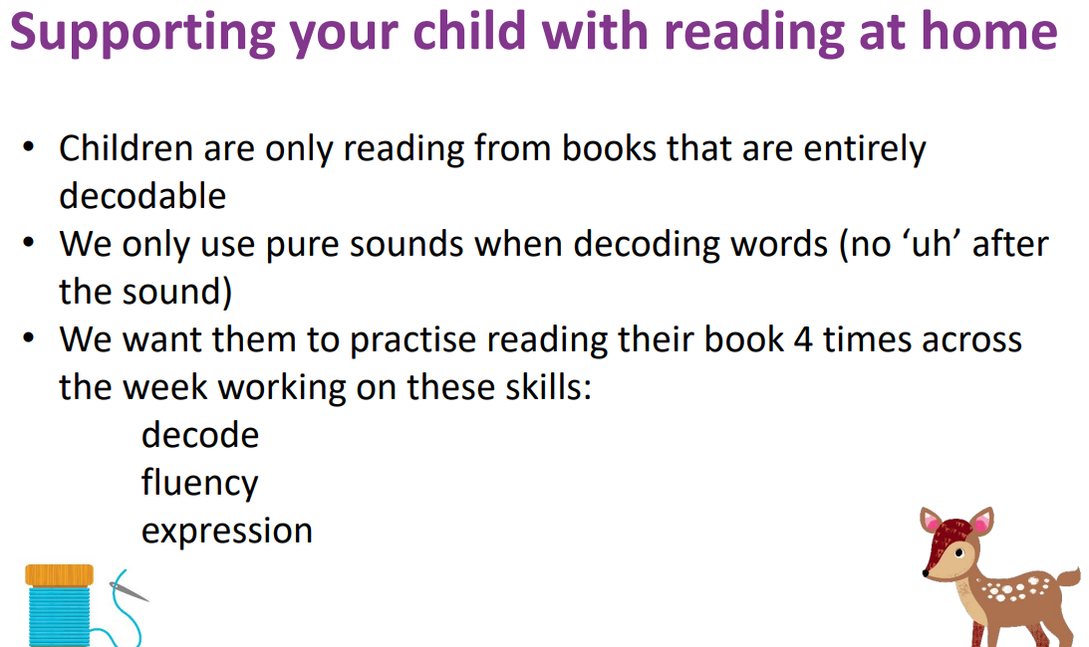

Slide 23
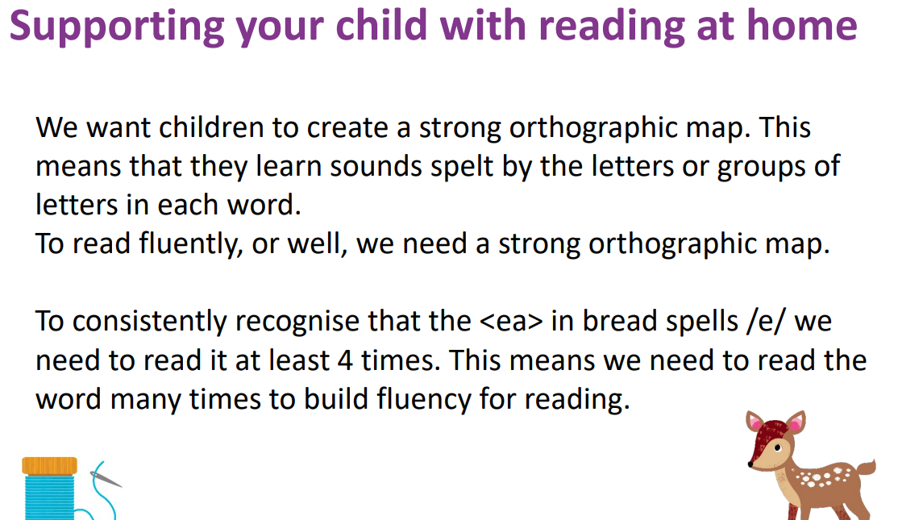

Slide 24

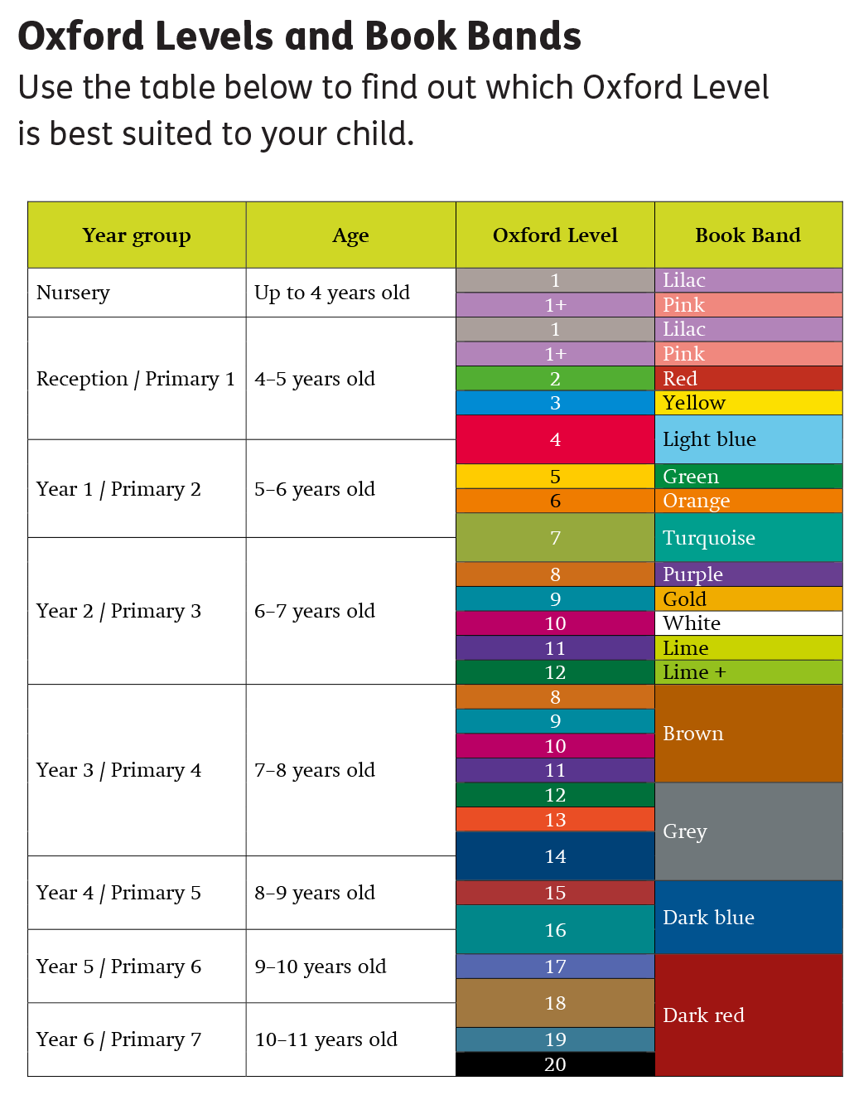
Reading in Year 2
At home:
Decodable reading books (changed on Fridays)
Library books (changed on Thursdays)
Year 2 Sharing Book (might need adult support)
Child’s own books at home
Oxford Reading Buddy… ELS eBook Library
In school:
Class reader
Whole class reading text
Poetry
Non-fiction
Book Corner

Slide 25
Oxford Reading Buddy
Please log in and use Oxford Reading Buddy
to read books and
Complete the quizzes on their own!
Log ins are in their reading diaries.
https://www.oxfordreadingbuddy.com/uk

Slide 26
Reading at home
Aim for your child to read to you at least 4 times a week.
Record reading in the reading diary which must come to school each day along with their school reading book.
Your child should have a phonics phased reading book that they bring home from school. Ask them questions. They should be able talk about what they have read to you. If the book is too hard they won’t be able to do this.
The books they read with us at school will contain more of a challenge.
Ideas of questions to ask:
Can you explain what just happened?
Can you predict what might happen next?
Can you say why (ask them to refer to the text for their answers)?
Can you say when something similar has happened to you?
Comprehension is essential in Year 2 as it will prepare them for tests later in the year.

Slide 27
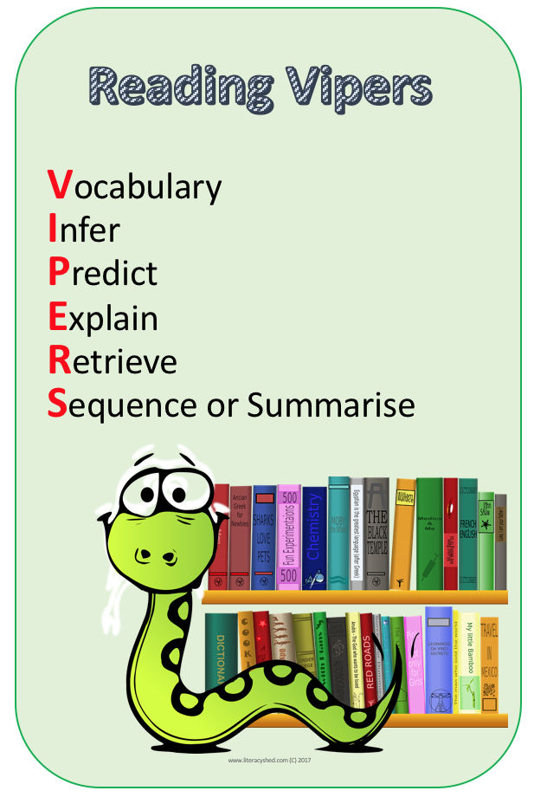
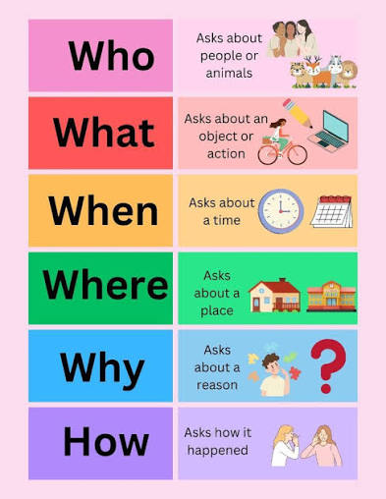
Reading Videos are on our Year 2 webpage. These will show you the expected standard at the end of KS1. I will send VIPERS ideas for you soon in reading diaries that show the types of questions to ask.

Slide 28
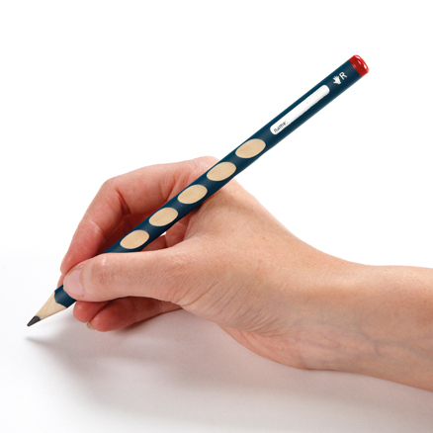

Writing in Year 2
Pencil grip
Cursive handwriting
Sentences
Punctuation
Grammar
Spelling
Tenses
Suffixes
Planning ideas
Vocabulary / word choice for effect
Editing writing
Fiction:
Story writing
Poetry
Diary writing
Character description
Non-Fiction:
Instructions
Reports
Information texts
Letter writing

Slide 29

Handwriting in Year 2
We are learning to form our letters correctly starting on the line to “whoosh up” before writing the letter. We do not join from capital letters.
Many children are not spelling their names with capital letters or do not know how to write their surname – please support us with this at home.
I will teach:
Form lowercase letters of the correct size relative to one another.
Start using some of the diagonal and horizontal strokes needed to join.
Letters and understand which letters, when adjacent to one another, are best left un-joined.
Write capital letters and digits of the correct size, orientation and relationship to one another and to lowercase letters.
Understand which letters belong to which handwriting ‘families’ (i.e. letters that are formed in similar ways).
Use spacing between words that reflects the size of the letters.
For children to be working at the expected level at the end of Year 6, they must have joined, legible handwriting.

Slide 30
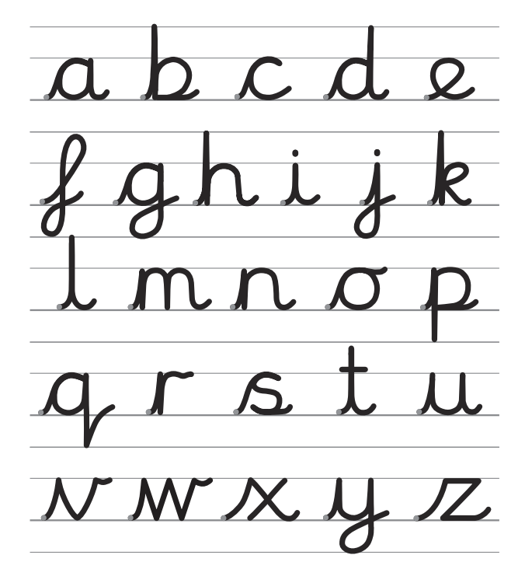

Slide 31
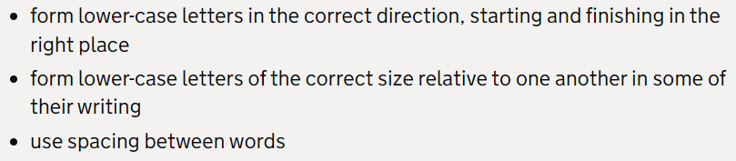
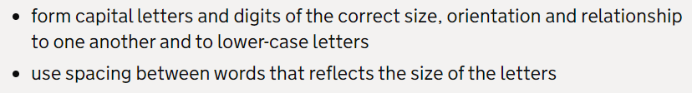
Handwriting in Year 2
Pupils working towards age related expectations will:
Pupils working at age related expectations will:
Pupils working at greater depth will:
Home log in:
Username:
Password: home
vt7452

Slide 32
End of Key Stage 1 non-statutory assessment frameworks
At the end of Year 2, I will be assessing your child for reading, writing and maths using these non-statutory assessment frameworks alongside end of year optional tests.
We no longer use End of KS1 (SATs) as a test. We use different assessments but take a look to see the criteria for working towards, working at, working at greater depth if you are interested in seeing the expectations for your child by the end of Year 2.
https://www.gov.uk/government/publications/teacher-assessment-frameworks-at-the-end-of-key-stage-1/non-statutory-teacher-assessment-frameworks-at-the-end-of-key-stage-1

Slide 33
Here are some examples of the types of assessments your child will sit 3 x year – autumn, spring, summer.
I will analyse their results and we work hard to “plug the gaps” and give them short interventions to practise the work they are not confident with yet so hopefully next time, they know how to answer those style questions.

Slide 34
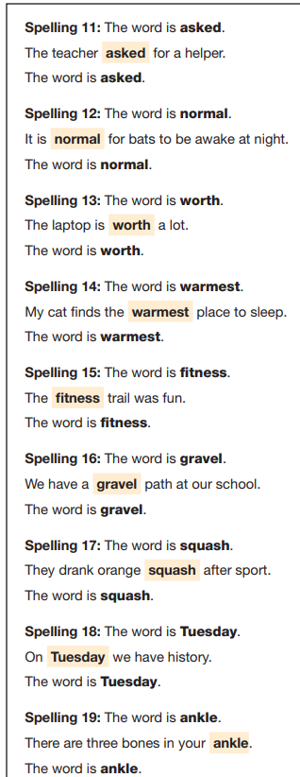
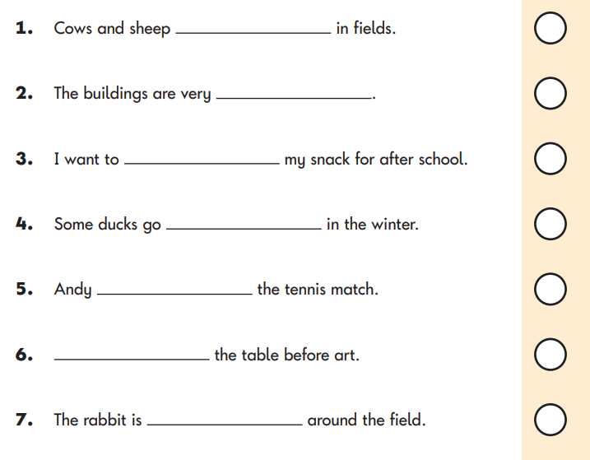
Grammar, Punctuation and Spelling test
Paper 1 – Spelling

Slide 35
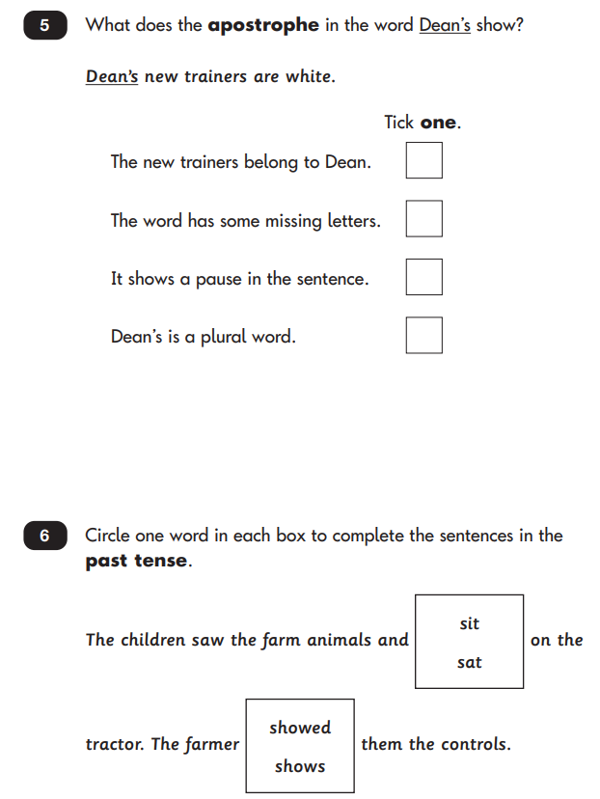
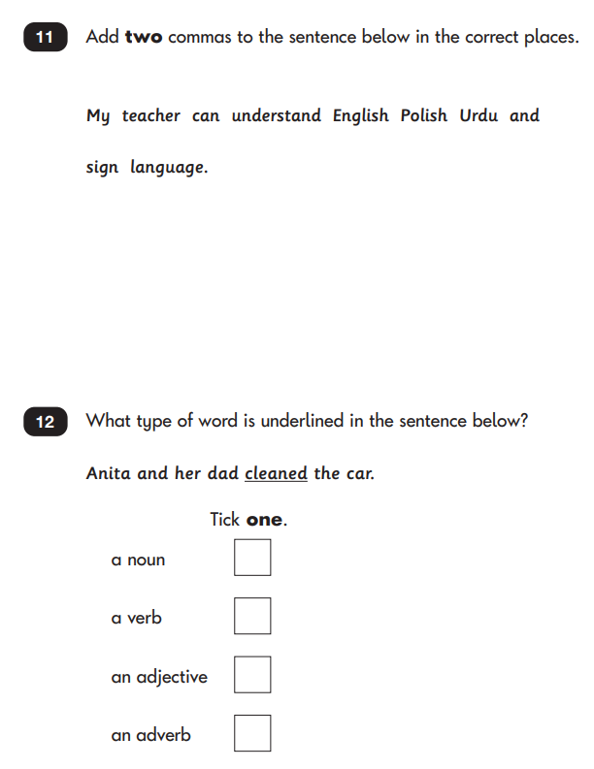
Grammar, Punctuation and Spelling test
Paper 2 – Grammar, Punctuation and Spelling

Slide 36
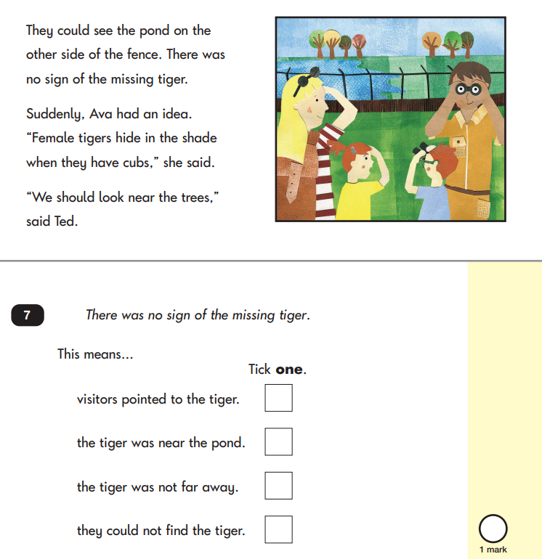
Reading Paper 1
2 Shorter texts
Text is above the questions in the same booklet

Slide 37
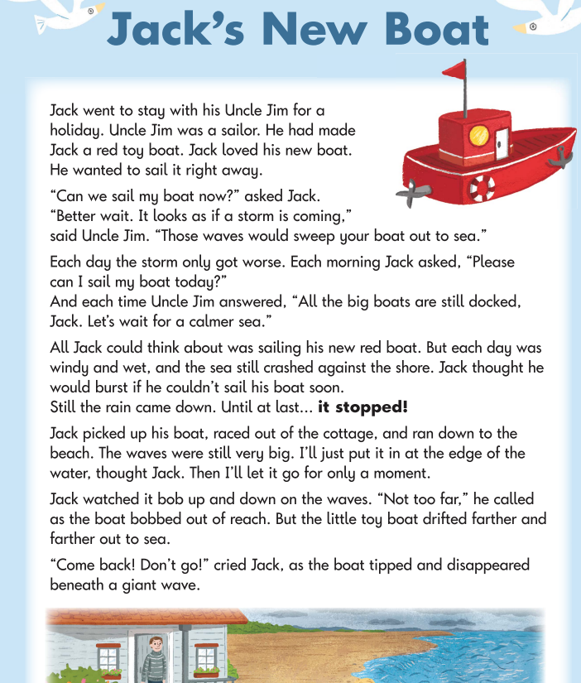
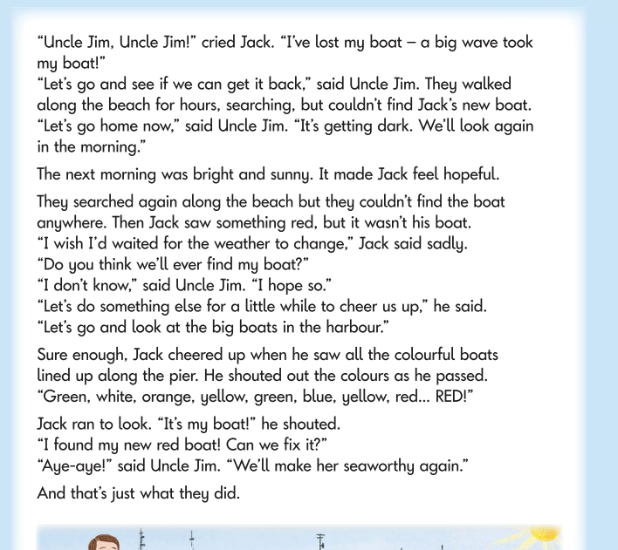
Reading Paper 2 – separate booklet of text and a separate booklet of questions

Slide 38
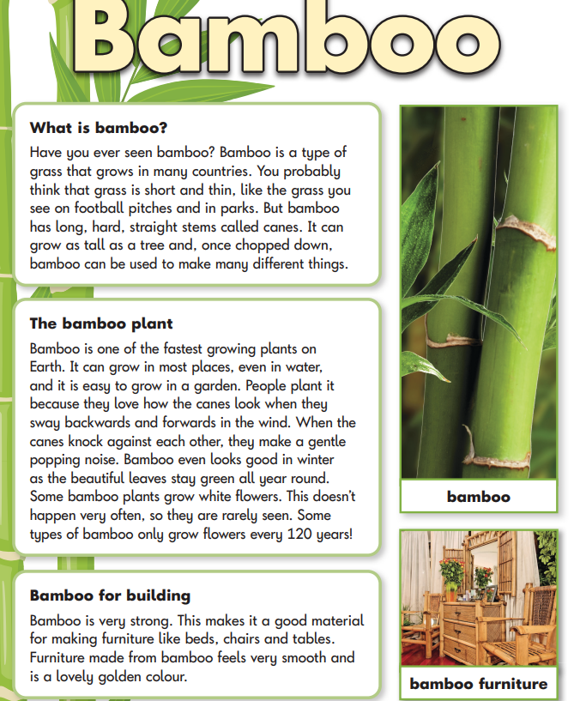
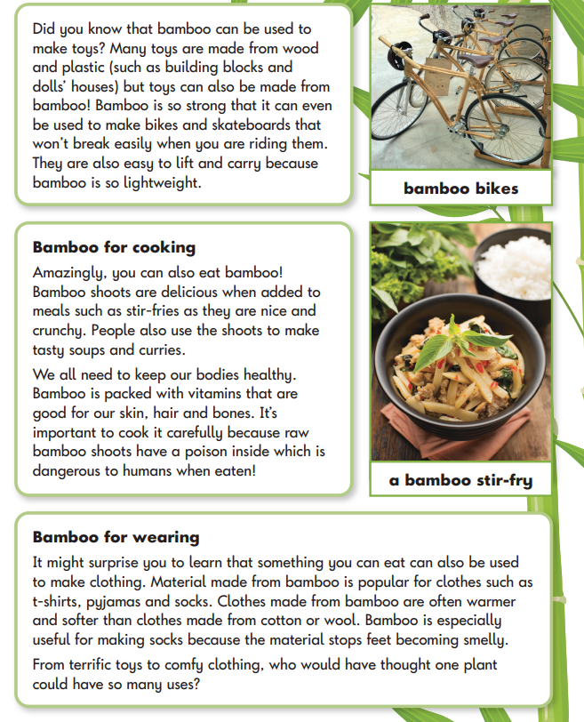

Slide 39
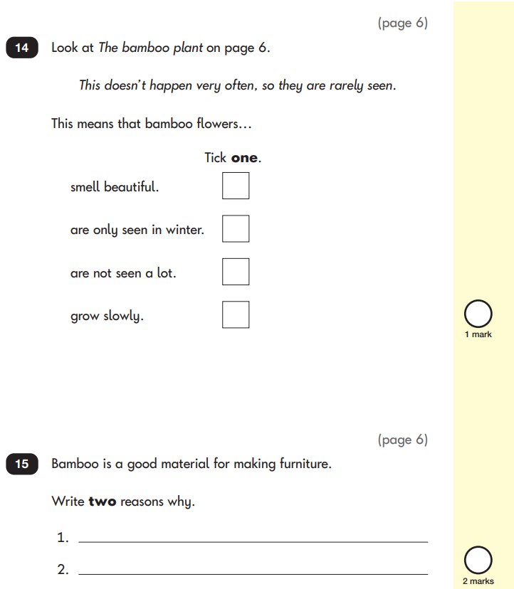
Separate question booklet – children have to locate the answers in the reading text booklet

Slide 40
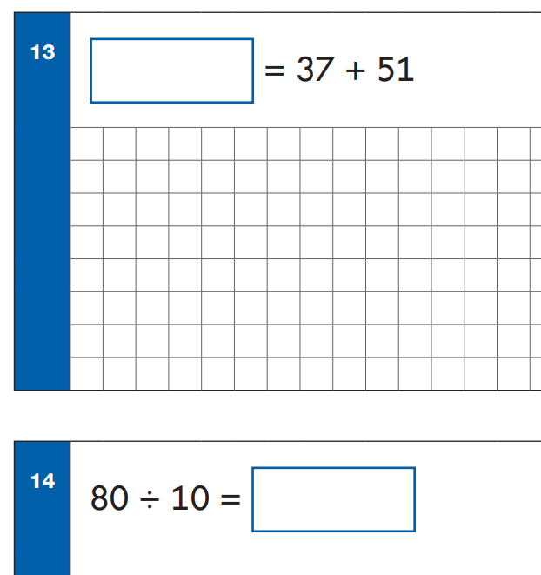
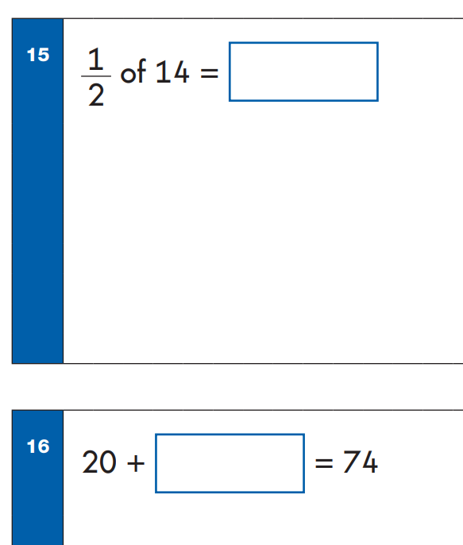
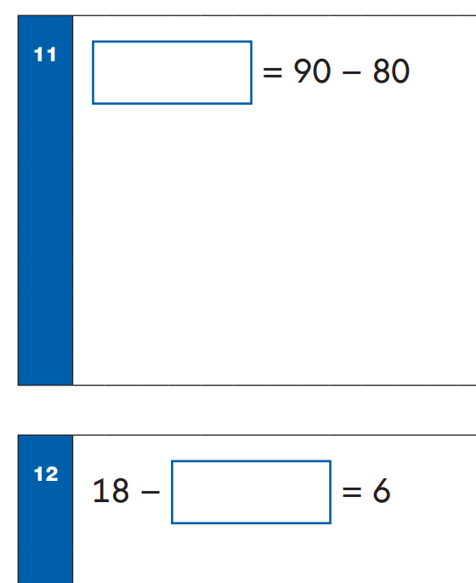
Maths Paper 1 – arithmetic
20 questions on calculation
Addition, subtraction, fractions, multiplication, division

Slide 41
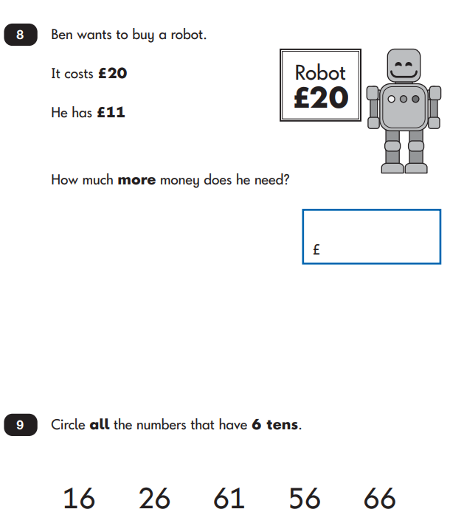
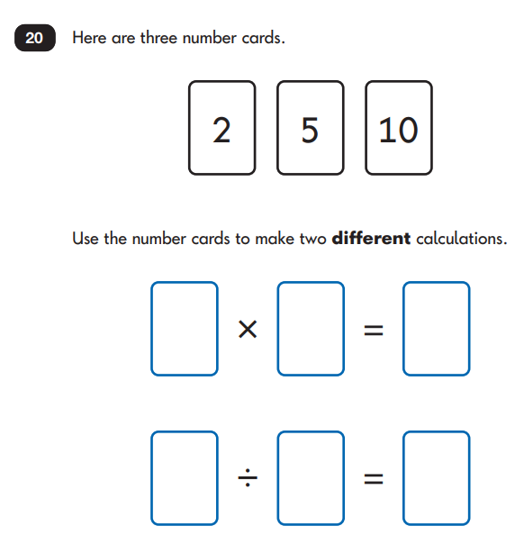
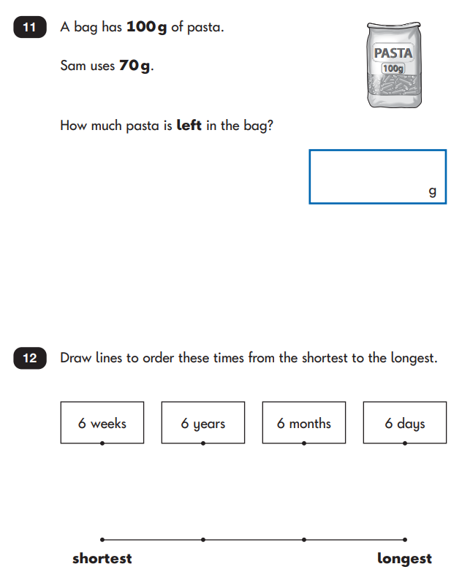
Maths Paper 2 – reasoning
shape, time, data, calculation, word problems, statistics, measure, position and direction, weight, height, money, temperature, capacity, volume

Slide 42
Phonics websites
www.free-phonics-worksheets.com
www.firstschoolyears.com
a good selection of resources including worksheets and some interactive games. Covers-
- Phase 3 and 5 sounds
- extensive list of long vowel worksheets and games such as hangman.
www.bbc.co.uk/schools/wordsandpictures/phonics/
mix of very good interactive games and worksheets covering most phonic phases. Recommend Sandcastle quiz for phase 3 and 5.
www.bbc.co.uk/schools/ks1bitesize/literacy/
a very good selection of interactive games focussing on phonics and sentence construction. Each is split into medium/hard/really hard and are short and fun.
www.ictgames.com/literacy.html
a great selection of games that link well with games in Letters and Sounds.
www.phonicsplay.co.uk
a selection of interactive games for all phonic phases. Mostly simple games.

