Slide 1
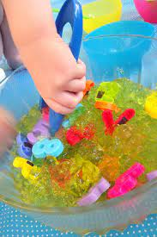
Reception Maths Workshop for Parents

Slide 2
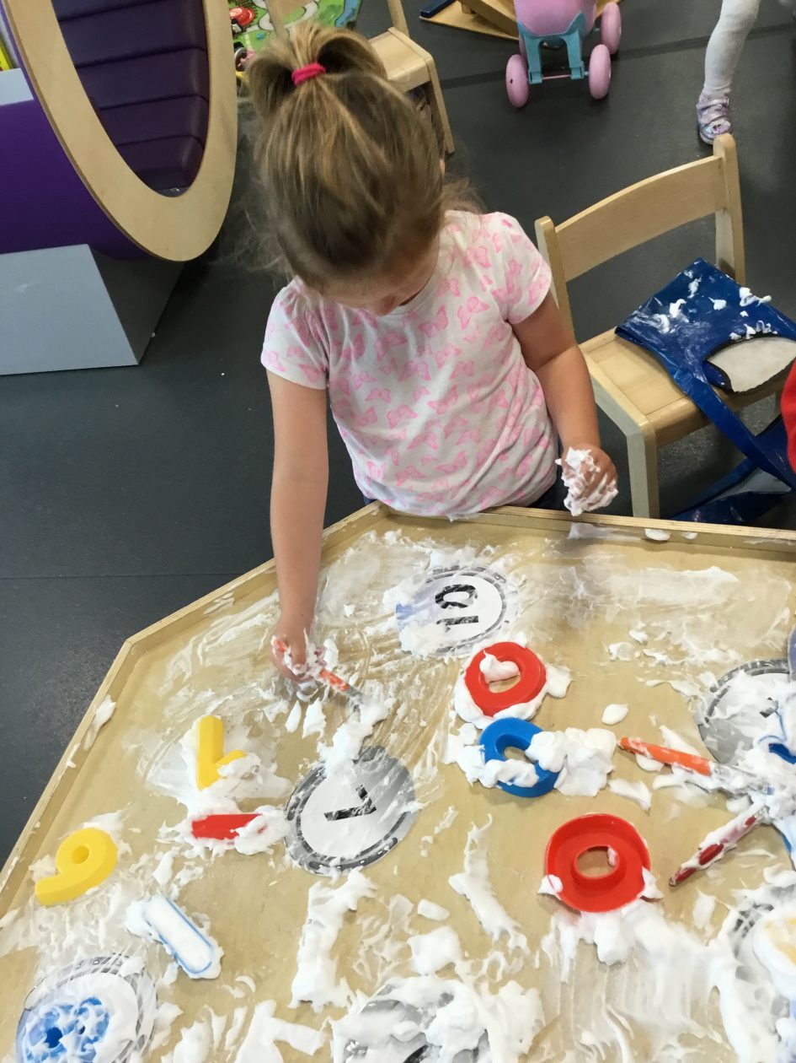
Learning through play at school and home
Play is essential in teaching and consolidating in maths.
Many of the maths objectives within the Reception curriculum can be developed during free play.
Play enables children to be independent and remain curious.

Slide 3
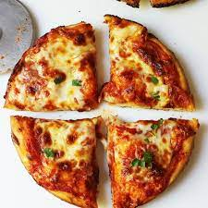
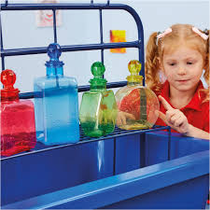
Learning through play at school and home
By setting up and supporting activities in the environment, children are not only learning about one specific maths objective, they are also learning so much more in other areas of learning; the possibilities are endless!

Slide 4
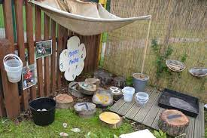
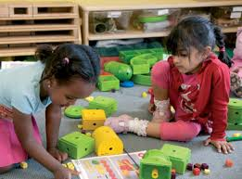
What can the environment teach in maths and how
teachers facilitate learning?

Slide 5
Visibility and Tools:
The physical environment should be designed to be visible and accessible, with tools like calculators, rulers, and measuring tapes readily available. Displays that are current and relevant to children's learning needs can also enhance the mathematical potential of the environment.
Nature and Outdoor Activities:
Engaging in nature and outdoor activities can inspire math concepts and provide opportunities for problem-solving and exploration. Teachers can create outdoor learning environments that encourage students to apply math in real-life situations.
Number-Rich Environment:
A numberrich environment encourages children to think about math in their daily lives and routines. Teachers can create opportunities for whole-school involvement in math activities, such as writing questions and discussing answers on display boards.
Physical and Sociocultural Factors:
The physical environment of a school, including the classroom setup and the school grounds, can influence learning outcomes. A well-maintained and safe physical environment fosters positive attitudes toward learning and boosts academic achievement.
Nature-Based Activities:
Incorporating nature-based activities into math education can enhance outdoor learning and develop critical thinking, problem-solving skills, and a deep appreciation for the environment. Teachers can use activities like estimating and measuring in nature,
symmetry in leaves and flowers, and outdoor fractions to engage students in math.
Sustainability Integration:
Integrating sustainability into mathematics education can prepare students for global challenges and encoure them to apply their knowledge to realworld sustainability issues. Teachers can use interdisciplinary approaches to connect mathematical concepts with subjects like geograpy or science.
By creating a supportive and engaging learning environment, teachers can facilitate effective math learning and help students develop a positive attitude toward mathematics.

Slide 6
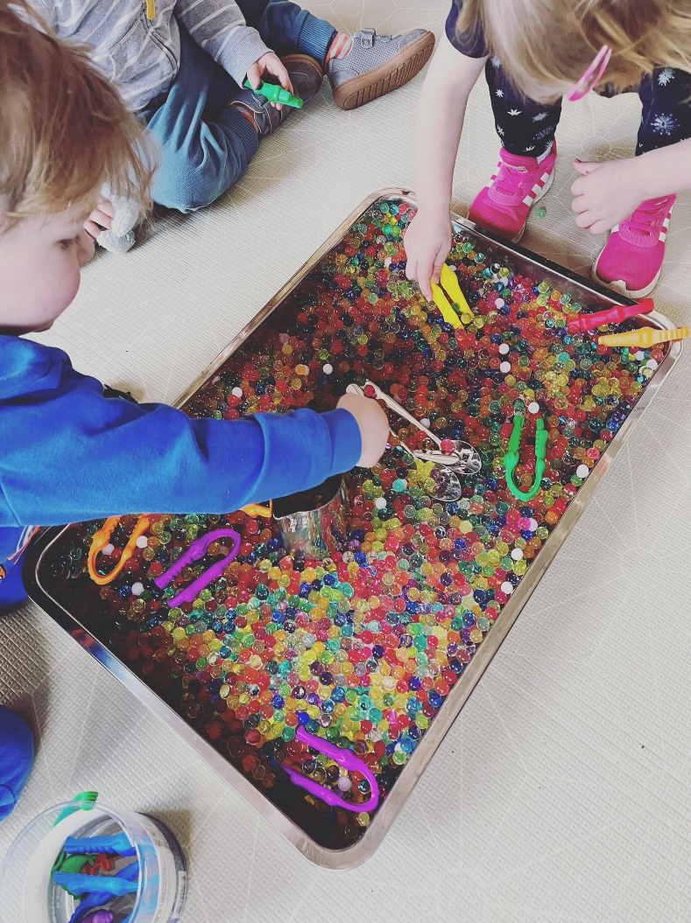
Mathematical Language
Lots of maths language for example more, less, big, small, wide, thin and positional language needs to be modelled by adults for children to learn and it is so much more effective if it's during authentic play experiences.
This can be replicated at home when doing every day activities.

Slide 7
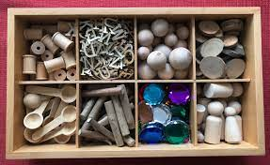
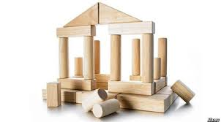
Problem solving, reasoning and pattern
Loose parts are not only amazing for helping children to develop creativity, problem-solving and reasoning skills, but are also perfect for developing and embedding pattern creating.
Construction is another area where children can learn these undervalued skills.

Slide 8
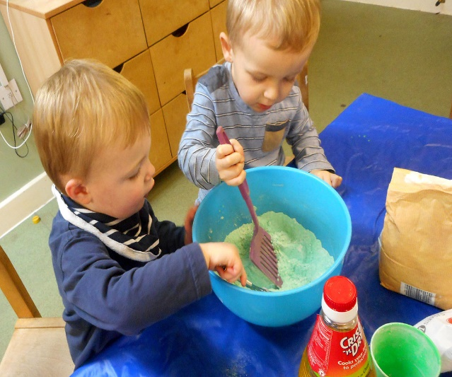
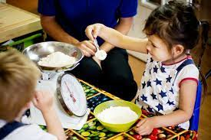
Weight and Measures
We model measuring for example outside during building and construction: large scales outside, small balance scales inside for children to explore.
Self-service play dough stations and cooking areas help children independently develop important maths skills while having fun!
Any cooking you do with your child at home will be really helpful.

Slide 9
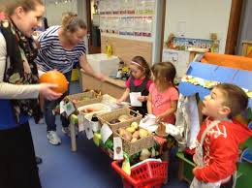
Money
The best way to learn about money is to use it in a purposeful way. We use a role play shop, rolling snack till, or impromptu shop. Children can use it independently. This is kept fresh by changing it to a Supermarket, Garden Centre, Cinema etc. where children must buy things using money.
Any shopping children can help with at home will help embed the learning.

Slide 10
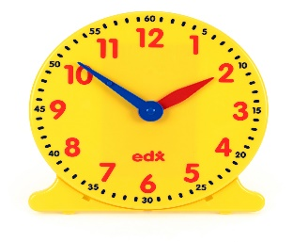
Time/Passing of Time
We encourage children to use time every day for example measuring how long running races or car racing through guttering takes: estimate then check; will a sand timer work?
Highlighting times of the day when discussing the daily routine, we talk about the times that things will happen.
Looking at days of the week and months of the year
Always have as many clocks and watches at home as you can and modelling using time.

Slide 11

Fractions
At snack time we ask children to share things.
You can encourage children to cut up sandwiches at home into halves and quarters.

Slide 12
Other ideas to help at home
Play board games such as Orchard Toys
Sing number songs and nursery rhymes
Engage in imaginative play with your child
Go on a number or shape hunt at home

Slide 13
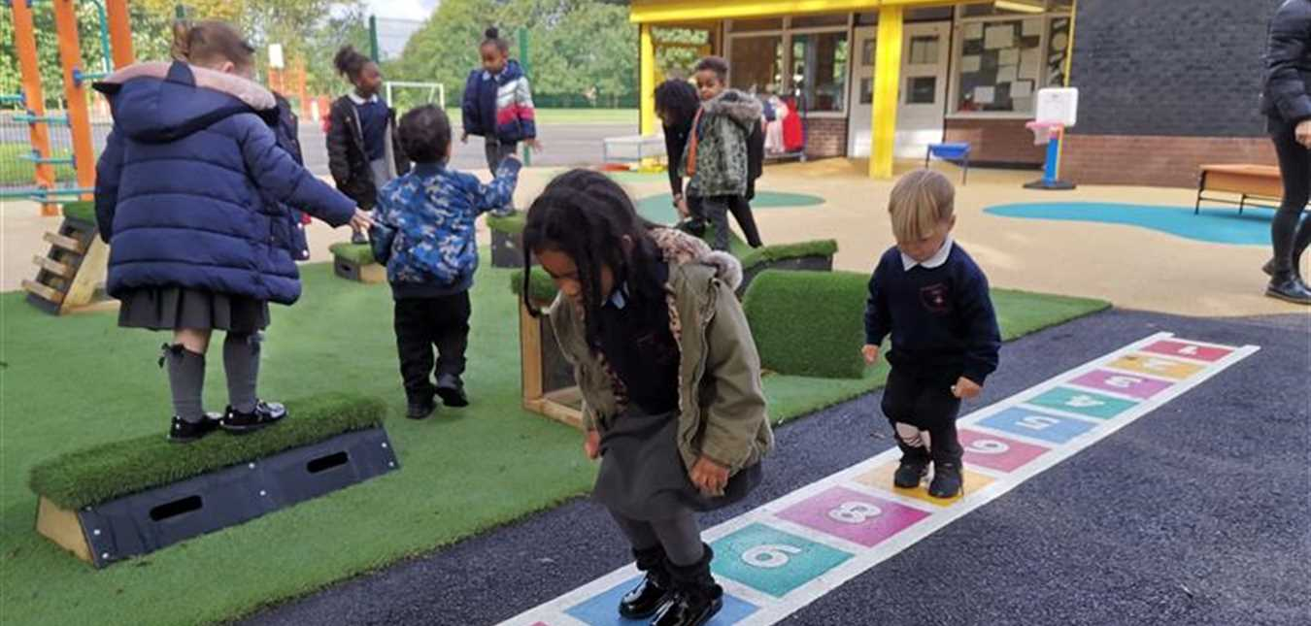
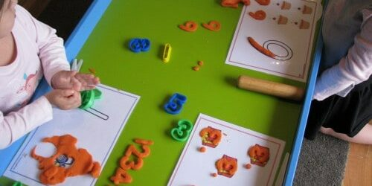
Maths Group Work
As well as learning through play, we teach maths every day with a teacher for short 10-15minute bursts in a whole class or small mixed groups.
Our guided maths planning is practical, extremely fun, and sometimes messy! We also work with the children 1:1 or in their play on maths activities to extend their learning.

Slide 14
Subitising
Subitising is the ability to look at a small set of objects and instantly know how many there are without counting them. For example, when rolling a dice we don’t need to count the dots to know what we have rolled. Subitising was first coined by theorist Piaget. It is important in the early development of number sense.
There are two types of subitising:
Perceptual subitising
Conceptual subitising
Perceptual subitising
Perceptual subitising is instinctive: we are able to look at the objects and just know what the number is without any further thinking. Children and adults alike are generally able to perceptually subitise smaller numbers up to 3 sometimes 5 depending on the arrangement.
Conceptual subitising
Conceptual subitising is the ability to look at a number of objects as a combination of smaller amounts. Looking at the dice example, when we roll a 6 we do not instinctively know it is 6. Instead, we see two groups of 3, meaning there must be 6.
Numbers can be grouped in different ways. For example, the number 8 can be interpreted by combining numbers like 3 + 5 or 4 + 4. Developing conceptual subitising skills is therefore an important step towards many other areas of maths.

