Slide 1
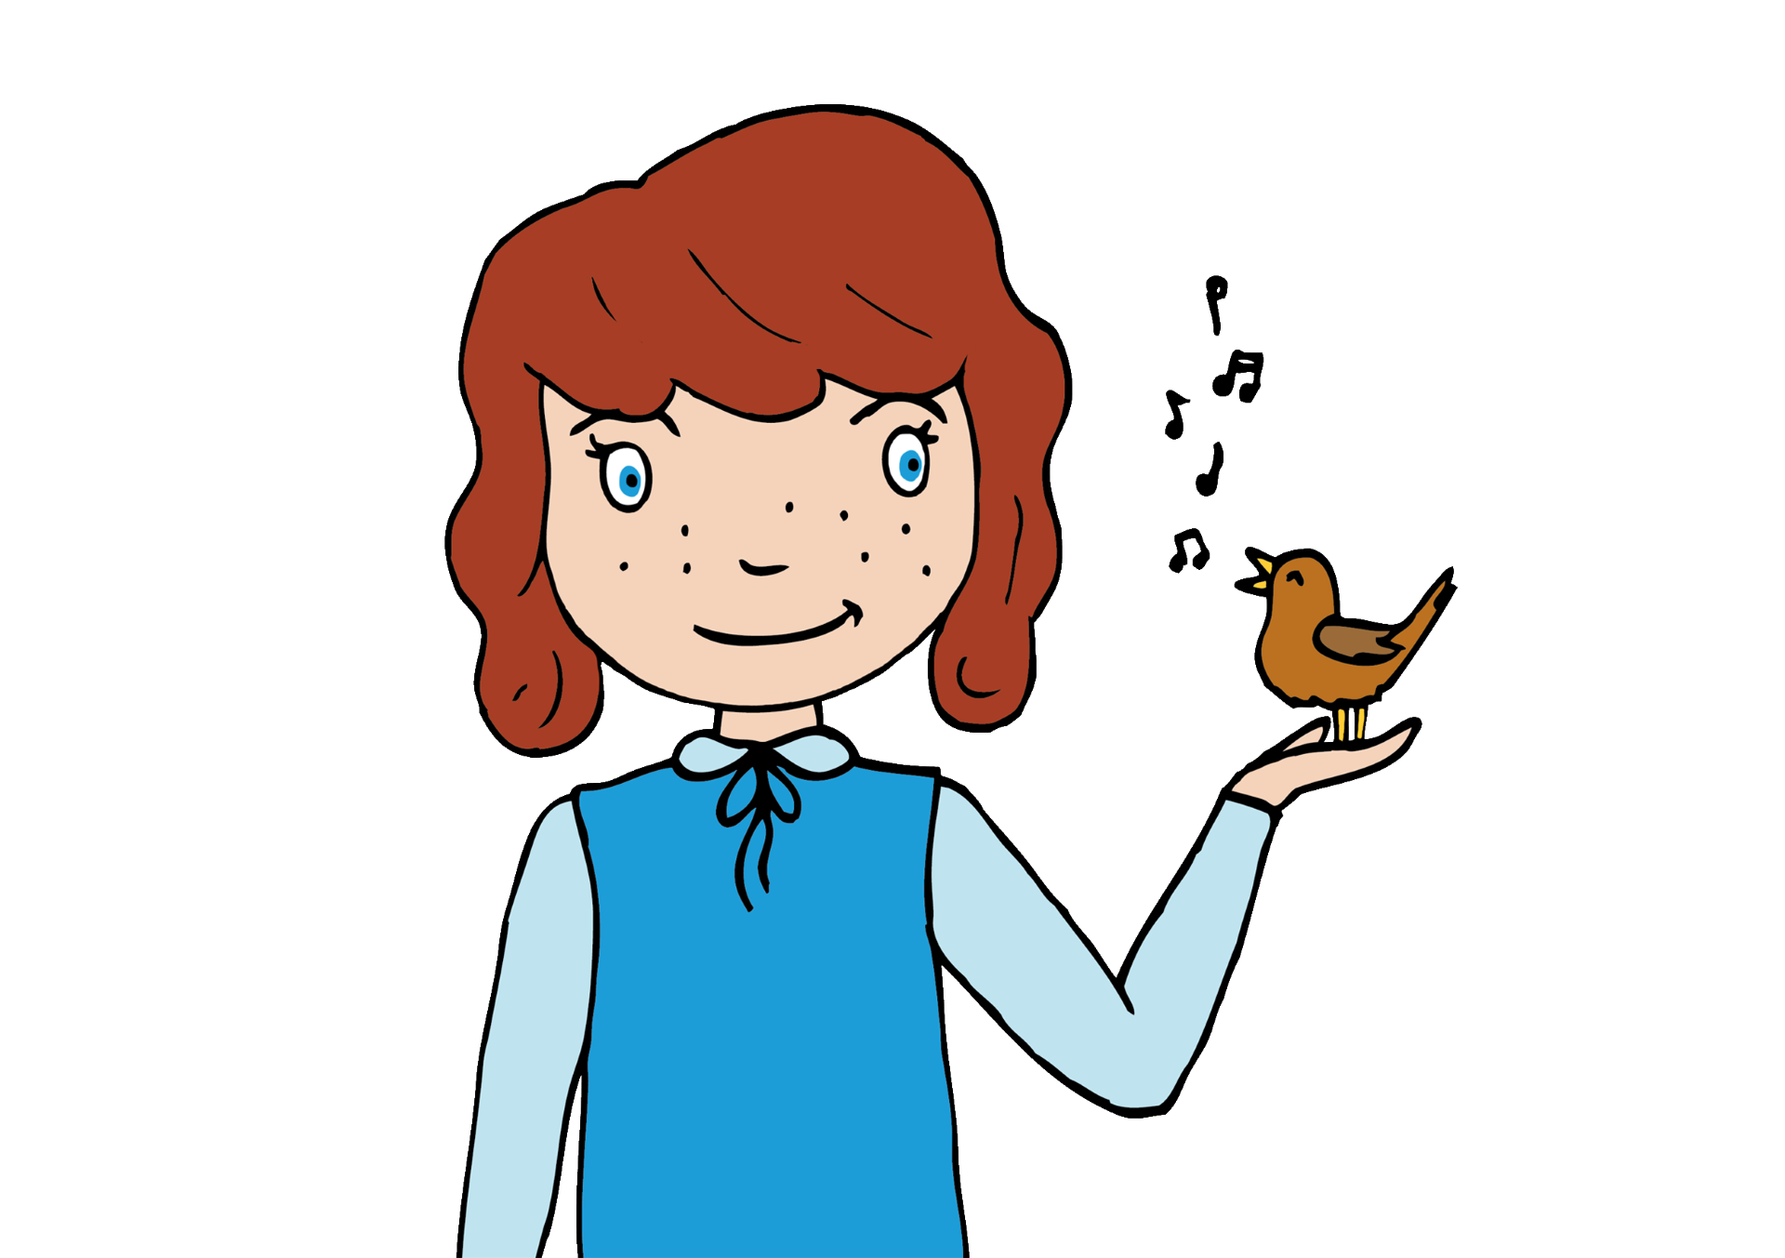
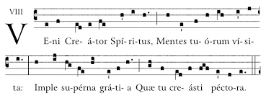
Veni Creator
Listen out for:
The single melodic line which moves mainly by step.
The voices which sing in Latin and in unison (all together).
What 3 words?
chant-like, choral, flowing
Fun fact: The first plainsong was sung by monks in 13th Century. This recording was from the coronation of King Charles III.
Link: "Veni, Creator Spiritus" Plainsong | Music at the Coronation of HM King Charles III - YouTube

Slide 2
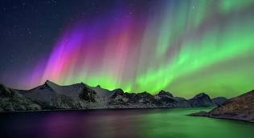
Northern Lights
Ola Gjeilo
Listen out for:
The voices move together.
A quiet and mysterious blend of voices.
What 3 words?
serene, beautiful, atmospheric
Fun fact: Ola Gjeilo is a living Norwegian composer. He was inspired to write a song entitled Northern Lights after seeing them for himself.
Link: "VOCES8: Northern Lights by Ola Gjeilo - YouTube

Slide 3
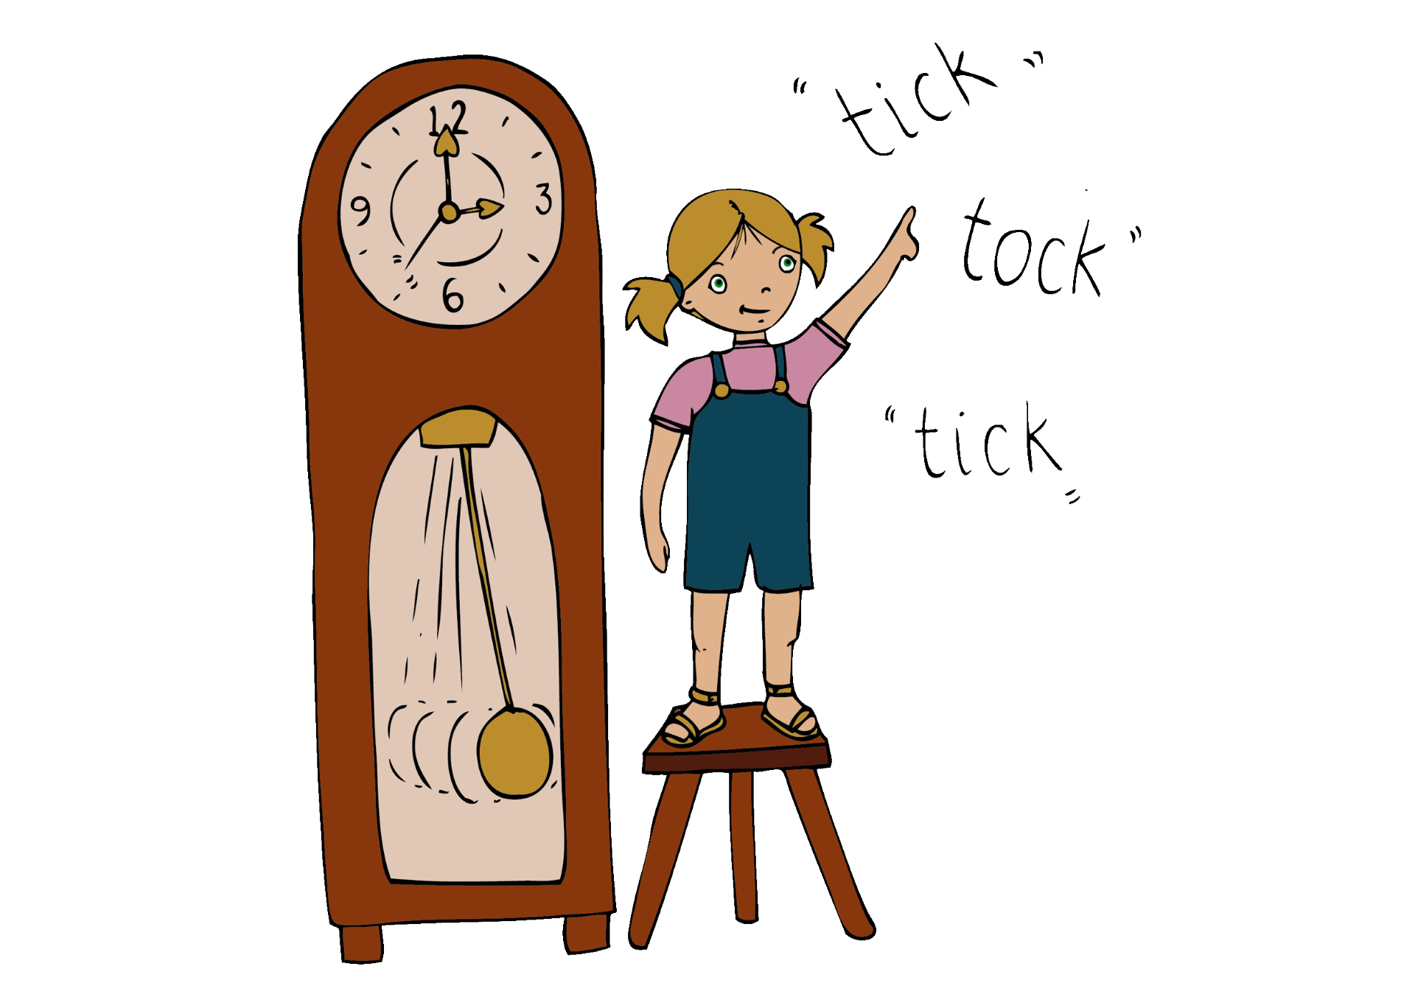

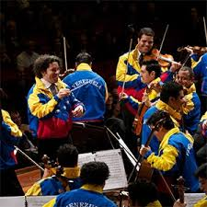
Mambo from
West Side Story
Leonard Bernstein
Listen out for:
The percussion section
What 3 words?
rhythmic, fast, energetic
Fun fact: West Side story is a musical that is based directly on the Shakespearean play Romeo and Juliet. The Simon Bolivar Venezuelan Youth Orchestra are playing it here.
Link: Gustavo Dudamel - Bernstein: West Side Story - Mambo (Sinfónica Simón Bolívar Orchestra, BBC Proms) - YouTube

Slide 4
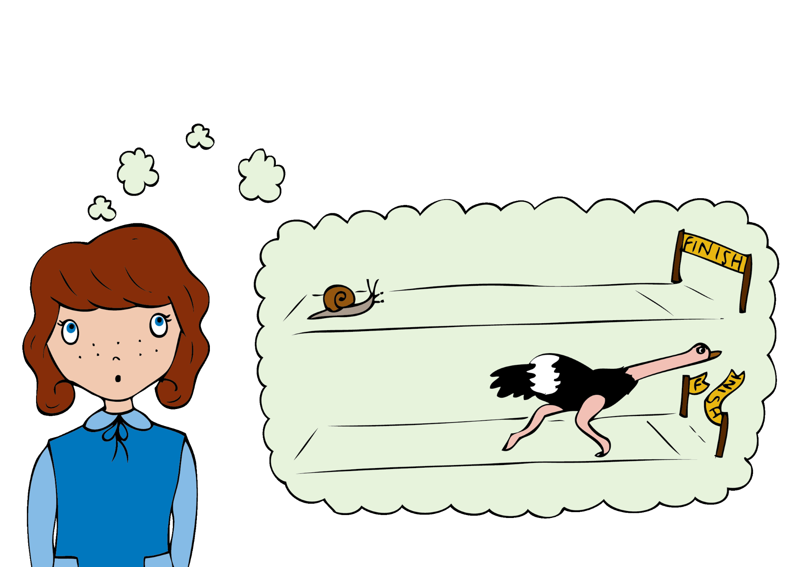
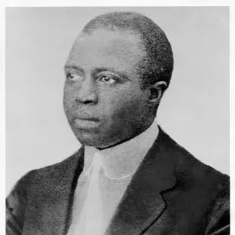
Solace
Scott Joplin
Listen out for:
The repeated ascending phrase which keeps returning
The slow, bluesy, jazzy feel to the music
The piano part
What 3 words?
sleepy, relaxed, restful
Fun fact: This piano piece was inspired by Cuban music.
Link: https://www.youtube.com/watch?v=mgyDQ1g3y-g

Slide 5
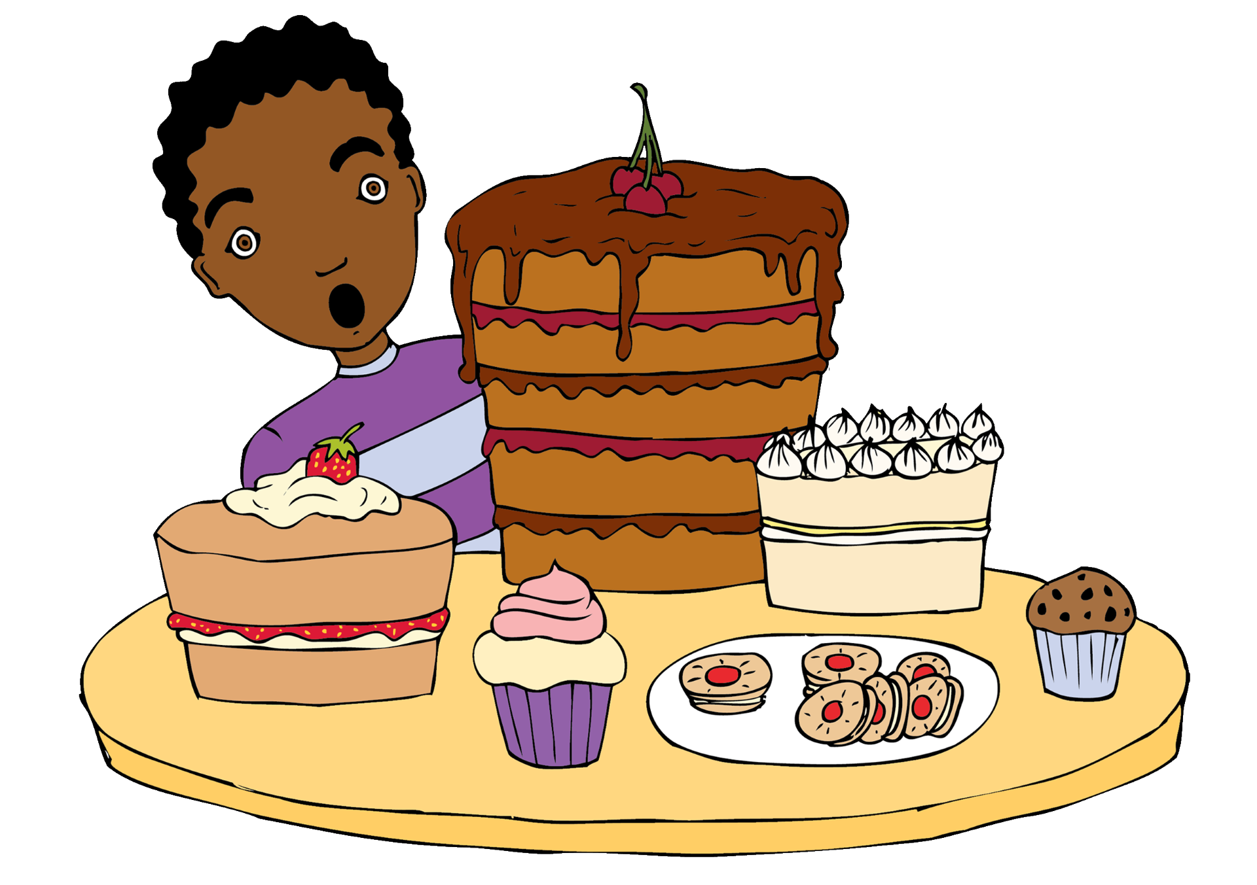
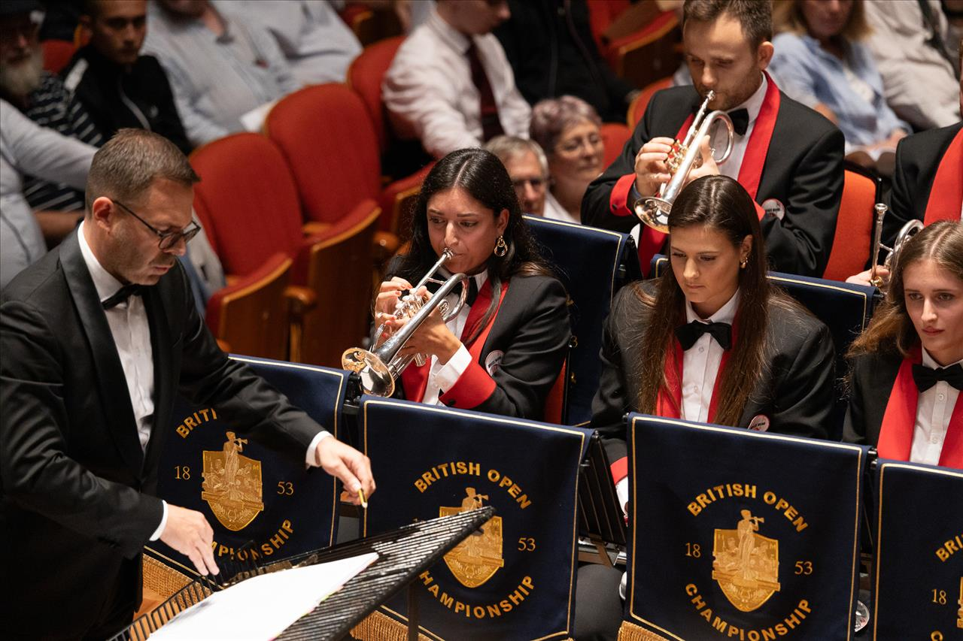
Waltzing Matilda
trad
Listen out for:
The brass instruments playing together -some are bigger and sound lower - some are smaller and sound higher.
How they work as a team and follow the conductor to keep in time,
What 3 words?
marching, fanfare like, fast
Fun fact: Brass instruments have a mouthpiece that the player blows into. To change the pitch they press valves or use a slide.
Link: https://www.youtube.com/watch?v=nWV2FmJc_2U

Slide 6

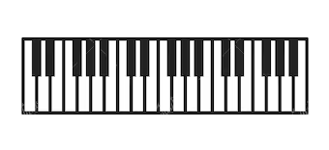
Variations on Ah vous dirai-je, maman
Wolfgang Amadeus Mozart
Listen out for:
The melody of the theme which you might recognise.
How each variation changes the existing theme, but you can still hear the Twinkle tune.
What 3 words?
changing, theme, piano
Fun fact: The tune is an old French folk tune, which we know as Twinkle Twinkle, and which inspired Mozart to write this set of variations.
Link: https://www.youtube.com/watch?v=NO-ecxHEPqI

