Slide 1
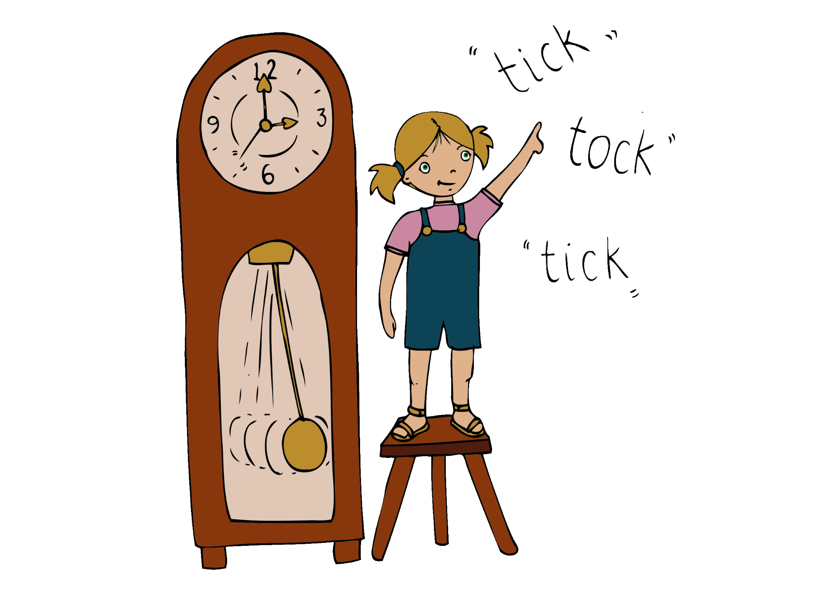
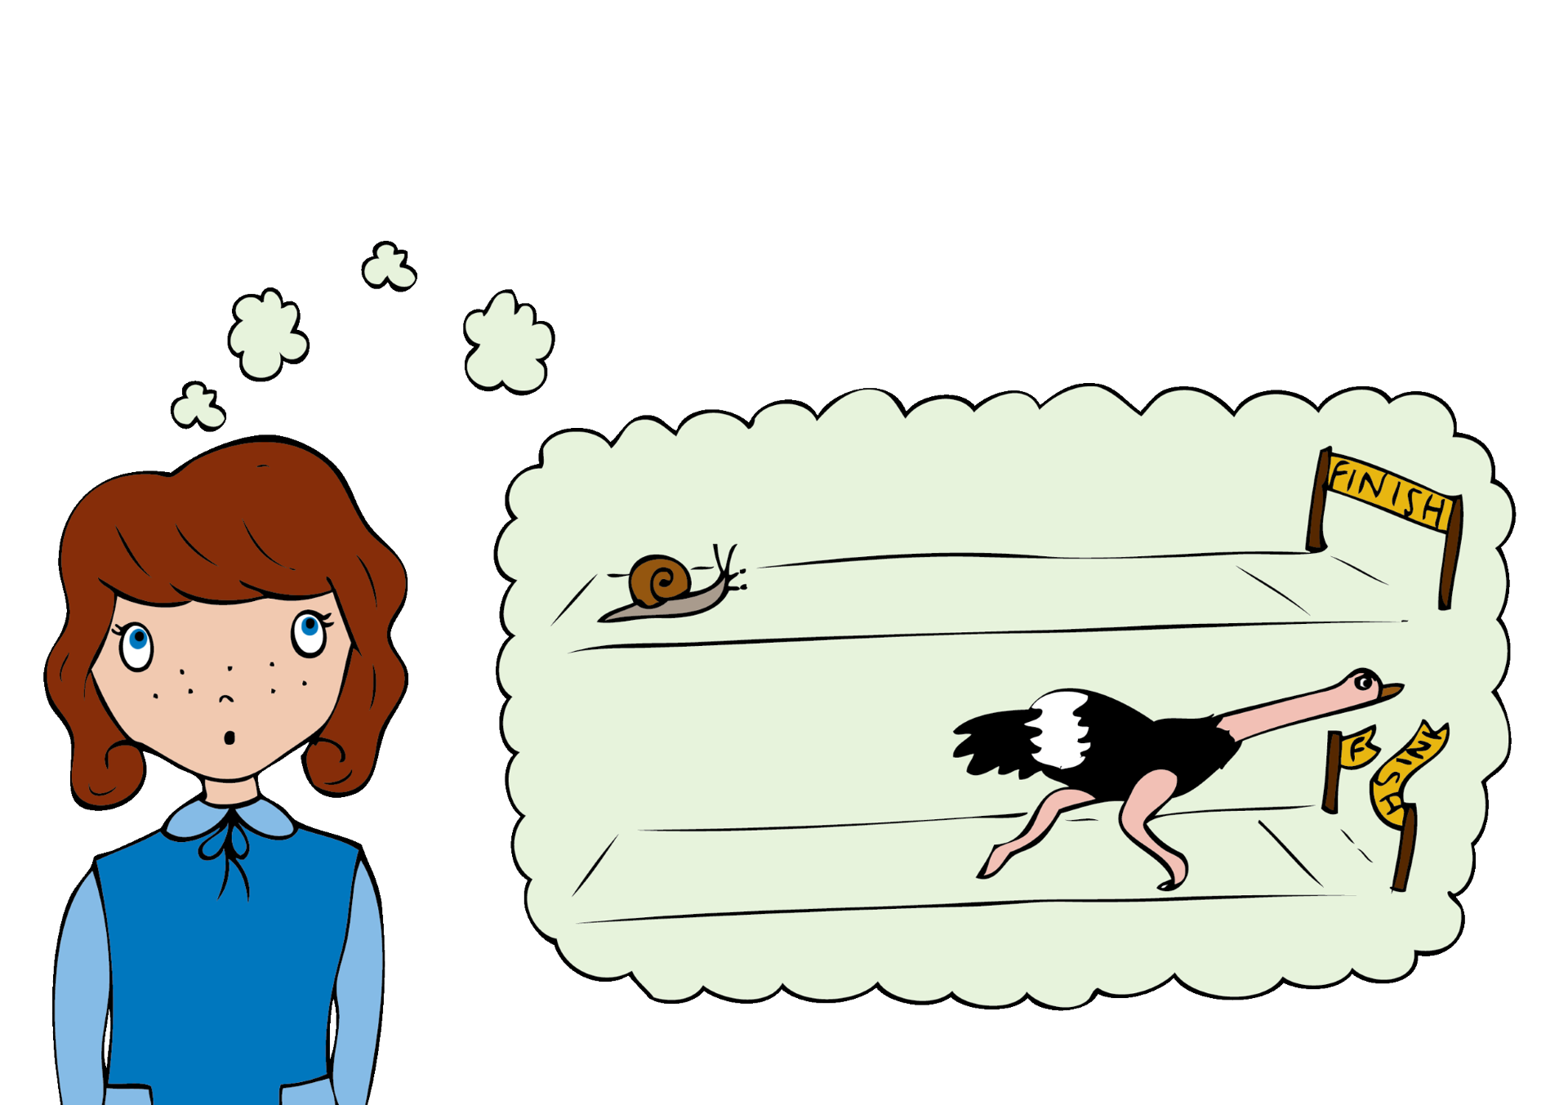
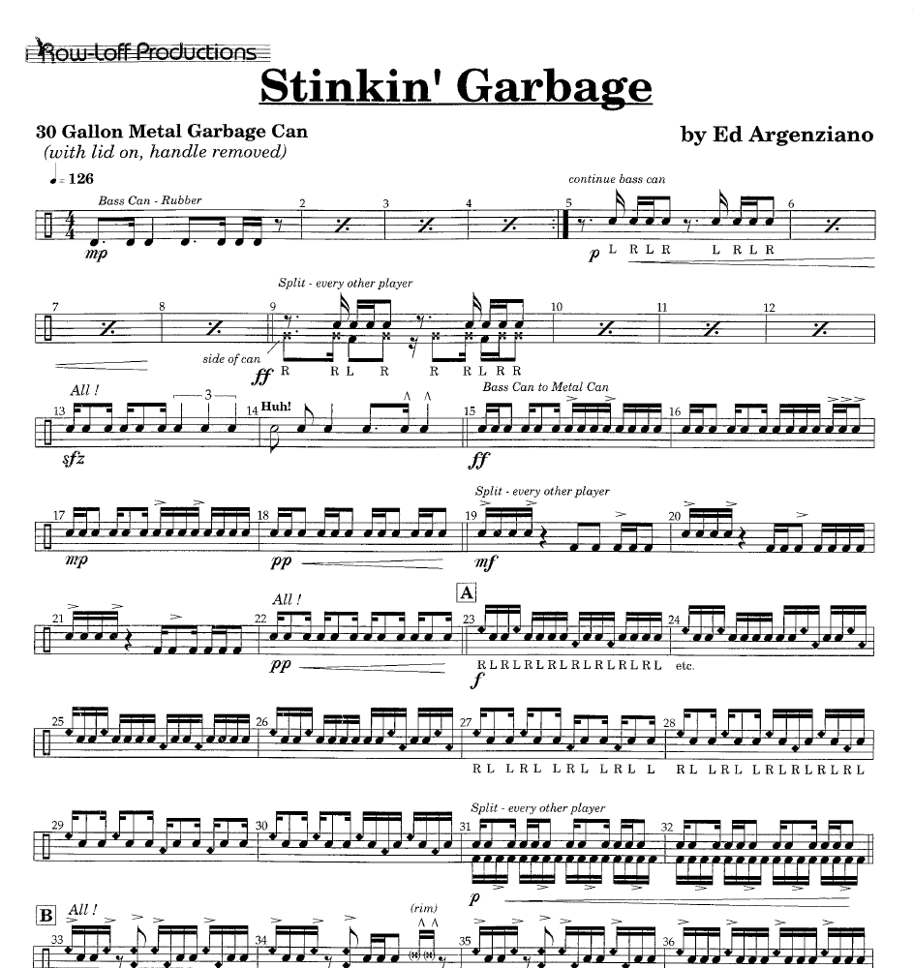
Stinkin’ Garbage
Ed Argenziano
Listen out for:
Where the performers play the same rhythms and where they play their own line.
The strong sense of rhythm and pulse
What 3 words?
fast, exciting, rhythmical
Fun fact: The piece was composed for anything from two to thirty two performers!
Link: https://www.youtube.com/watch?v=eLiZwU0r0Lw

Slide 2
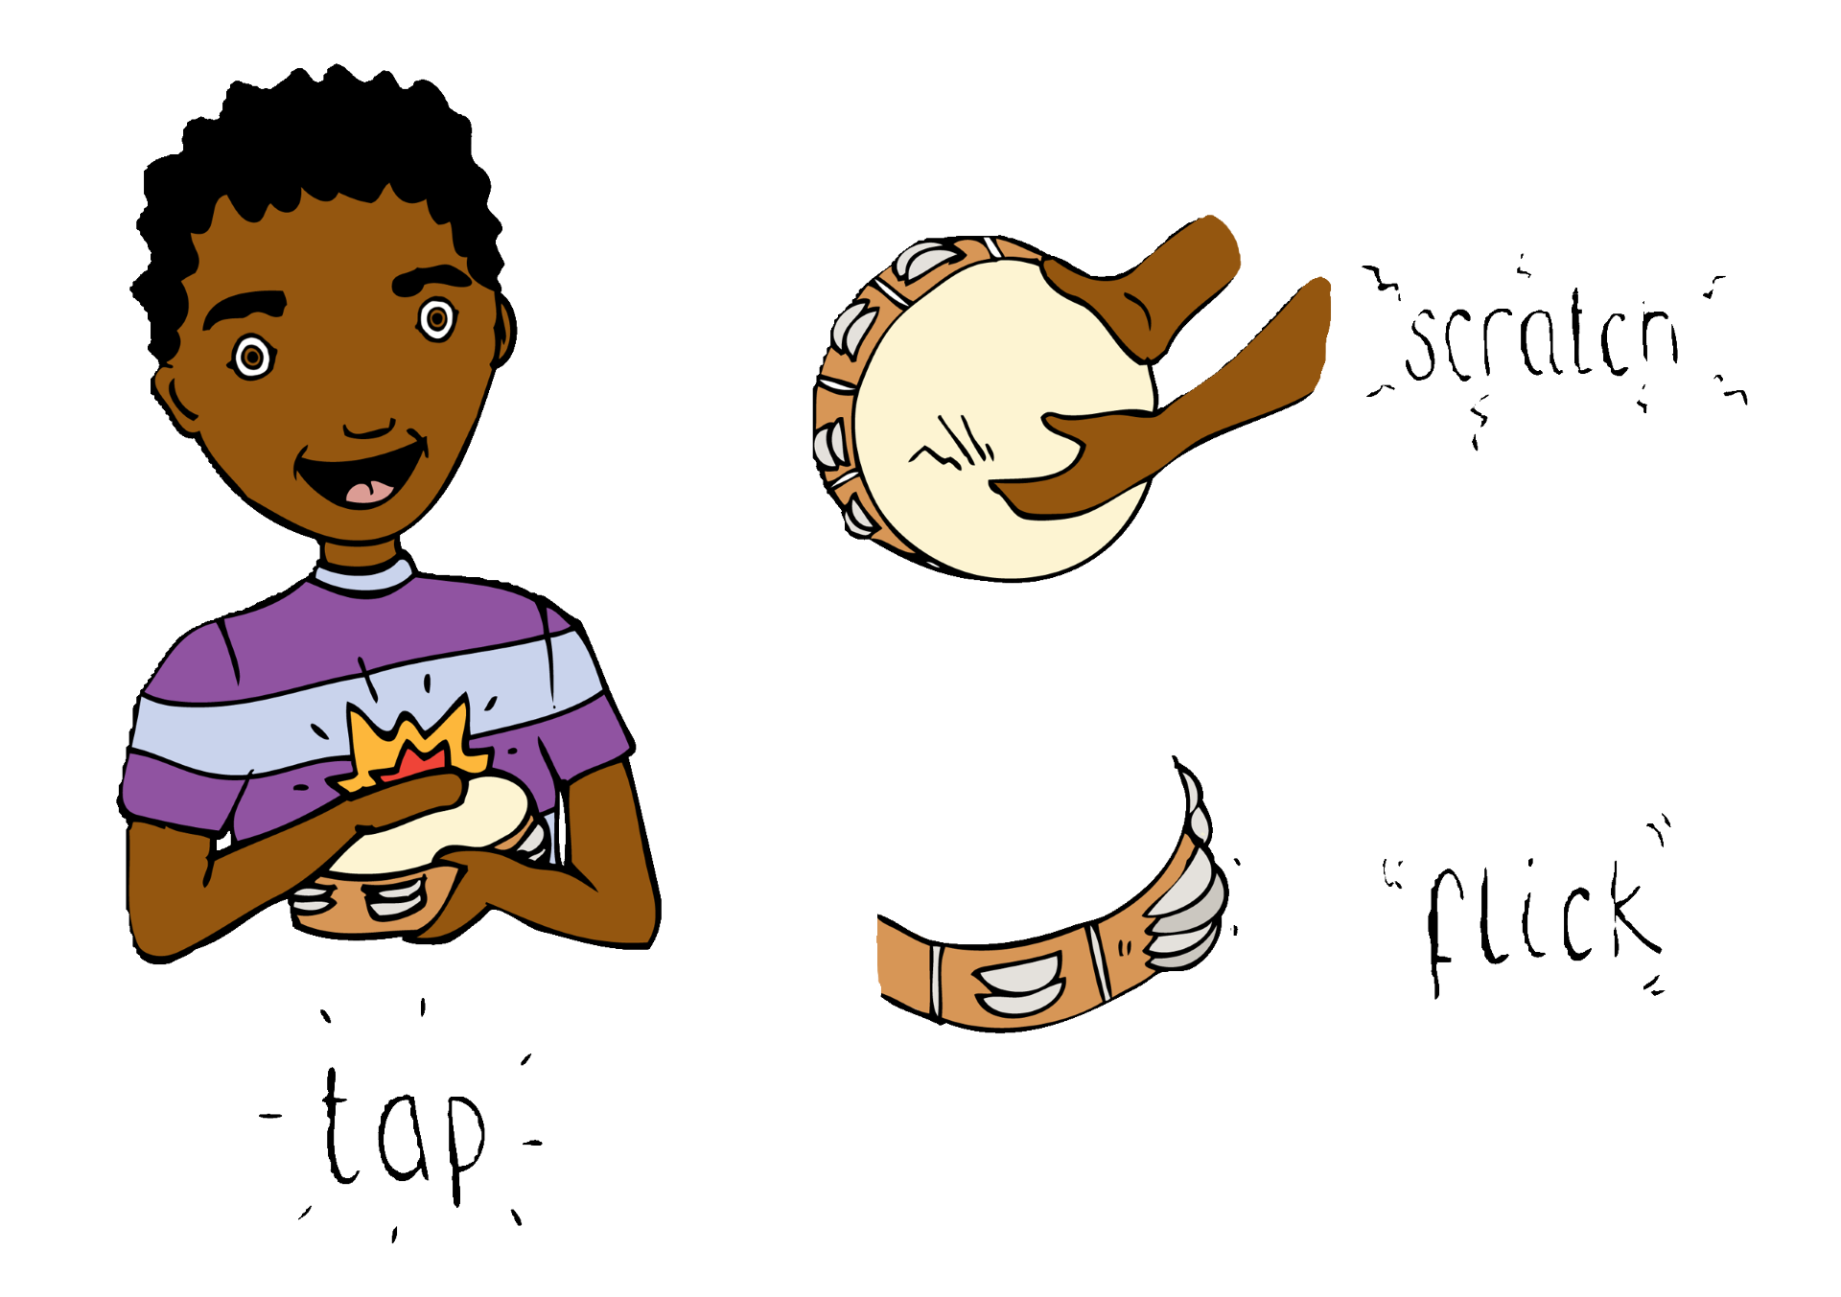

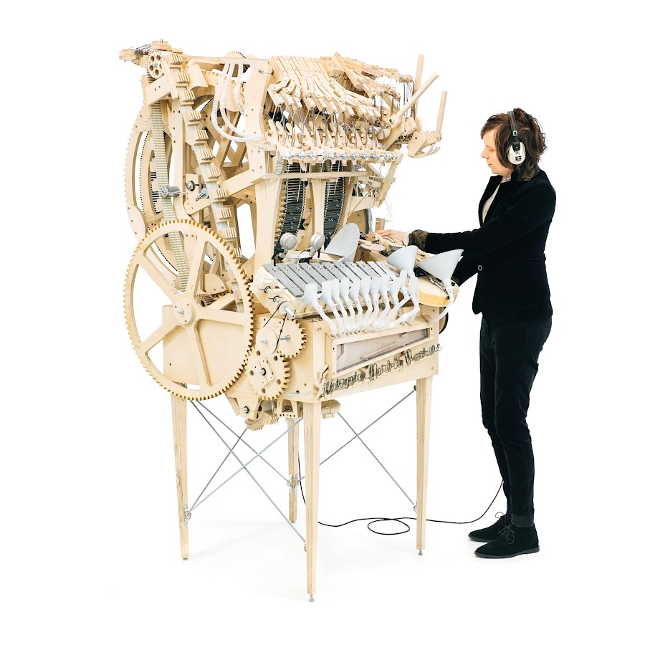
Marble Machine
Wintergatan
Listen out for:
The repeated musical pattern created by the machine.
Sounds of the vibraphone, kick drum, bass guitar, cymbal hi hat and snare drum.
What 3 words?
innovative, percussive, repetitive
Fun fact: The music box used marbles to play instruments. It is actually a real instrument powered by a hand crank.
Link: https://www.youtube.com/watch?v=IvUU8joBb1Q

Slide 3
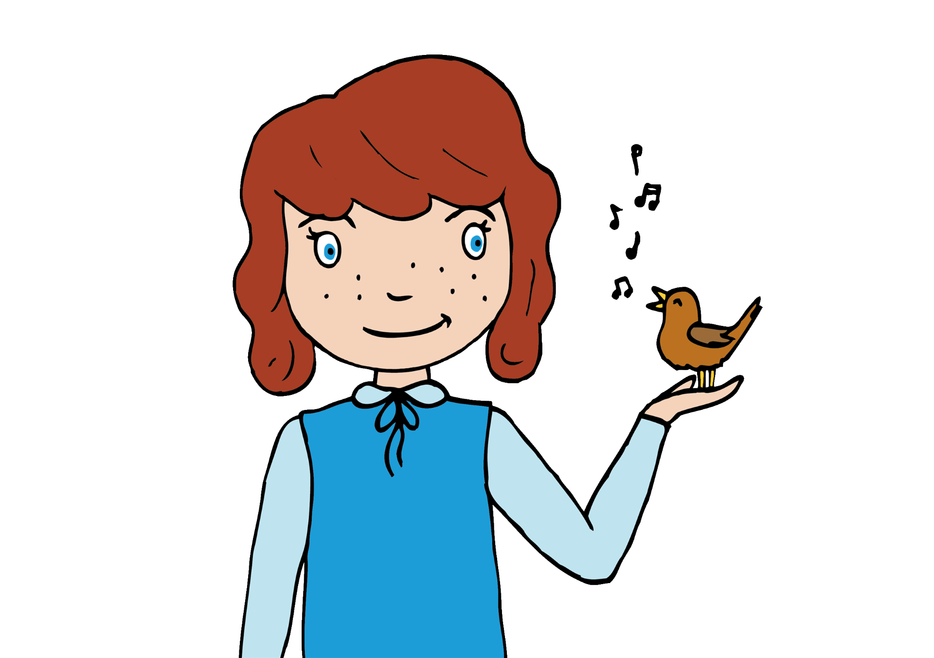
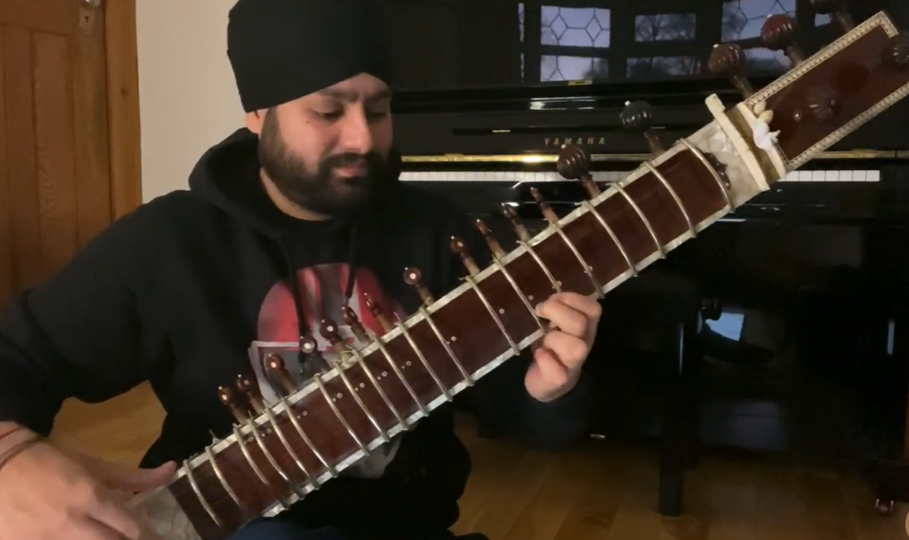
Raag Bhairavi
Jasdeep Singh Degun
Listen out for:
The sitar, a stringed instrument used in Hindustani classical music.
Improvisation, where Jasdeep is creating ‘ in the moment’ music based on the raga.
What 3 words?
relaxed, laid-back, easy going
Fun fact: Raag Bhairavi is a popular Hindustani classical raga. A raga is a structure of notes of different pitches.
Link: https://www.youtube.com/watch?v=YKrASGVWZIk

Slide 4
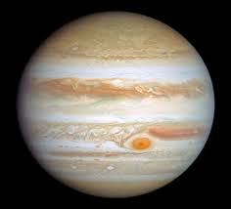
Jupiter (from The Planets)
Gustav Holst
Listen out for:
The main theme is played by six horns, viola and cellos.
The two sets of timpani (drums)
What 3 words?
thoughtful, dramatic, emotional
Fun fact: Jupiter has the fastest rotation of any planet in our solar system and Holst, the composer represents this by asking violins to play a tiny three note figure over and over very quickly.
Link:https://www.classical100.org/sort/5/instruments/9/piece/44/jupiter

Slide 5

Mighty River
Errollyn Wallen
Listen out for:
The French Horn at the beginning playing the well-known hymn Amazing Grace
At the beginning each instrument stands out but then gradually they begin to add layers to the sound.
What 3 words?
evocative, unstoppable, hymn-like
Fun fact: Errollyn Wallen. the composer, imagines that The Mighty River is an unstoppable force of seeking freedom.
Link: https://www.bbc.co.uk/teach/ten-pieces/articles/zhfg239

Slide 6
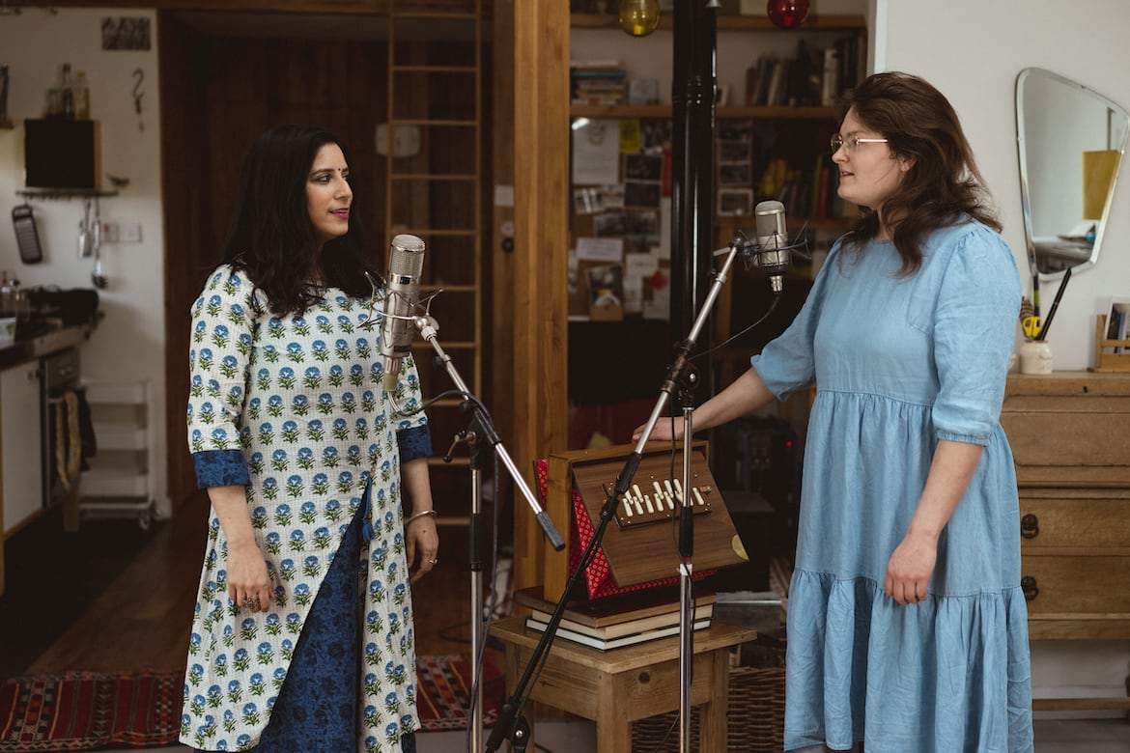
Vaishnava Jana To/Quiet Joys of Brotherhood
Ranjana Ghatak / Iona Lane
Listen out for:
The shruti - an instrument that looks like a box and creates a drone underneath the sung vocal line
What 3 words?
dreamlike, gentle, mesmerising
Fun fact: This is a fusion of folk influences. Ranjana sings Vaishnava Jana, loosely based on a Indian raga called Khama, whilst Iona’s heritage is steeped in Scottish folk music
Link: https://www.youtube.com/watch?v=7PLGZIM5xzY

