Slide 2
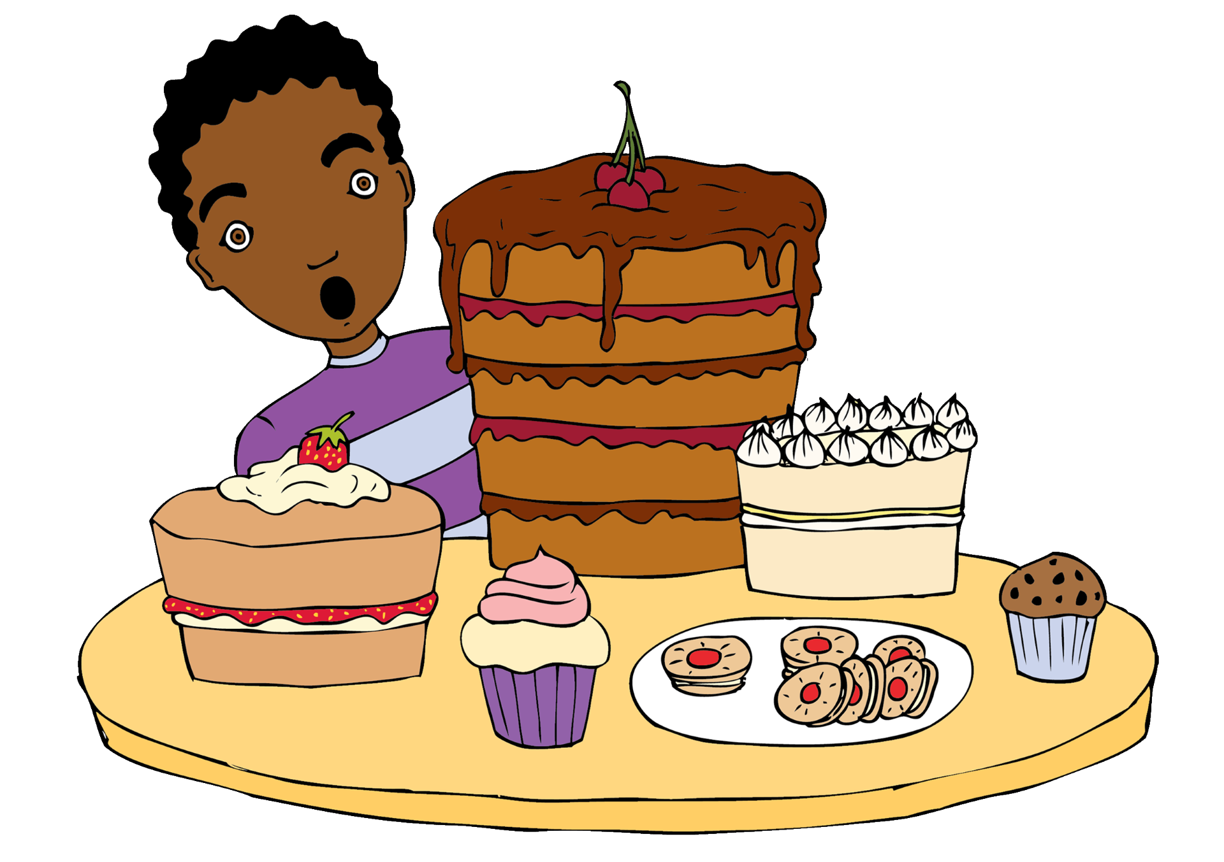

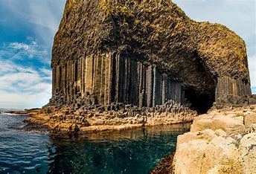
Overture to Fingal’s Cave
Felix Mendelssohn
Listen out for:
The waves of dynamics and layers of sound that sound like waves of the sea.
What 3 words?
powerful, immense, surging.
Fun fact: Fingal’s Cave is on an island called Staffa in the Hebrides. Mendelssohn was enchanted by a visit to this island.
Link: https://youtu.be/3zjb1E_8UD8?si=zZ485FKLivpXWaqD

Slide 3
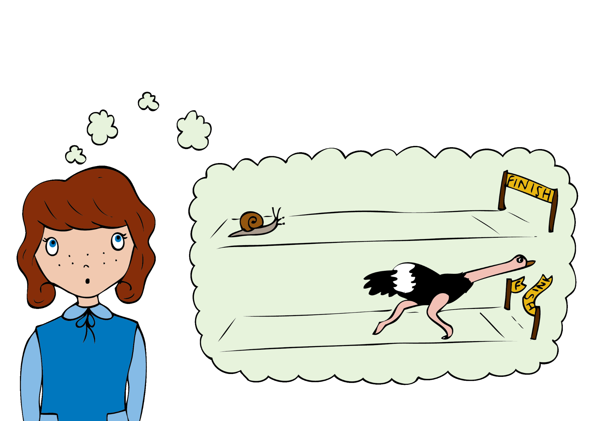
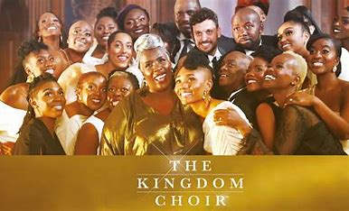
Stand by me
Ben E. King
Listen out for:
The solo voice at the beginning then voices blending together in a slow gospel song.
What 3 words?
soulful, uplifting, harmonies.
Fun fact: The Kingdom Choir are a contemporary choir who sing together in London.
Link: 'Stand by Me' performed by Karen Gibson and The Kingdom Choir - The Royal Wedding - BBC - YouTube

Slide 4
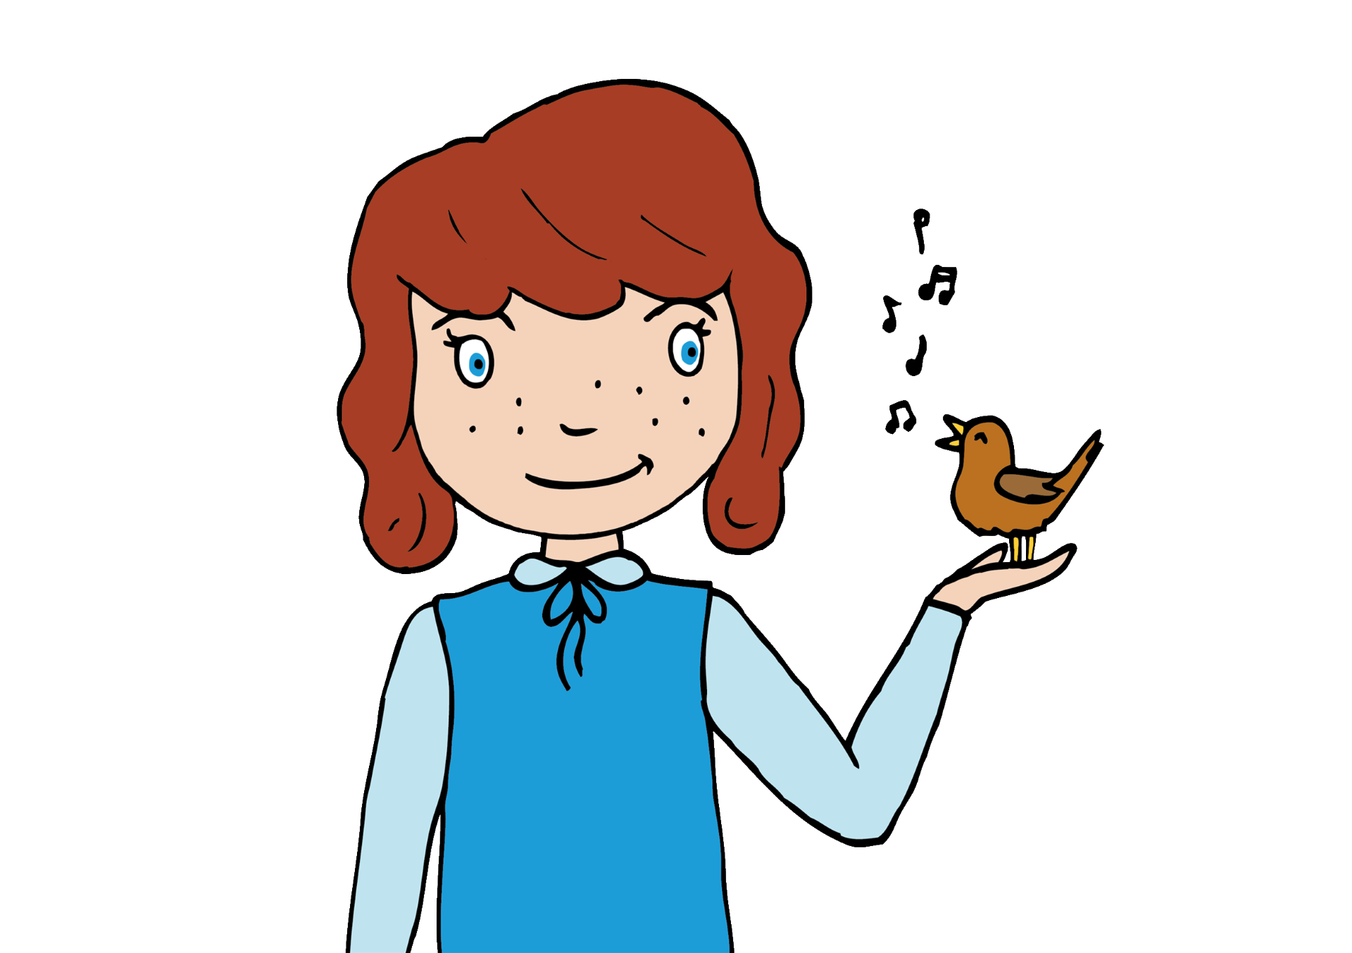
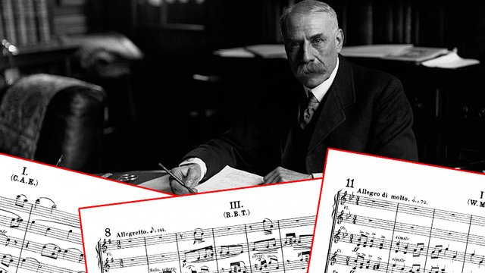
Enigma Variations
Edward Elgar
Listen out for:
The string section at the beginning playing the theme.
The main tune which appears in a different way in each variation.
What 3 words?
thoughtful, dramatic, emotional
Fun fact: An Enigma is a mystery and many people believe the composer Edward Elgar hid a secret in his main theme which is still to be discovered.
Link:https://play.lso.co.uk/performances/Elgars-Enigma-Variations

Slide 5
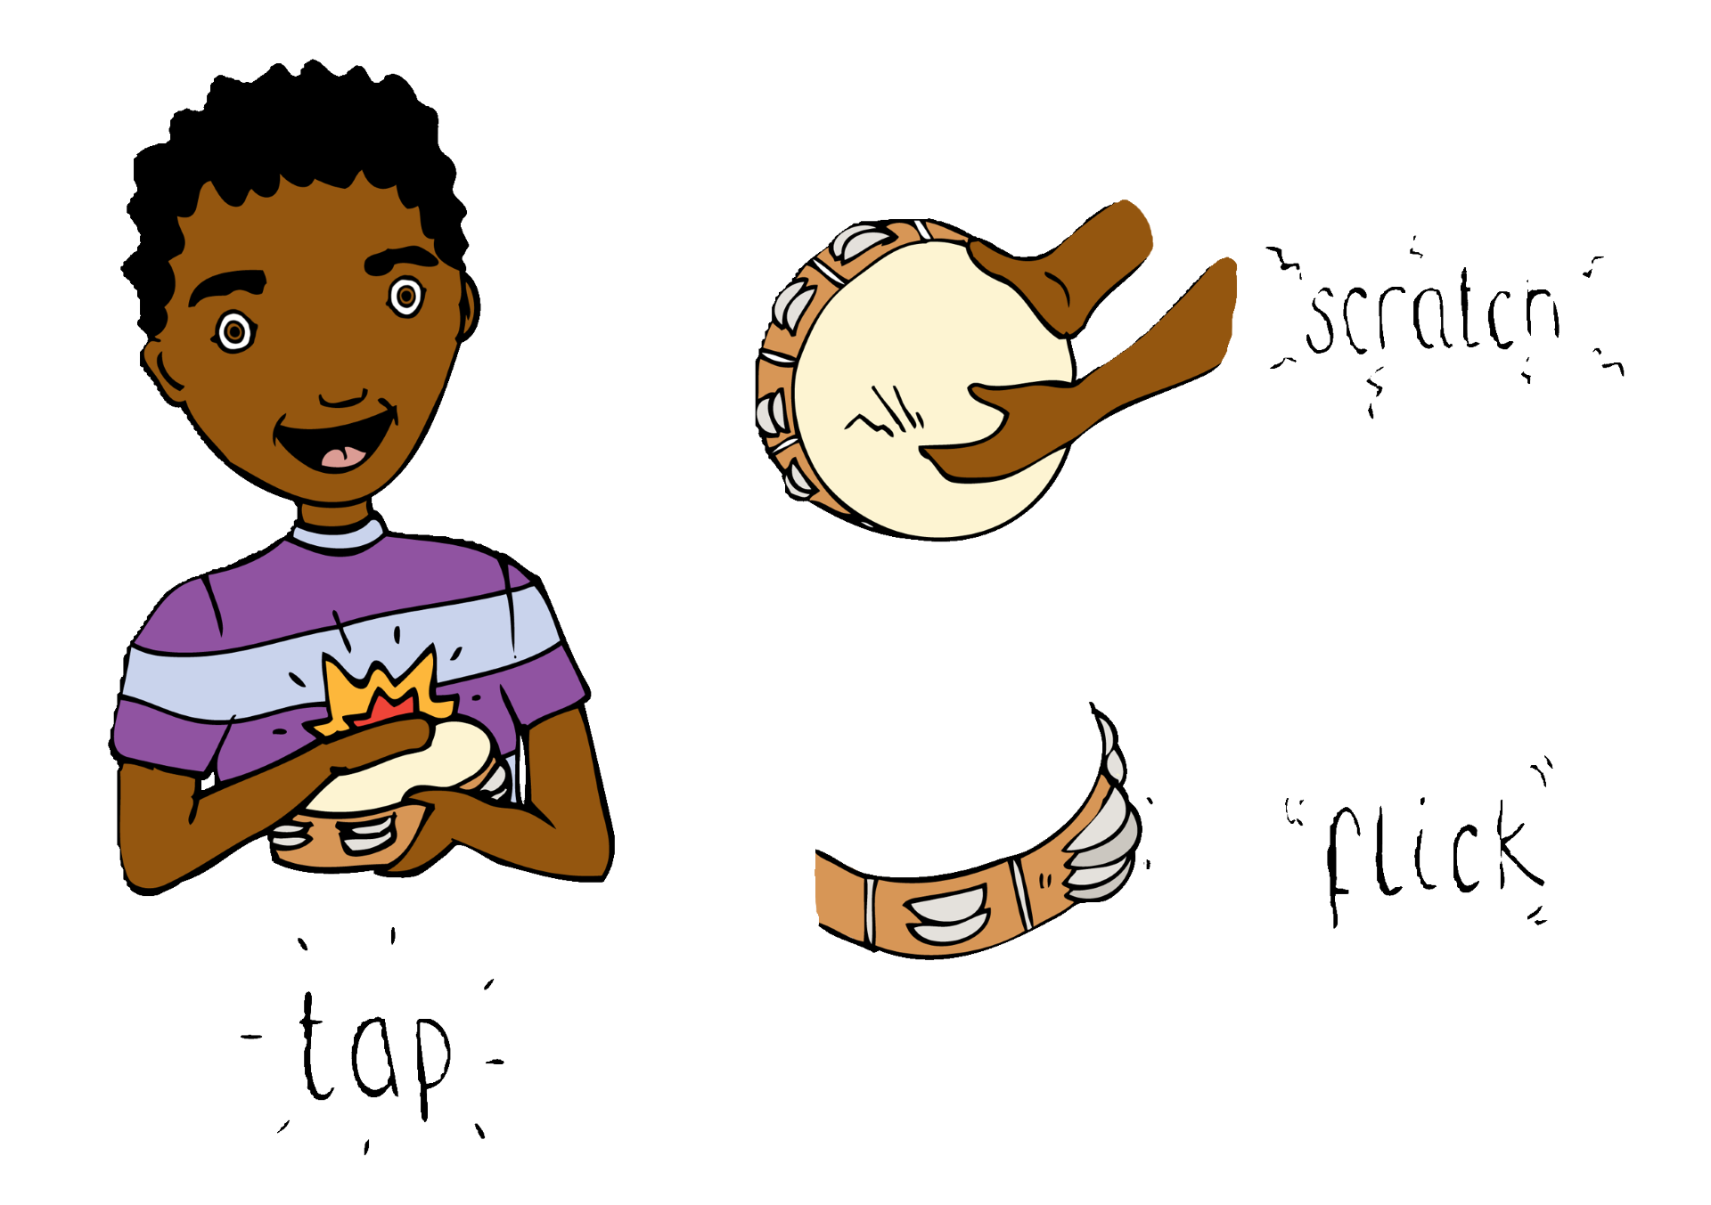

Cantus Arcticus
Einojuhani Rautavaara
Listen out for:
The sounds of birds woven into the texture of the orchestra.
What 3 words?
sombre, mysterious, melancholy.
Fun fact: A concerto for birds and orchestra recorded near the Arctic Circle in Finland.
Link: CANTUS ARCTICUS SD

Slide 6
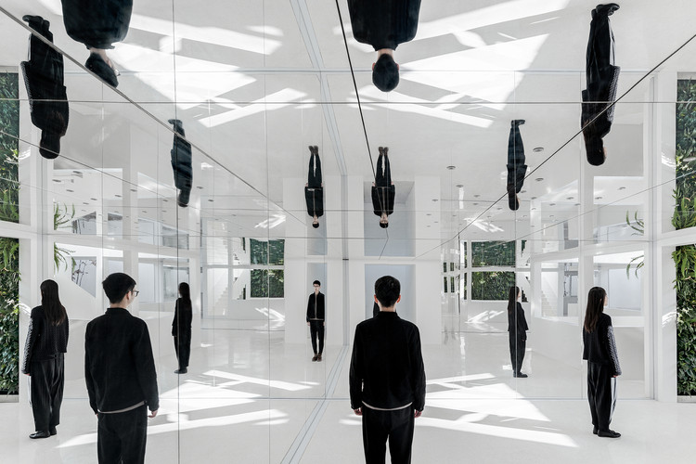
Spiegel im spiegel
Arvo Pärt
Listen out for:
Lots of repetition and gradual changes.
Step by step movement in the violin part.
What 3 words?
reflective, meditative, calm.
Fun fact: The words Spiegel im spiegel mean mirror in mirrors. .
Link: https://www.youtube.com/watch?v=81ZMz3I5CNU

Slide 7

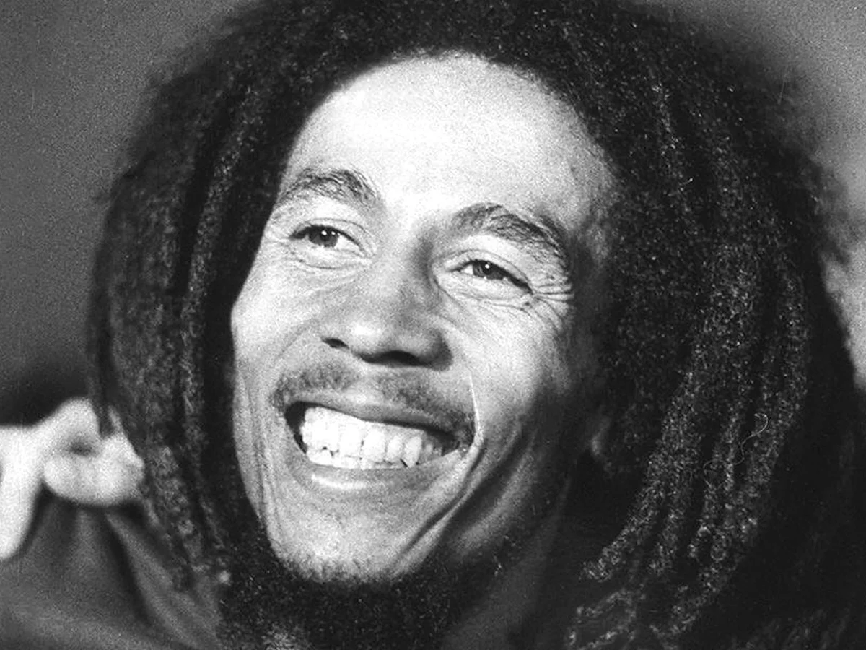
Redemption Song
Bob Marley
Listen out for:
The cellos, violins and piano.
The music of the chorus which you can hear is played more than once.
What 3 words?
hopeful, wistful, lyrical
Fun fact: All the performers in this recording are brothers and sisters. The song has a strong message of freedom..
Link: https://www.youtube.com/watch?v=k_LmRcr8Mm4

Slide 8
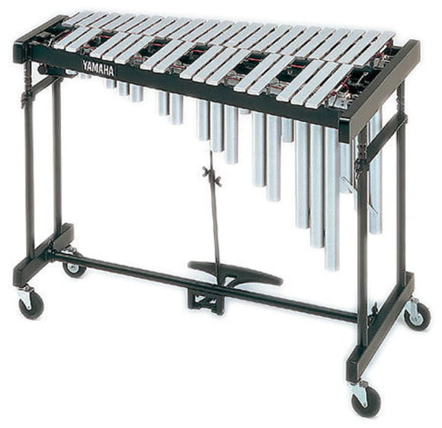
Blues
Ney Rosauro
Listen out for:
The vibraphone which has metal bars, resonating tubes and a sustaining pedal.
The repeated ‘blues’ pattern which gives the piece it’s character.
What 3 words?
relaxed, laid-back, easy going
Fun fact: The performer needs to play with four mallets at once. That is quite tricky.
Link:https://www.youtube.com/watch?v=MsWuoXS5uxQ

Slide 9
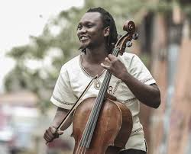
Voices of Bantu
Abel Selaocoe
Listen out for:
The cello and voice intertwining together
Where Abel, the musician improvises which means that the music evolves spontaneously as it is being played.
What 3 words?
warm, energised, creative
Fun fact: The composer, musician Abel Selaocoe combines performance with improvisation, singing and body percussion.
Link: https://www.youtube.com/watch?v=XNqEueXoKLs

