Slide 1
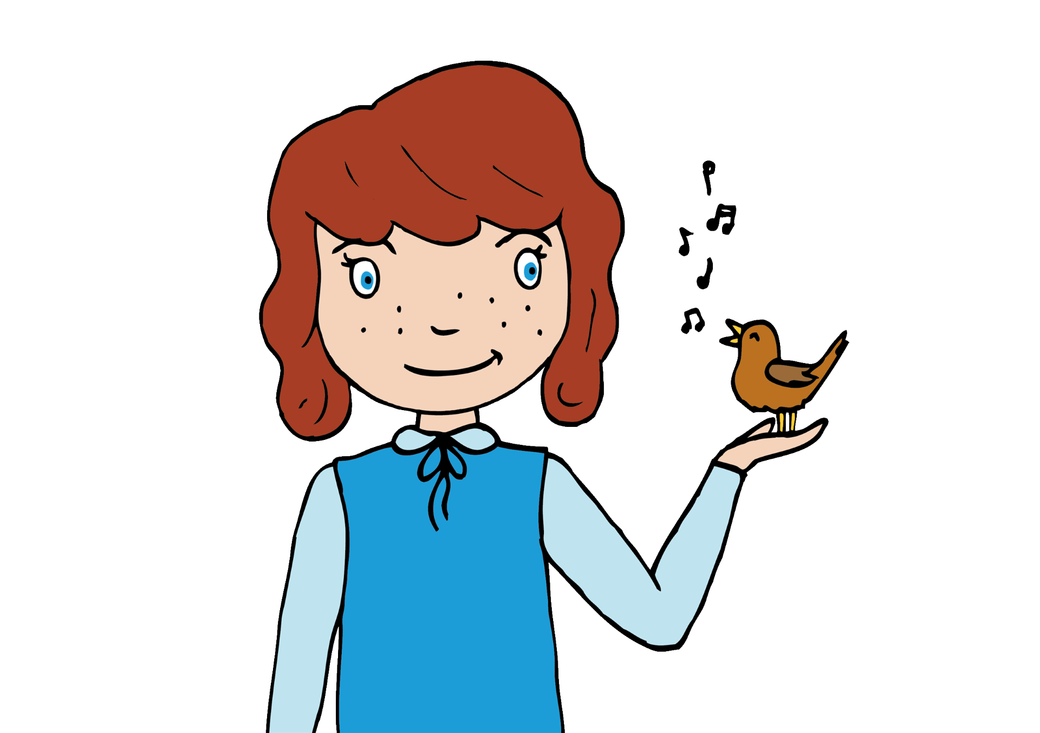
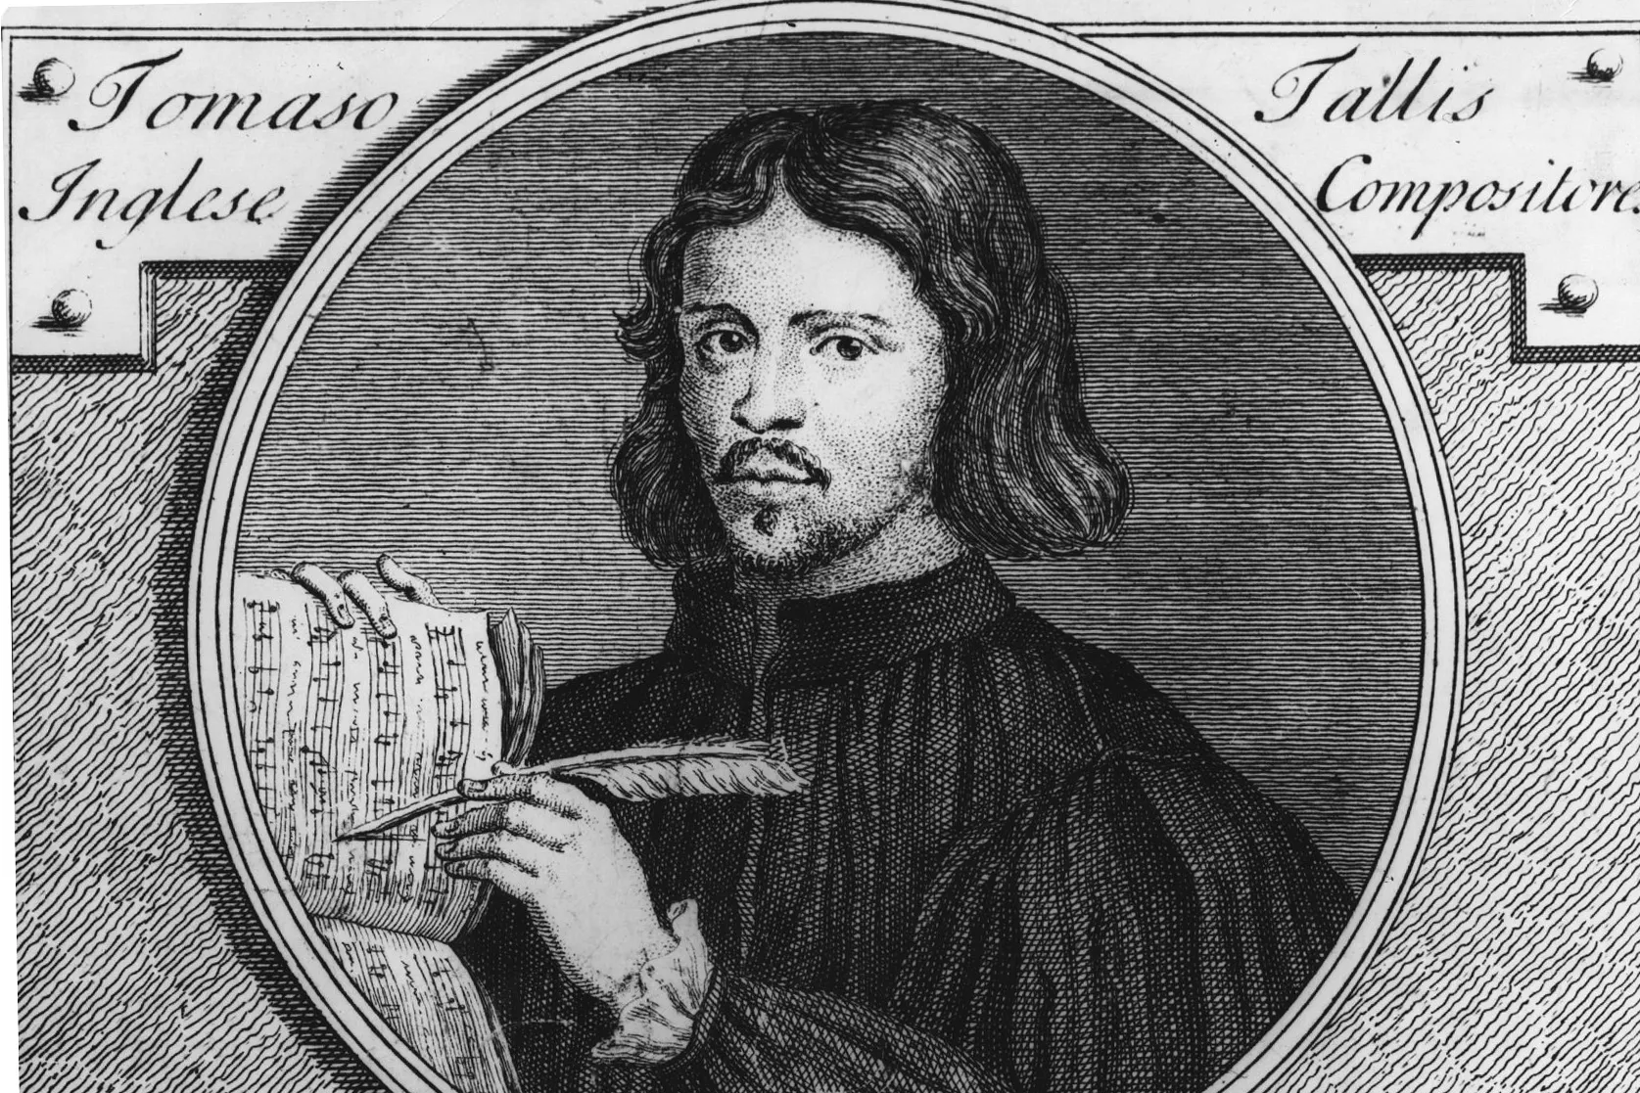
Fantasia on a theme
Ralph Vaughan Williams
Listen out for:
The string section of the orchestra - there is no wind, brass or percussion.
The movement between major and minor (happy and sad)
What 3 words?
beautiful, rich, full
Fun fact: The inspiration for this music was from a really old theme written by English composer Thomas Tallis who was alive at the same time as Henry VIII.
Link:https://www.youtube.com/watch?v=C3nxOF8wnMk

Slide 2
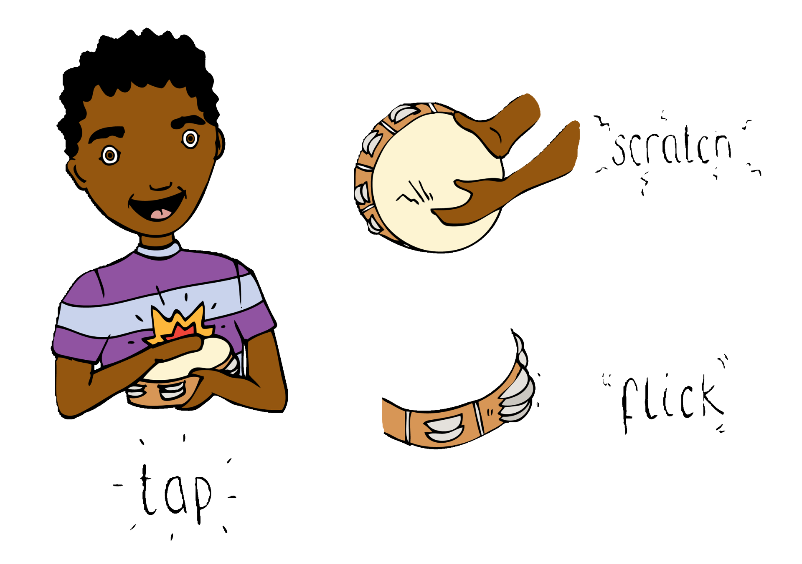
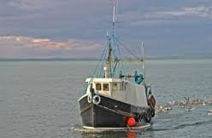
Haven from Seavaigers
Sally Beamish
Listen out for:
The string instruments plucking the strings (pizzicato)
The ever changing beat of the music which makes you feel like you are at sea in a boat.
What 3 words?
improvisatory, folk influence, lively
Fun fact: Seavaigers means seafarers in Scots. Seafarers are people who travel by sea and work on boats.
Link: https://www.bbc.co.uk/teach/ten-pieces/articles/z4bcxg8

Slide 3
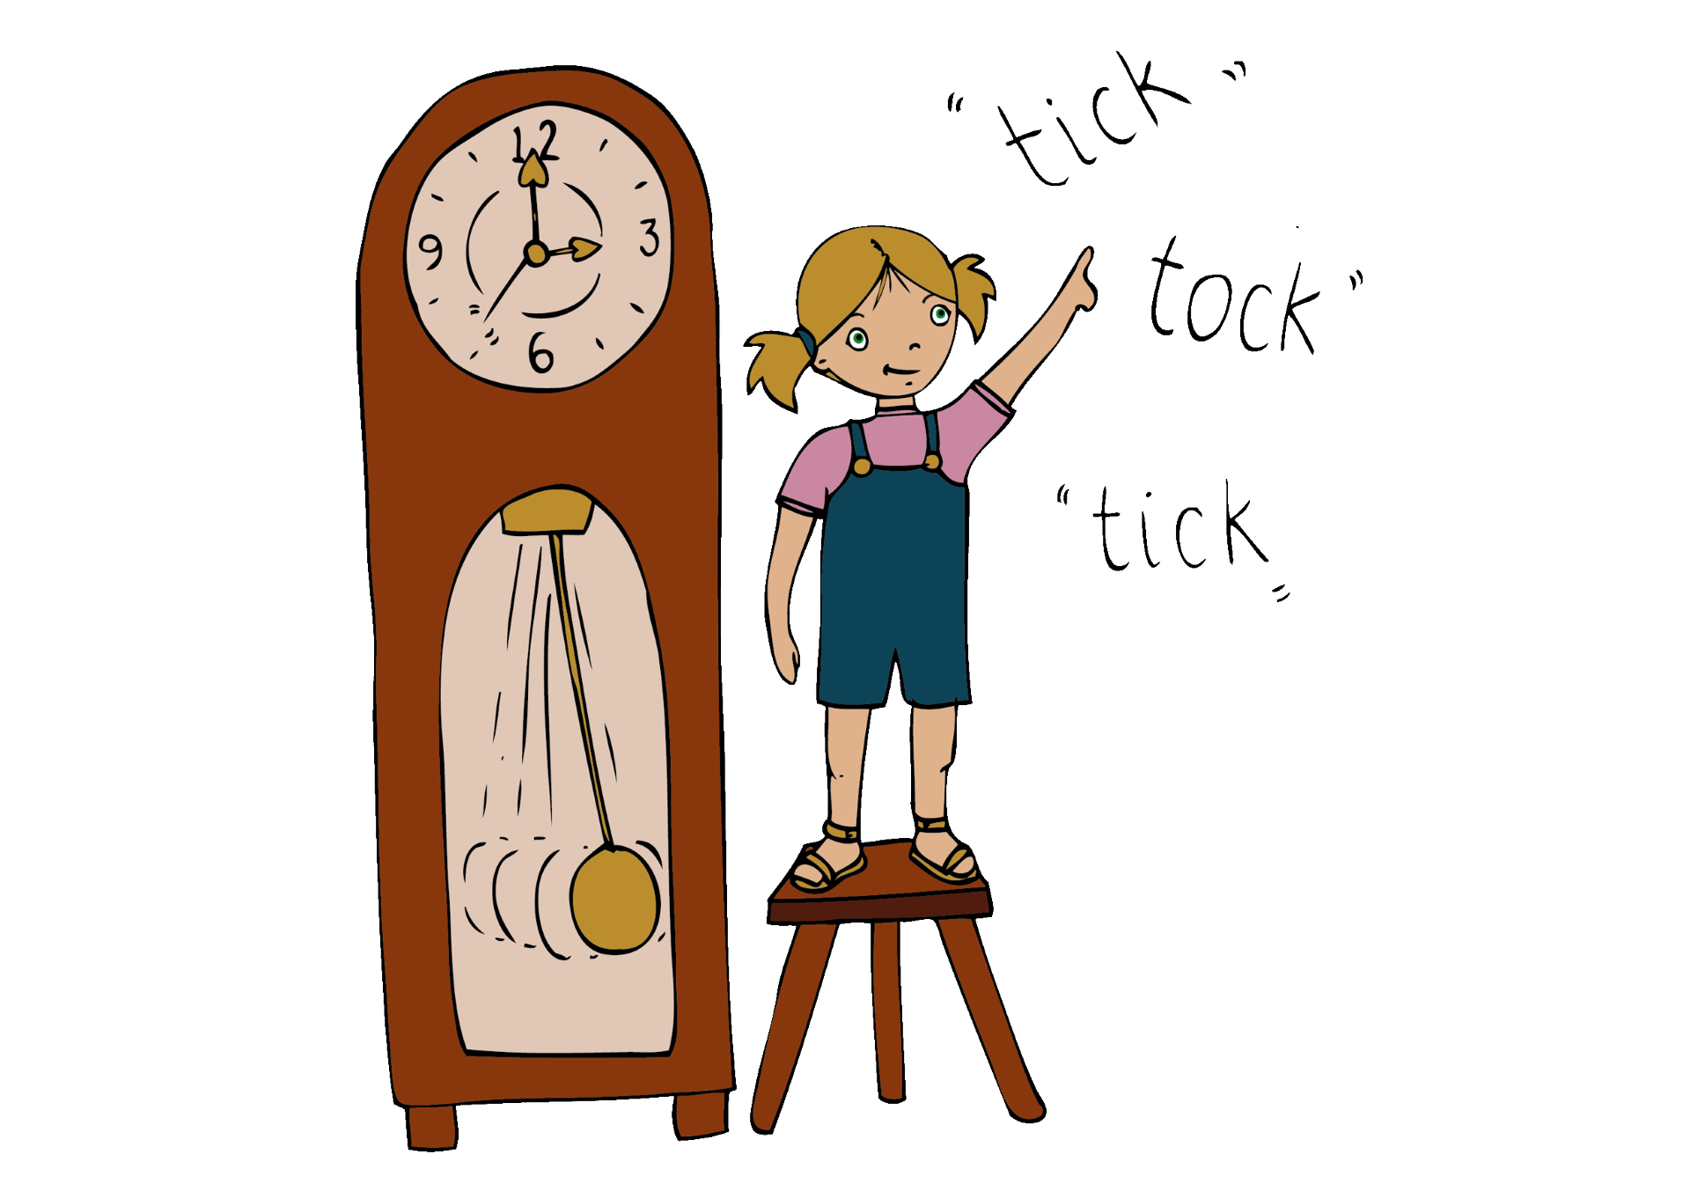
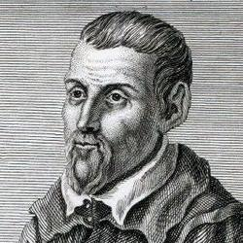
Miserere
Gregorio Allegri
Listen out for:
The voices sing, a capella - without an accompaniment.
The high soaring notes of the soprano - the music moves gracefully and follows the speech rhythms.
What 3 words?
choral, floating, flowing
Fun fact: the words are sung in Latin and mean “Have mercy upon me, O God, after Thy great goodness.”
Link: Allegri: Miserere | Peter Phillips & Tallis Scholars

Slide 4
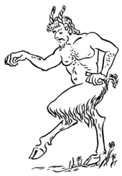
Prélude à l'après midi d’un faune
Claude Debussy
Listen out for:
The flute solo at the beginning which moves up and down in chromatic steps making it sound mysterious.
How the music sounds like a ‘wash’ of many colours.
What 3 words?
mysterious, magical, atmospheric
Fun fact: A faun is a mythological creature -half goat, half man. Debussy was an impressionistic composer and focussed on the atmosphere and mood of his music.
Link:https://play.lso.co.uk/performances/Debussy-Prelude

Slide 5

Cello suite No. 1 G major
J S Bach
Listen out for:
The cello, and how the melody rises and falls.
The musical line flows over a strong pulse.
What 3 words?
floating, flowing, melodious.
Fun fact: the performer here is Yo-Yo Ma and he plays the cello. He first heard this piece of music when he was 4 years old.
Link: Yo-Yo Ma - Bach: Cello Suite No. 1 in G Major, Prélude (Official Video)

Slide 6
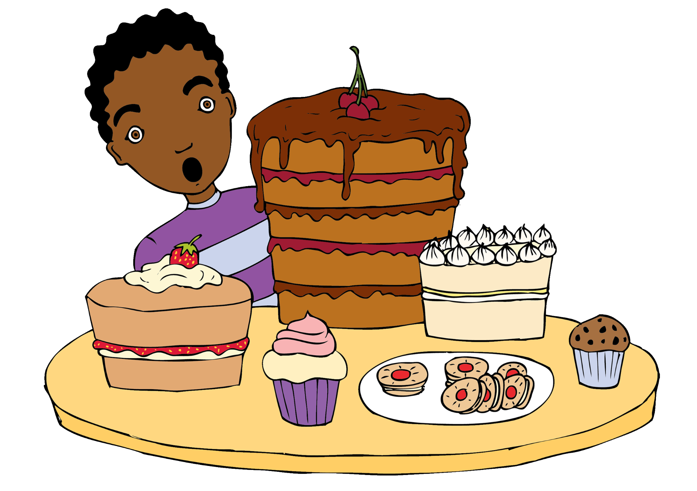

If: from The Diary of Anne Frank
Michael Nyman
Listen out for:
The saxophone, it has a song like theme.
The slow graceful music of the orchestra.
The minor or ‘sad’ tonality.
What 3 words?
haunting, melancholy, moving
Fun fact: This is film music. The composer masterfully adds layers of sadness and emotion to the score.
Link: Jess Gillam, BBC Concert Orchestra, Jessica Cottis - Nyman: The Diary of Anne Frank - Arr. Harle: If

