Slide 1
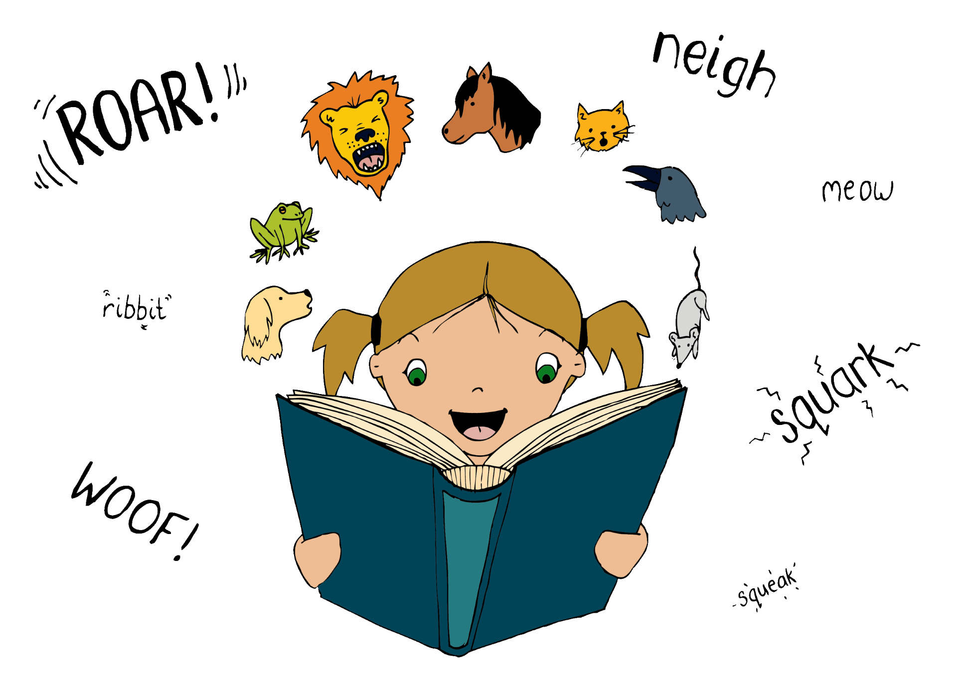
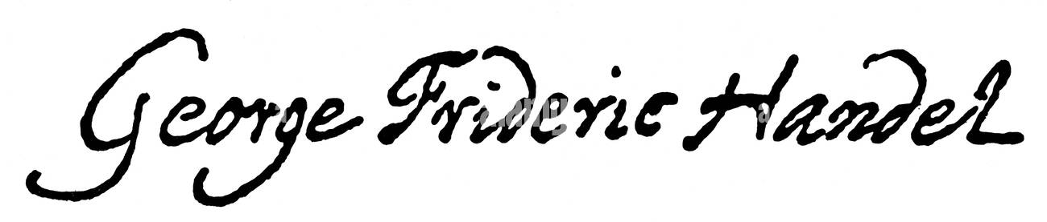
Hallelujah Chorus from The Messiah
George F Handel
Listen out for:
“Hallelujah” which means “praise God”
How the voices move together making it easier for the audience to hear the words.
What 3 words?
celebratory, happy, loud
Fun fact: The Hallelujah chorus has been performed in the Albert Hall on Good Friday almost every year since 1876!
Link: Handel Messiah, Academy of Ancient Music AAM & Choir of The Queen's College, Oxford - YouTube 1.41.50

Slide 2
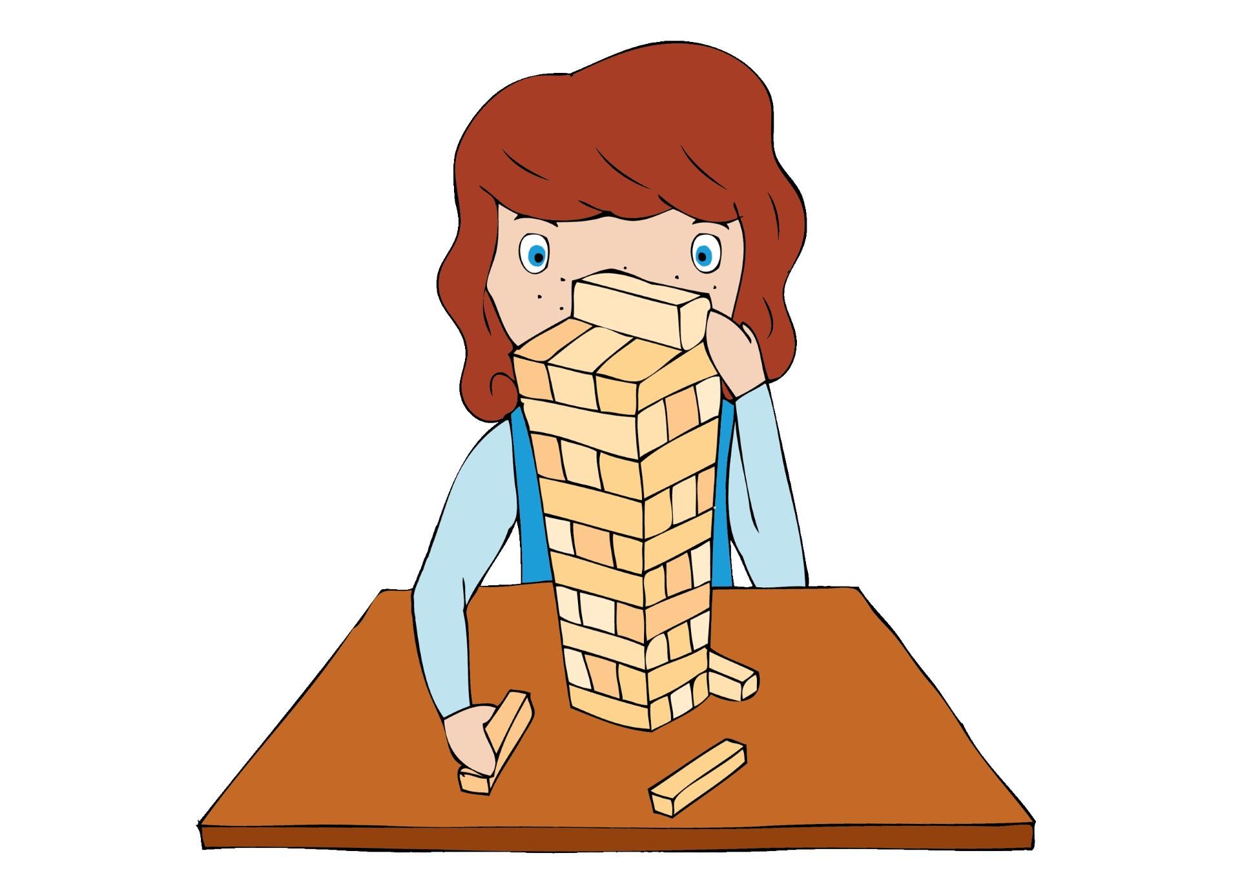
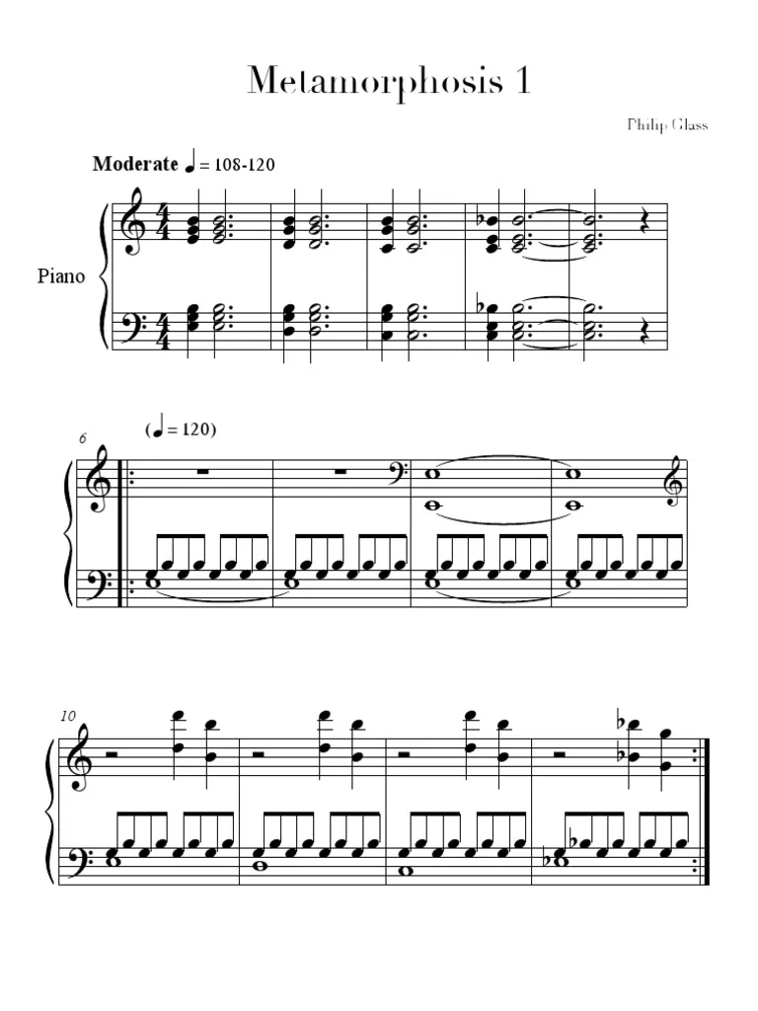
Metamorphosis
Philip Glass
Listen out for:
Small repeated cells of music that are played again and again.
The piano
What 3 words?
repetitive, mesmeric, minimalist
Fun fact: Minimalism in music uses simple, repetitive musical patterns and a focus on process, often featuring slow, gradual changes and a steady pulse.
Link: https://www.youtube.com/watch?v=aX96z7AuICs

Slide 3
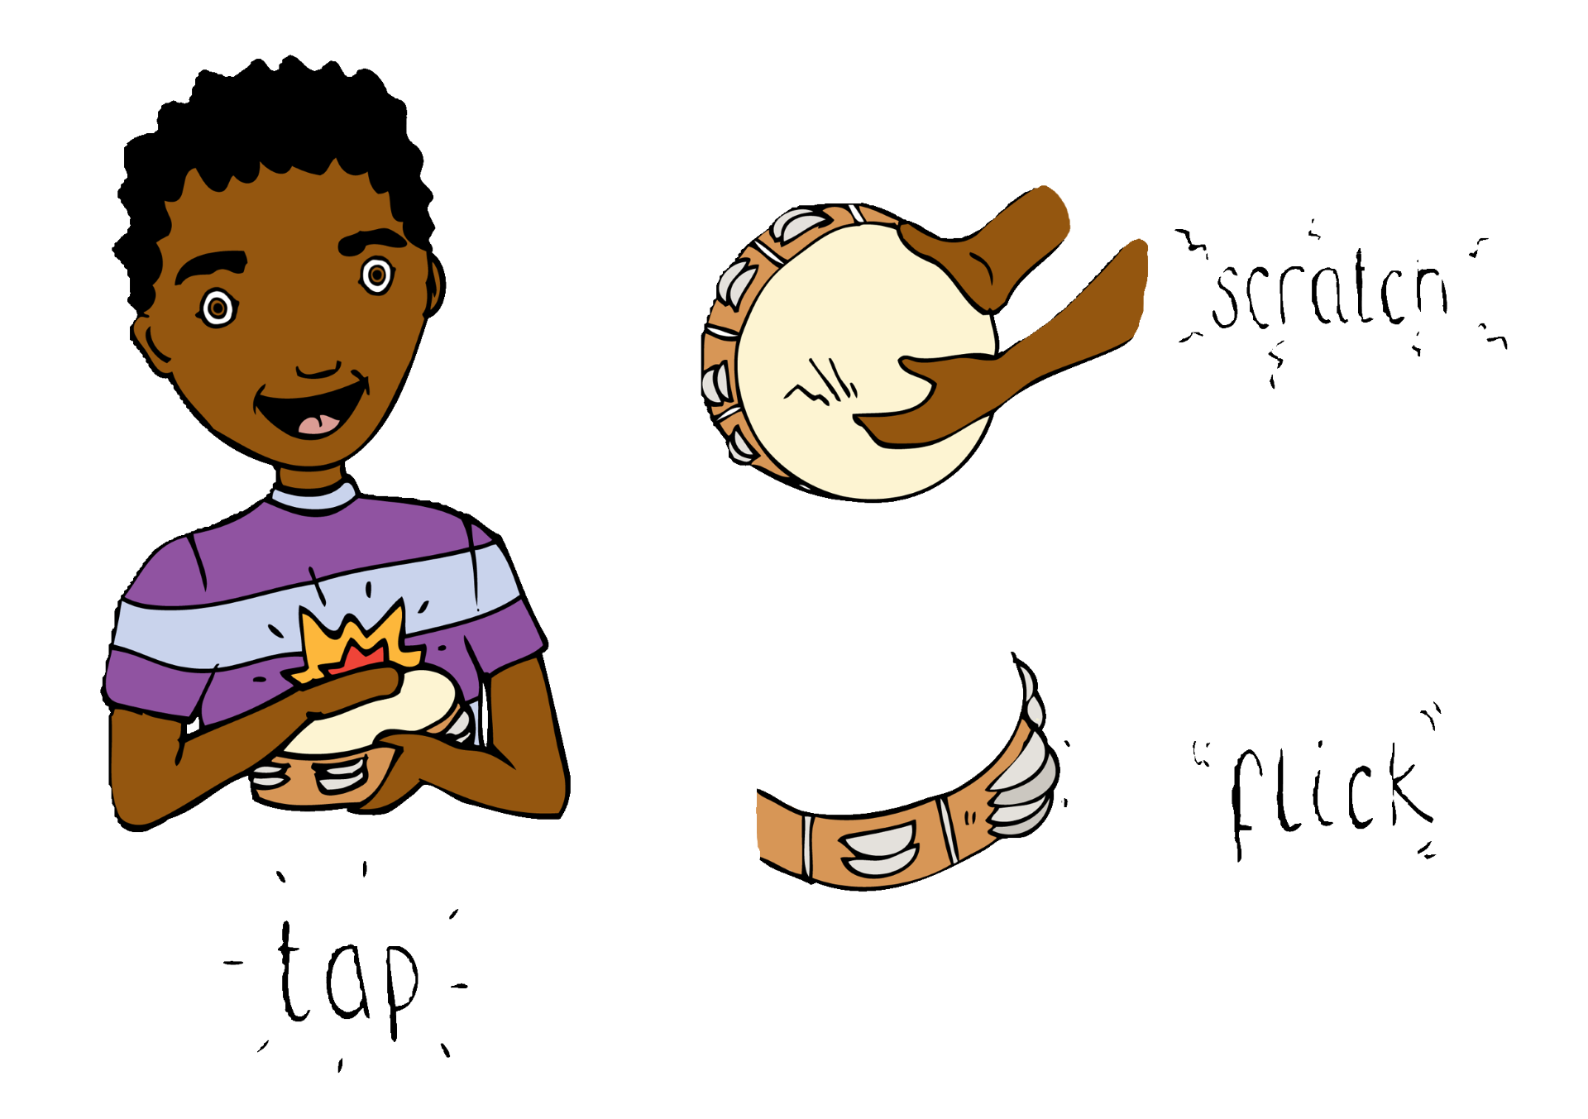
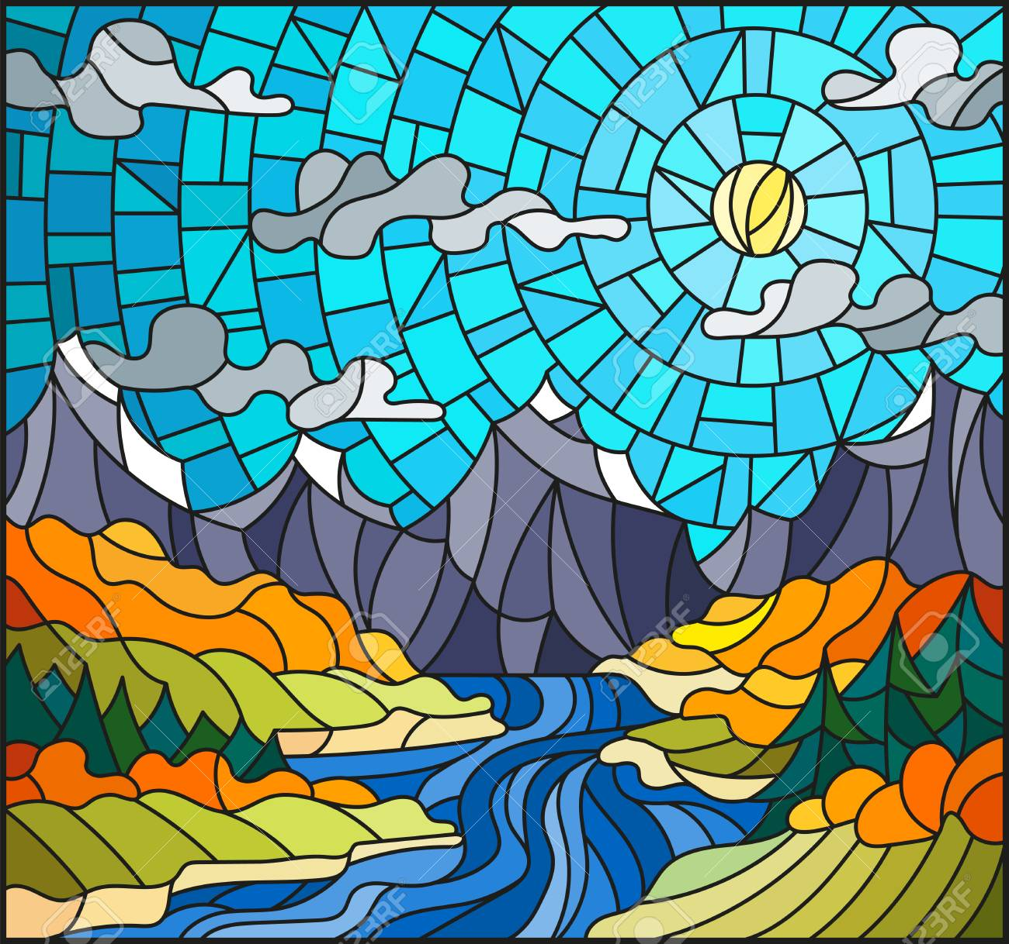
Deep River
Gospel arr. Matthew Lynch
Listen out for:
Voices moving together at the beginning , making the words come across really clearly.
What 3 words?
powerful, rich sound, devotional
Fun fact: Gospel is sacred music, originally sung by African-Americans, based on spirituals and hymns.
Link: https://www.youtube.com/watch?v=e9ggOxkg-uc

Slide 4
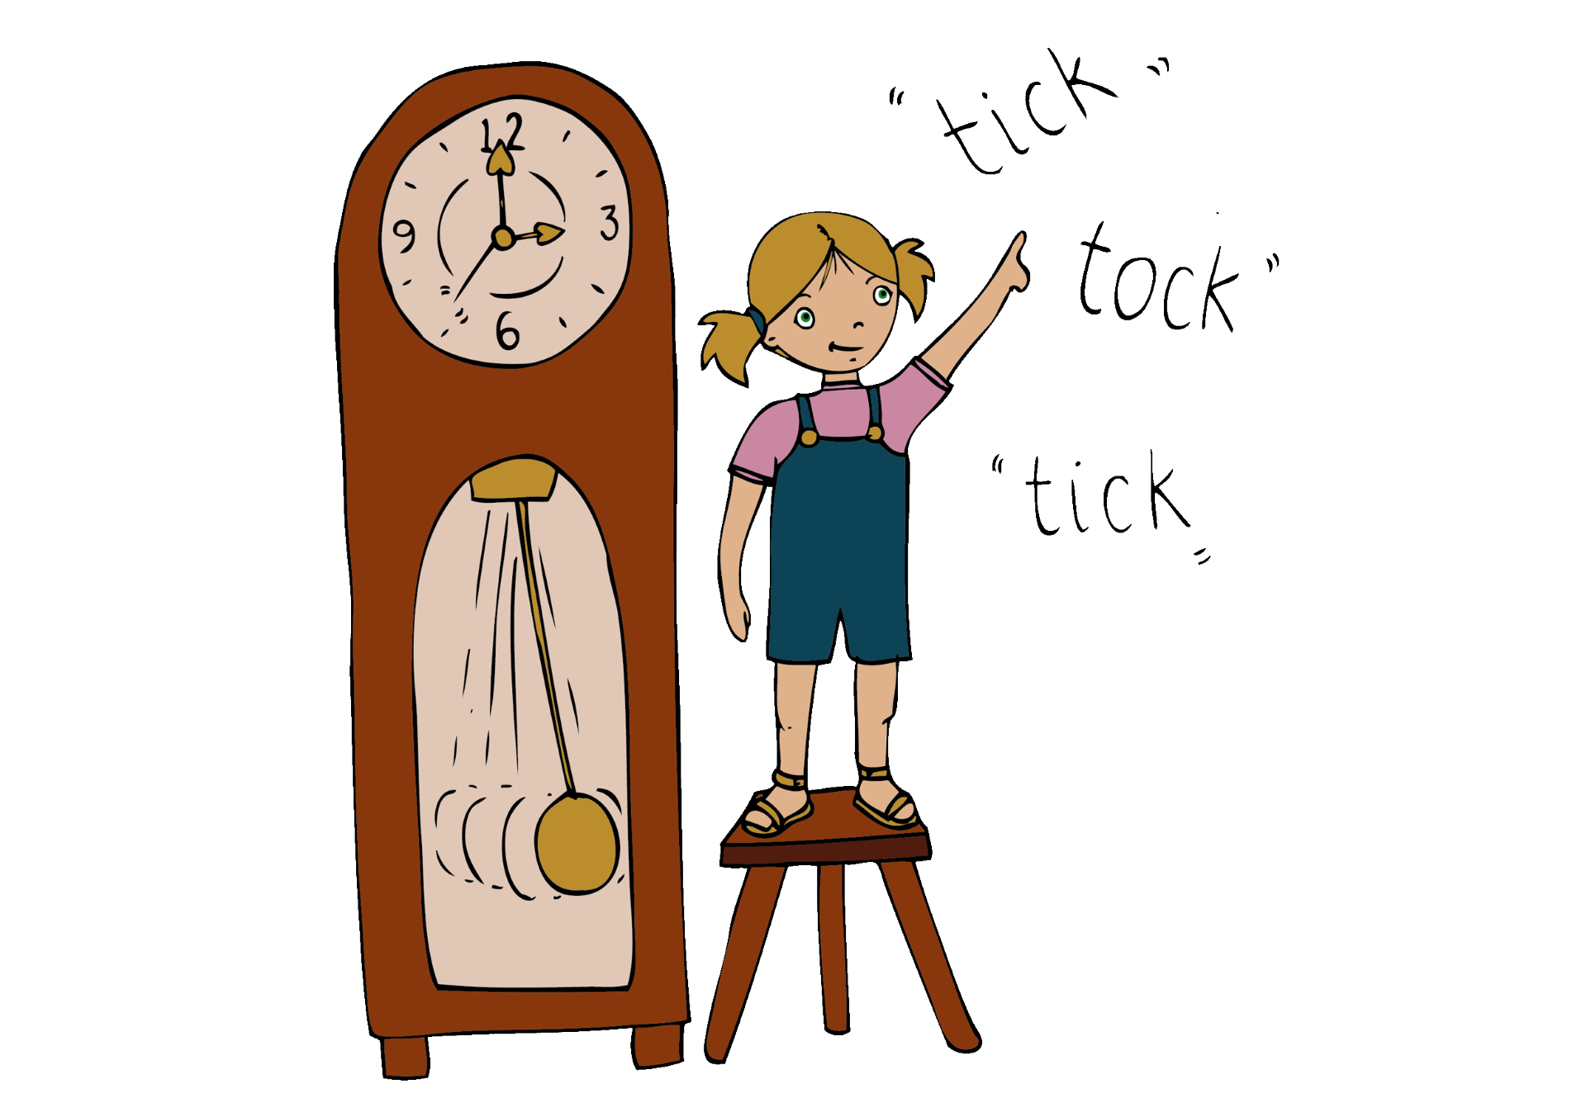
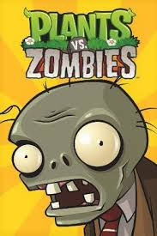
Grasswalk from Plants vs. Zombies
Laura Shigihara
Listen out for:
The really steady ‘walking’ pulse that pervades the music
Try drawing a square with one finger on your hand - the music stays at a constant speed all the time.
What 3 words?
non-stop, simple, lumbering
Fun fact: Grasswalk is one of the pieces of music that form the soundtrack to a game called Plants vs. Zombies.
Link: https://www.bbc.co.uk/teach/ten-pieces/articles/ztsb7v4

Slide 5
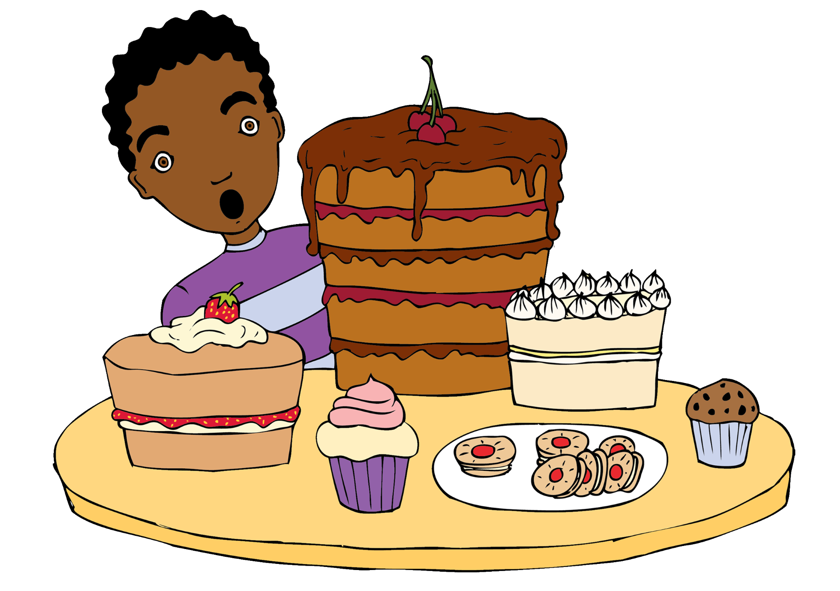

Raise a Voice
Toby Young
Listen out for:
The chorus returns again and again - it starts ‘raise a voice’
The layers of voices which build into a ‘wall’ of sound.
The syncopated rhythms.
What 3 words?
determined, bouncy, memorable
Fun fact: This song was written to challenge us to think about climate culture.
Link: https://www.youtube.com/watch?v=4nrCCTr4jhI

