Slide 1
Year 1 Phonics Screening Check

Slide 2
Welcome: The aim of todays meeting
For you to leave today’s meeting knowing what the Phonics Screening Check is and when it will take place.
Who does the check apply to?
What will it consist of?
How you can support and help prepare your child for the check at home?

Slide 3
What is the Phonics screening check?
The Phonics Screening Check is a statutory check of your child’s phonics knowledge. It helps the DfE to confirm whether children have made the expected progress. It takes place in June. All children in Year 1 have to sit the check as well as pupils in Year 2 who did not achieve the past mark in the previous year.

Slide 4
Your child will be assessed on their reading of 40 words, 20 of which are real and 20 of which are nonsense ‘pseudo’ or ‘alien’ words. Pseudo words are important to include because these words are new to all children. Children cannot read the pseudo words by using their memory or vocabulary; they have to use their phonic decoding skills. This is a good way to assess their ability to decode words without the support of any memory of words that they may have come across in reading.
Your child will be told before the check that there will be alien words that they will not have seen before. All children are familiar with this because we already use alien words when we teach our daily phonics. These will be presented with an alien next to them in the check.

Slide 5

What does the check look like?

Slide 6
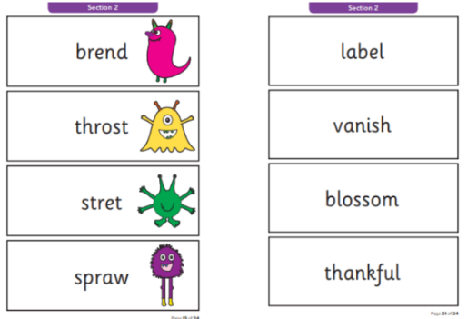
What does the check look like?
As you can see the words get longer and more complex further along in the check, which is where misconceptions quite often happen.

Slide 7
Each page of the test has 4 words. Your child is expected to segment and blend each word on the page before moving on to the next page (we have to take their first answer).
Your child will go through the words at a pace that is right for them. Your child will be offered a break if we feel that their focus has drifted. Once they have completed the test they go back to class. The test should last no more than between 5 and 20 minutes dependant on your child’s reading pace.

Slide 8
Why are children tested at this stage?
The purpose of the phonics screening test is to confirm that all children have learned phonic decoding to the right age-appropriate standard. It keeps parents informed about their child’s progress in developing word-reading skills and ensure that any potential gaps in learning can be addressed.

Slide 9
Phonics websites
www.bbc.co.uk/schools/wordsandpictures/phonics/
mix of very good interactive games and worksheets covering most phonic phases. Recommend Sandcastle quiz for phase 3 and 5.
www.bbc.co.uk/schools/ks1bitesize/literacy/
a very good selection of interactive games focussing on phonics and sentence construction. Each is split into medium/hard/really hard and are short and fun.
www.ictgames.com/literacy.html
a great selection of games that link well with games in Letters and Sounds.
www.phonicsplay.co.uk
a selection of interactive games for all phonic phases. Mostly simple games.

