Slide 1
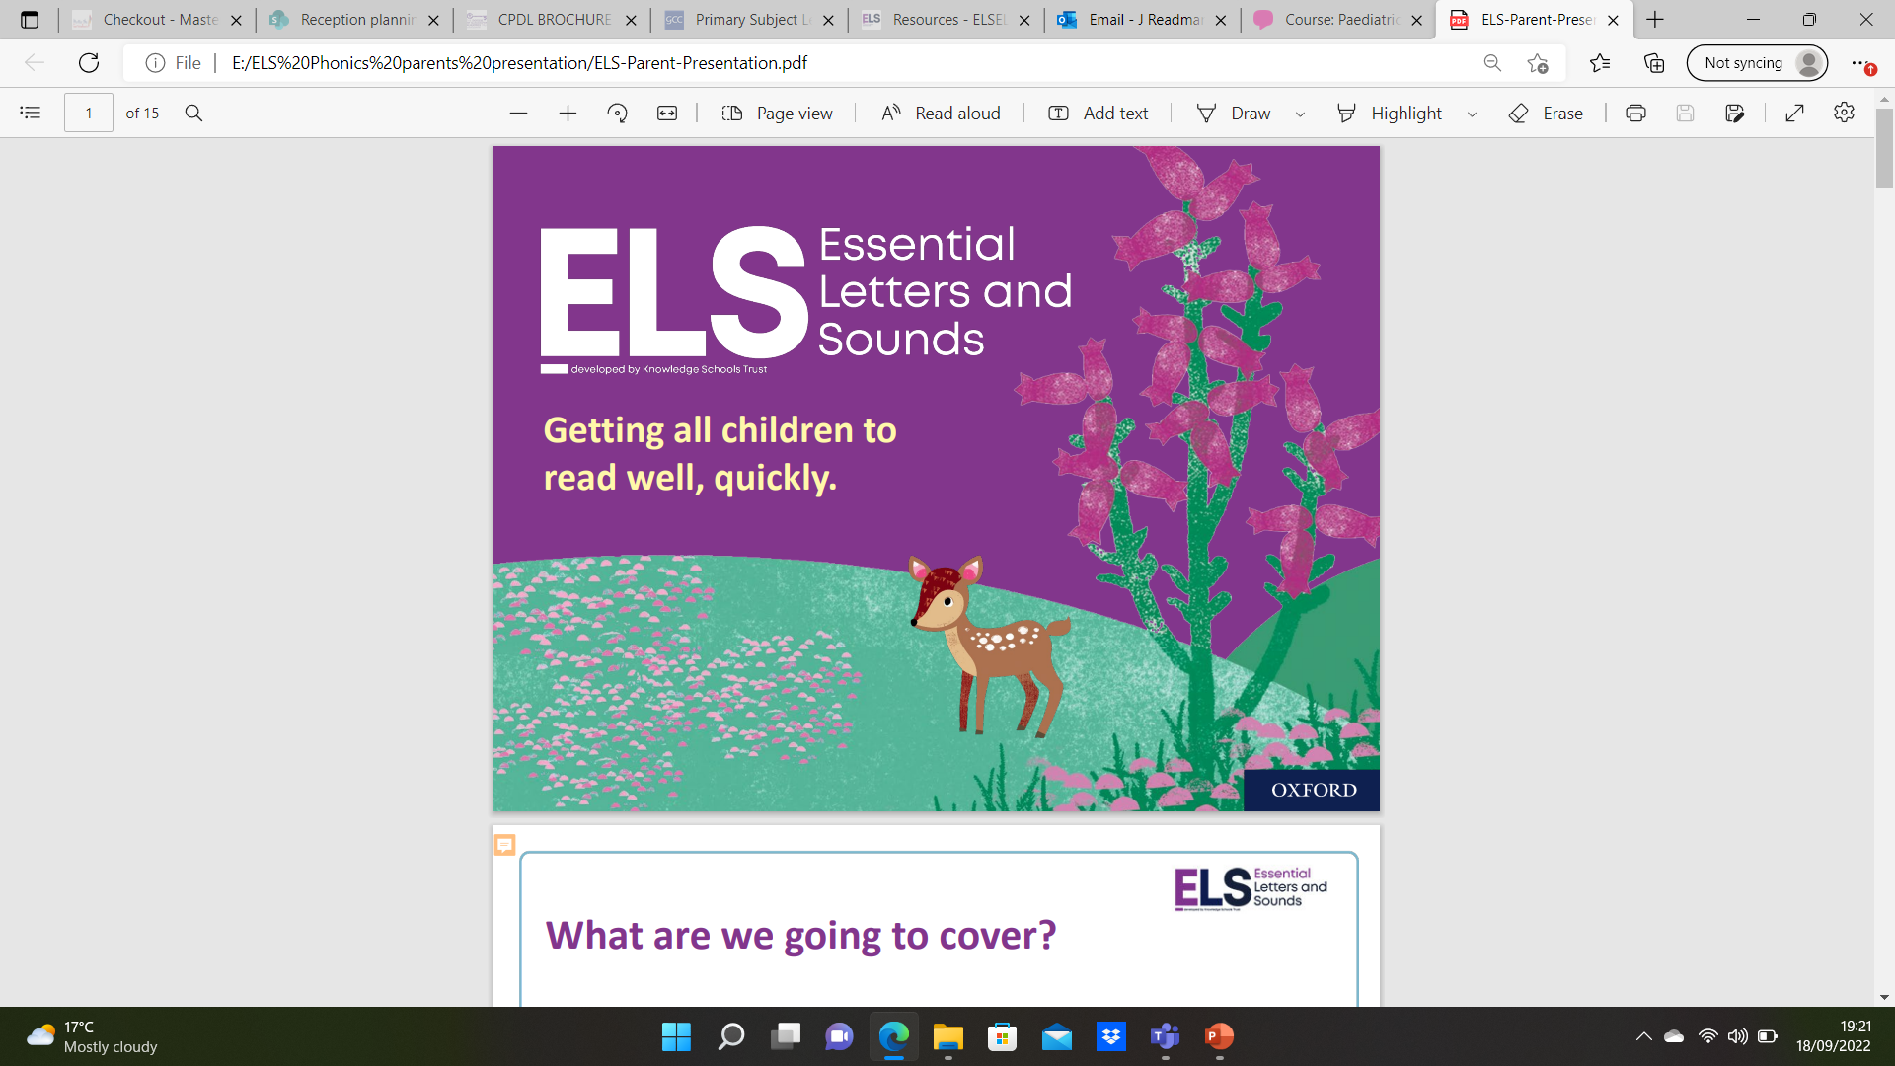

Slide 2
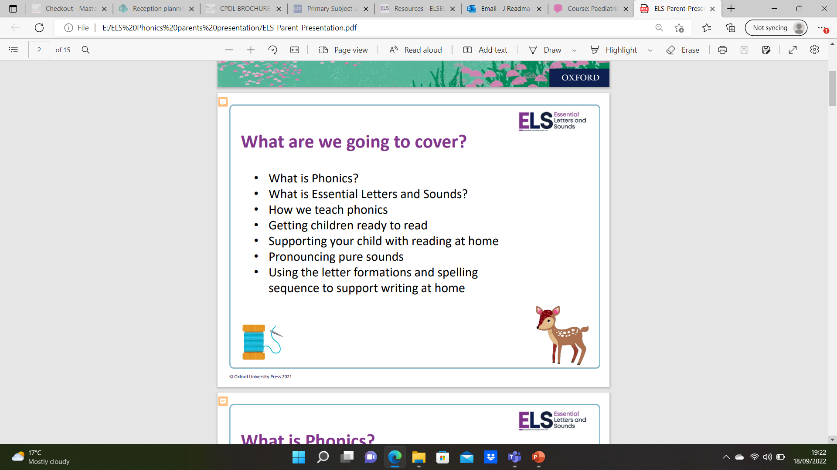

Slide 3
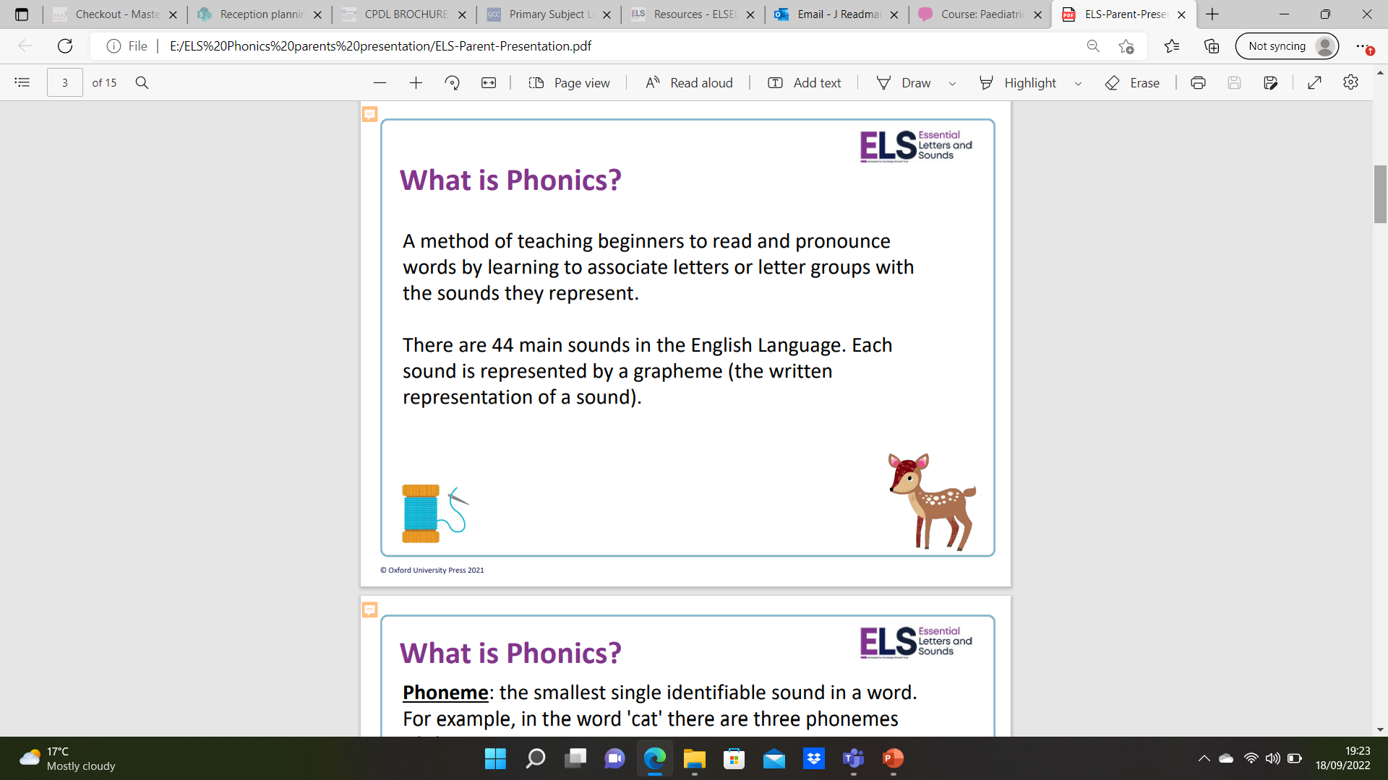
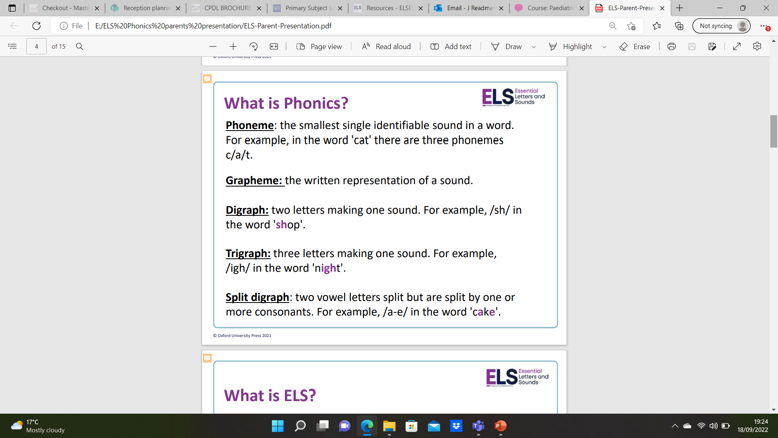

Slide 4
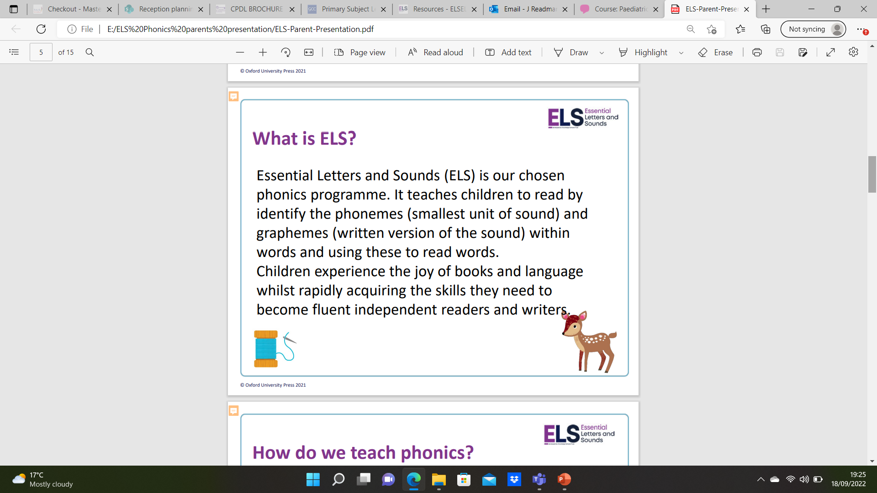

Slide 5
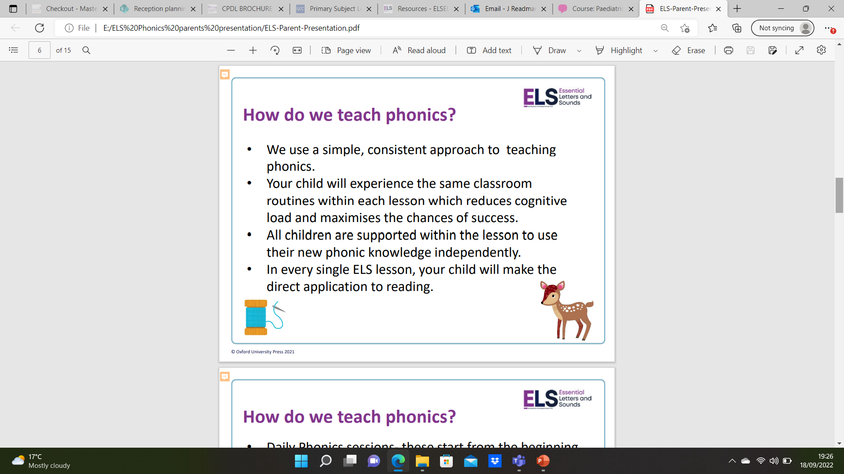
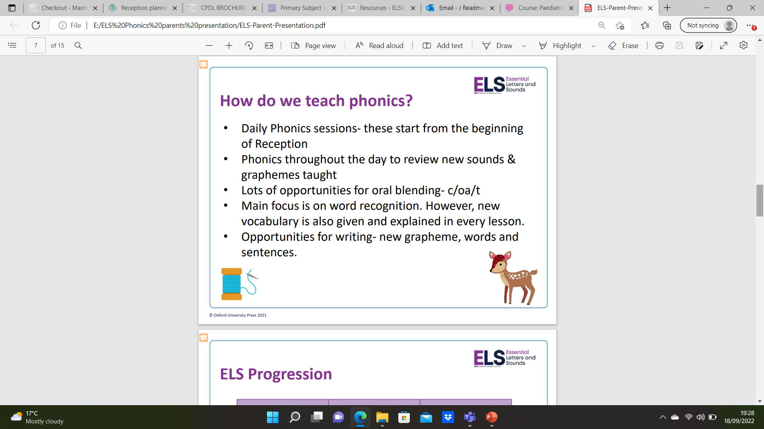

Slide 6
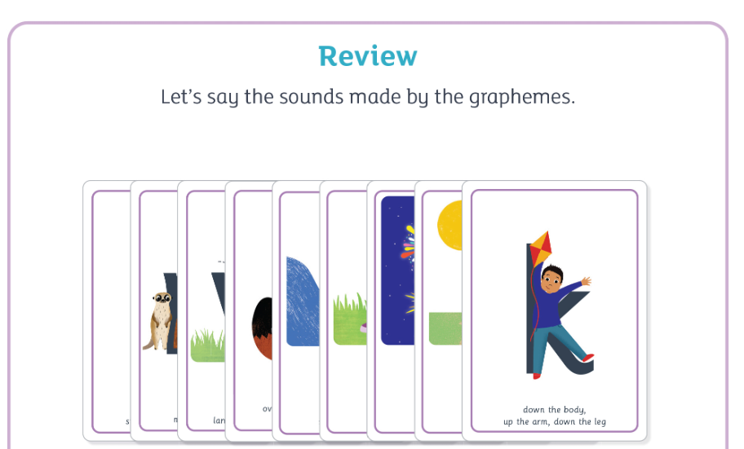
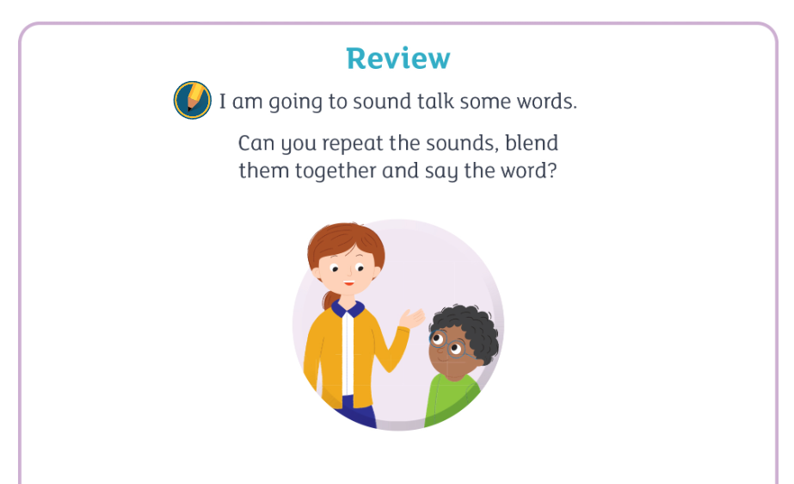
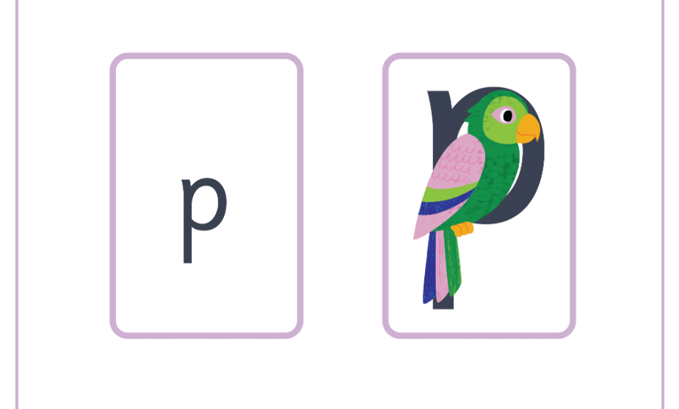
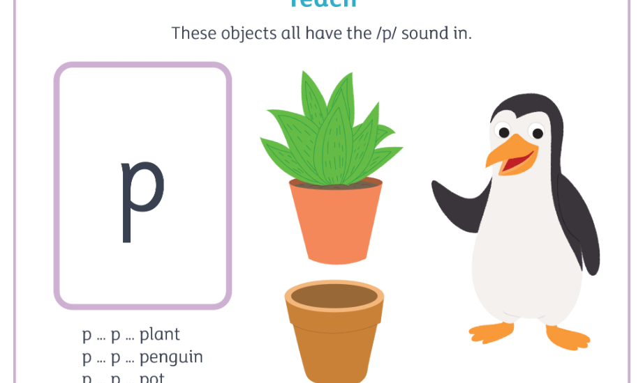
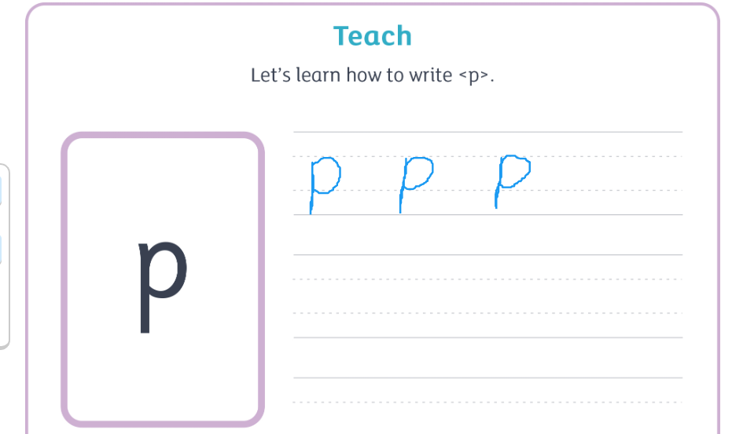
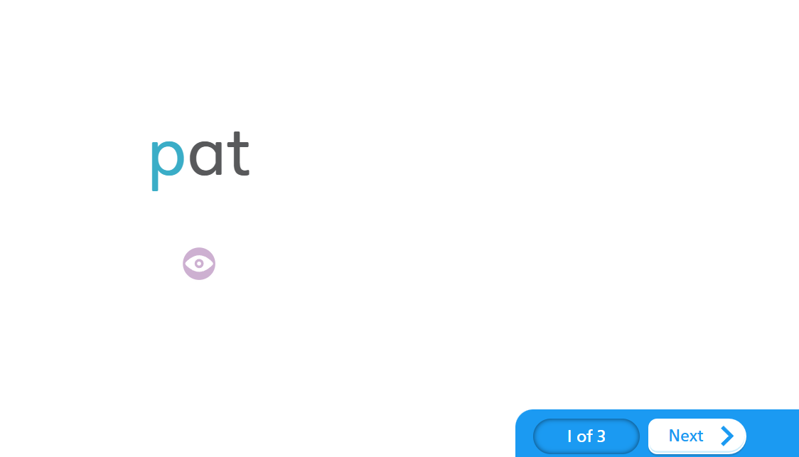
Overview of a lesson before we move to the writing element in the activity book

Slide 7
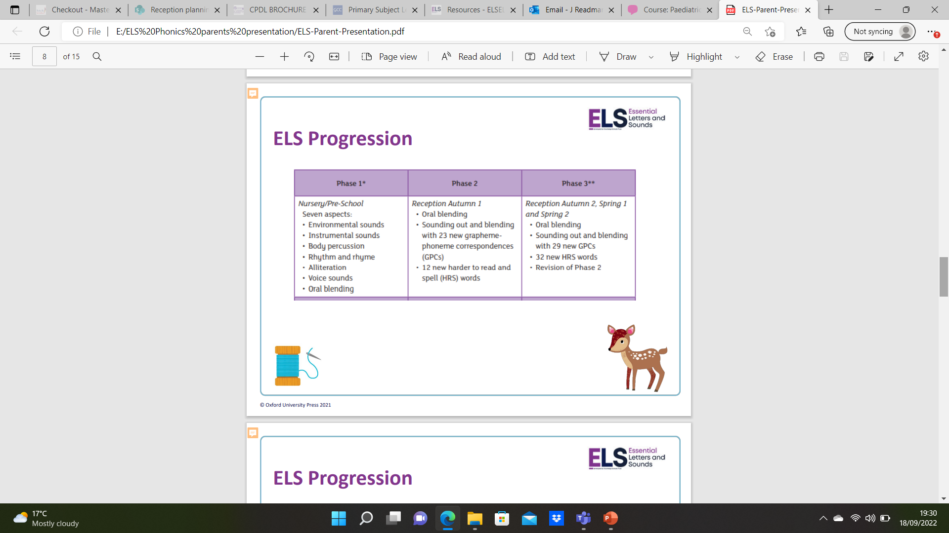
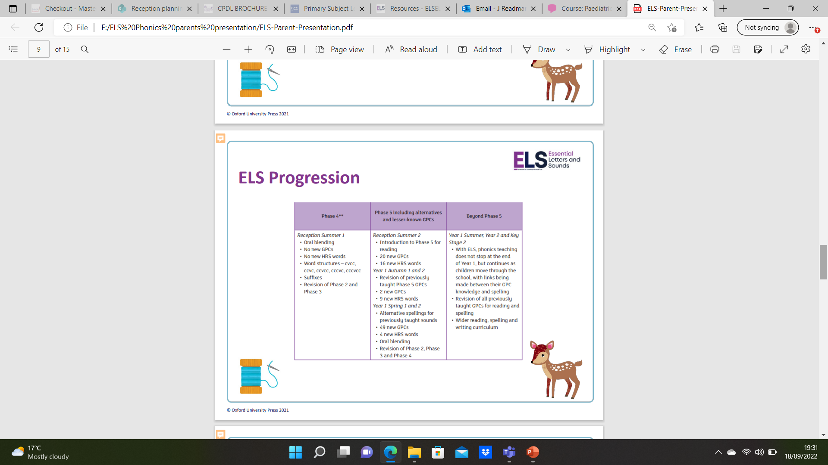

Slide 8
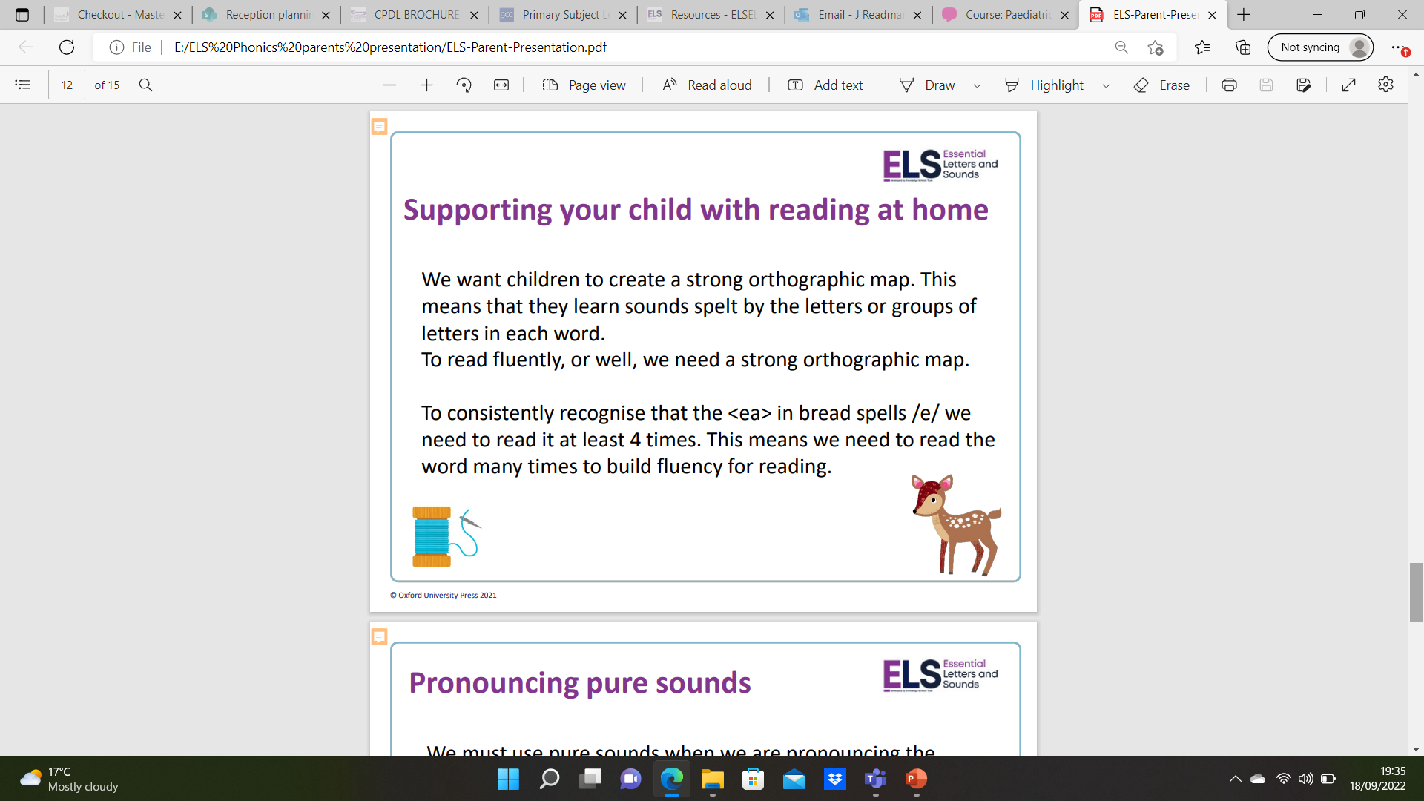

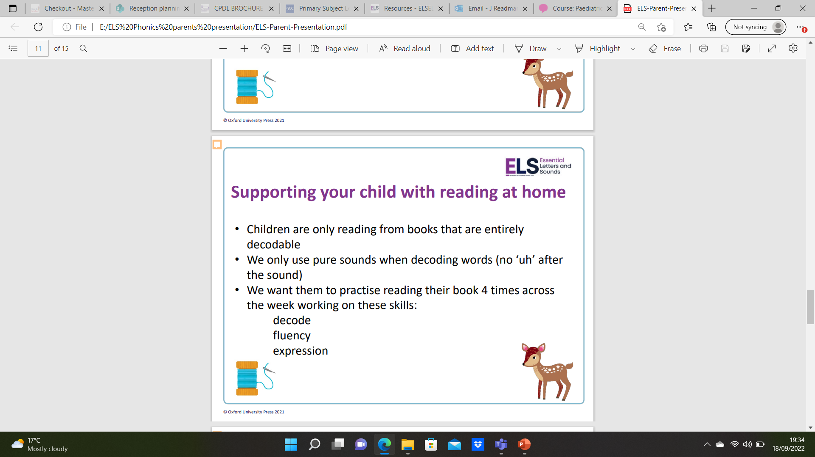
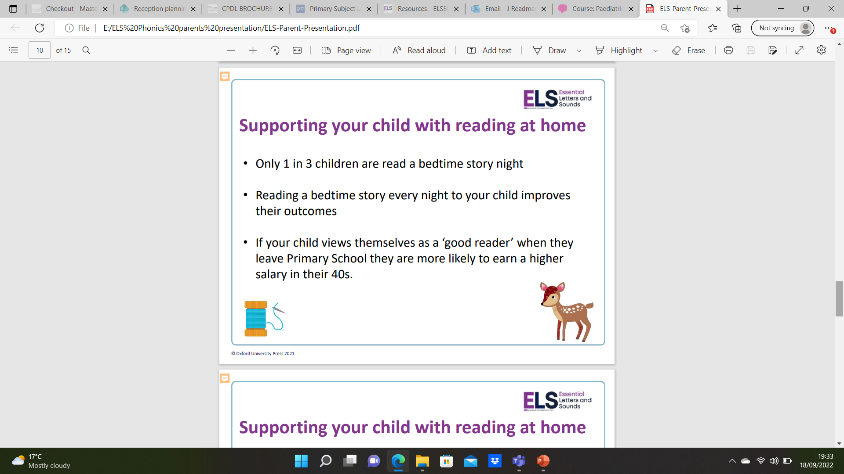

Slide 9
Reading at home reminder………
Aim for your child to read to you at least 4 times a week, this develops their fluency and comprehension.
Reading books will be changed once a week on a Friday (although sometimes this will be a Thursday).
Your child should be able to read the book that comes home with them fairly easily. They should be able to decode and read most of the words.
Ask them questions. They should be able to talk about what they have read to you. If the book is too hard they won’t be able to do this.
A sharing book and library book will also come home – Library days vary in each class, sharing books are chosen by your child and come home on a Friday with the new reading book.
You can also share and read books you have at home. Please also write these in your child’s reading record
You can also practice the sounds learnt and the HRSW. These are put in bookbags and updated weekly so please make sure they are always in school.
Ideas of questions to ask:
Can you explain what just happened?
Can you predict what might happen next?
Can you say why (ask them to refer to the text for their answers)?
Can you say when something similar has happened to you?
Comprehension is essential in order to fully understand the text. This is why reading
a text several times is essential for your child’s development.

Slide 10
Phonics websites
www.ictgames.com/literacy.html
a great selection of games that link well with games in Letters and Sounds.
www.phonicsplay.co.uk
a selection of interactive games for all phonic phases. Mostly simple games.
Alphablocks on Cbeebies also has a great selection of games and episodes to watch

